Slide 1
TERRE HAUTE CONVENTION CENTER
CONSTRUCTION UPDATE
JULY 2020

Slide 2
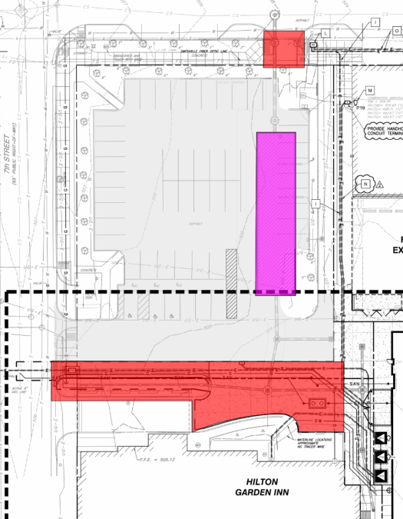
RECENT PROGRESS – NW Lot at 7th and Cherry
Restoration of NW lot began
Concrete poured:
Streets, curbs, sidewalks along
Cherry Street, 7th Street, and HGI
HGI Porte Cochere
HGI Dumpster Pad

Slide 3
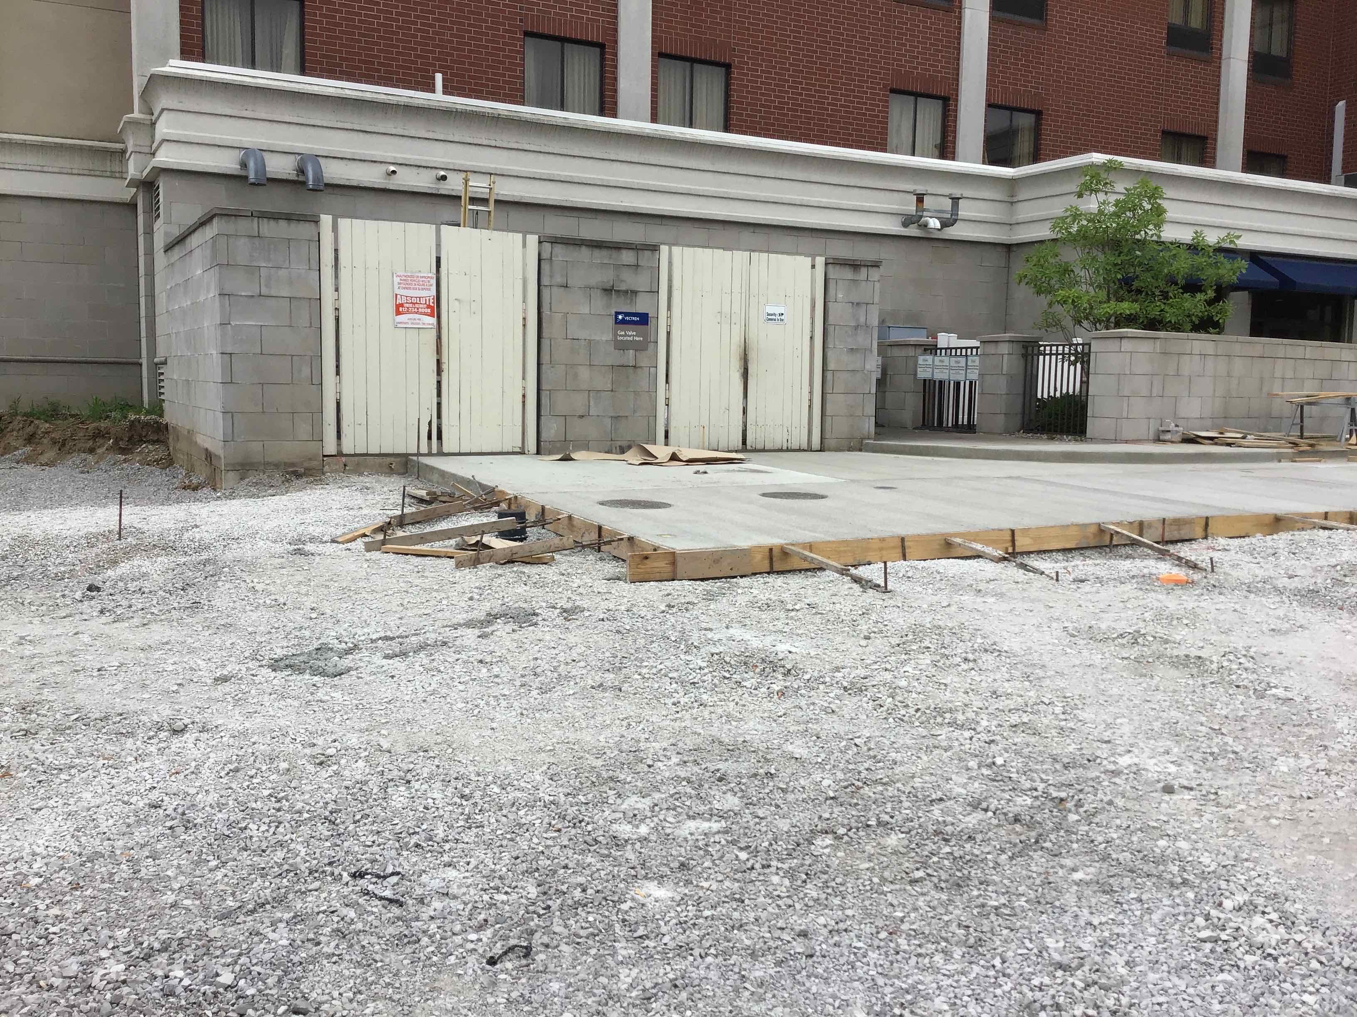
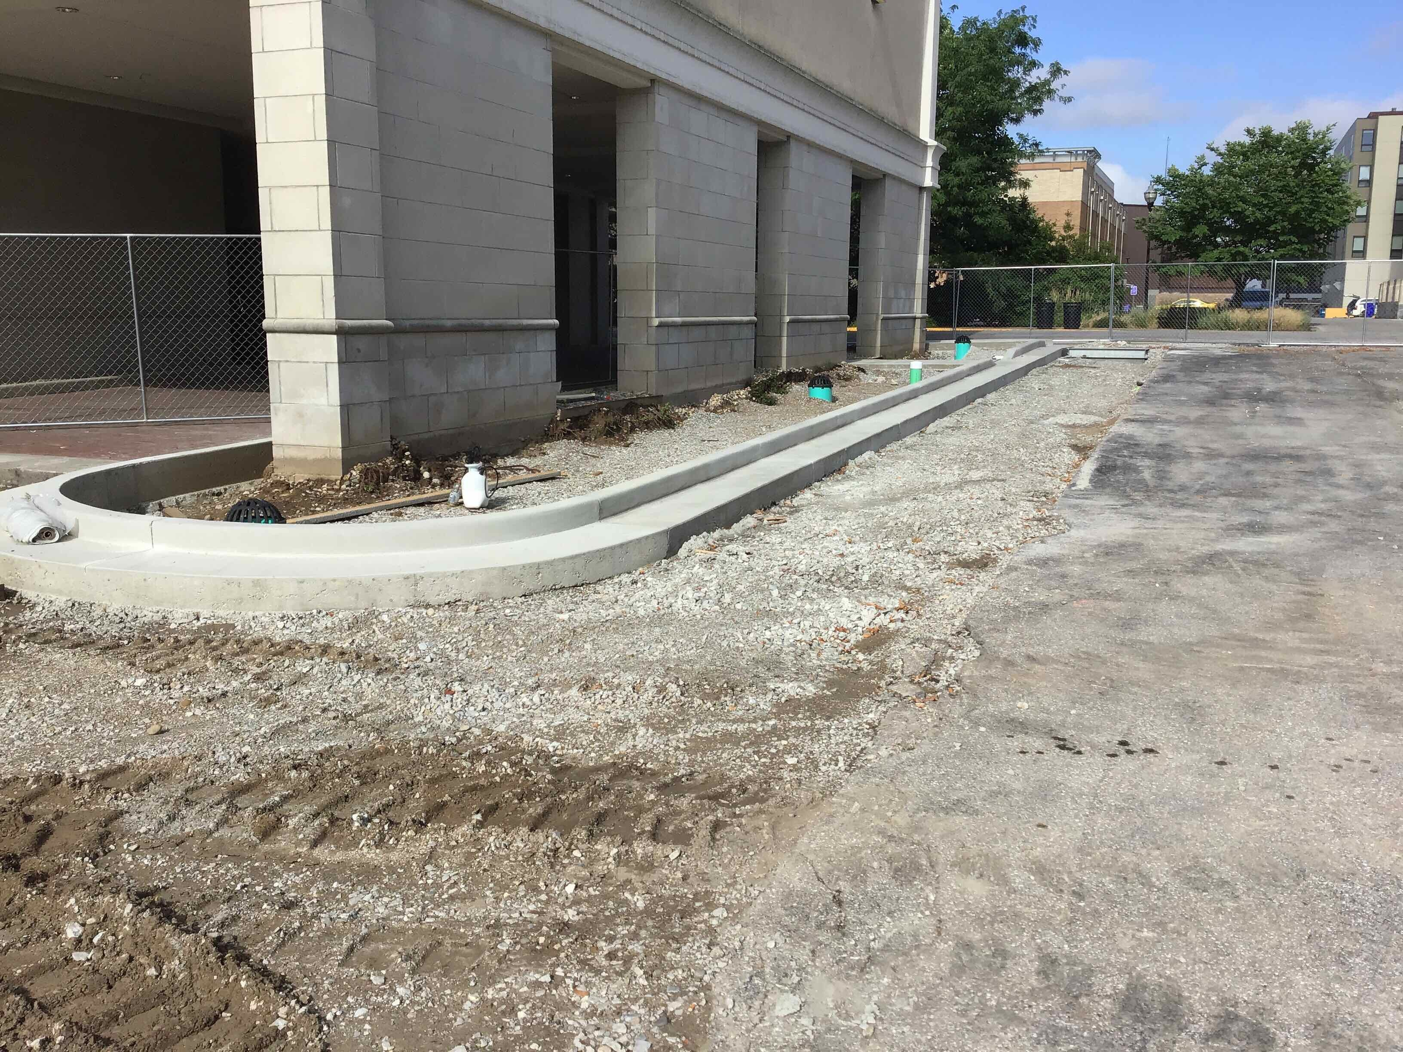
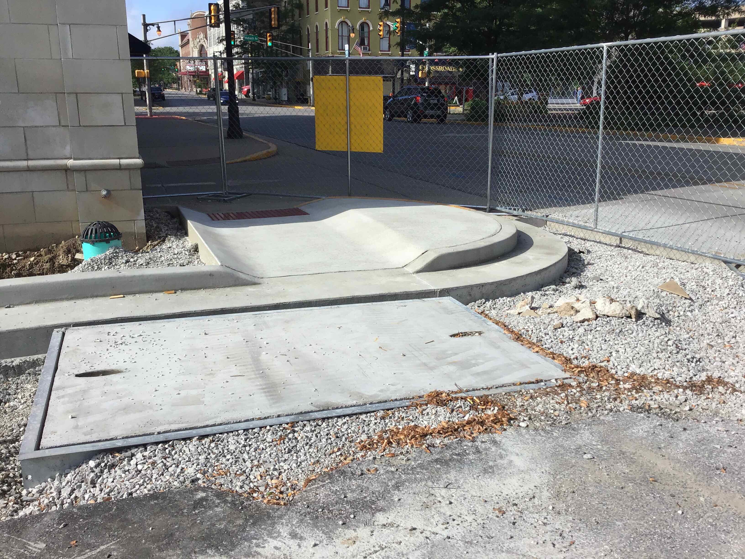
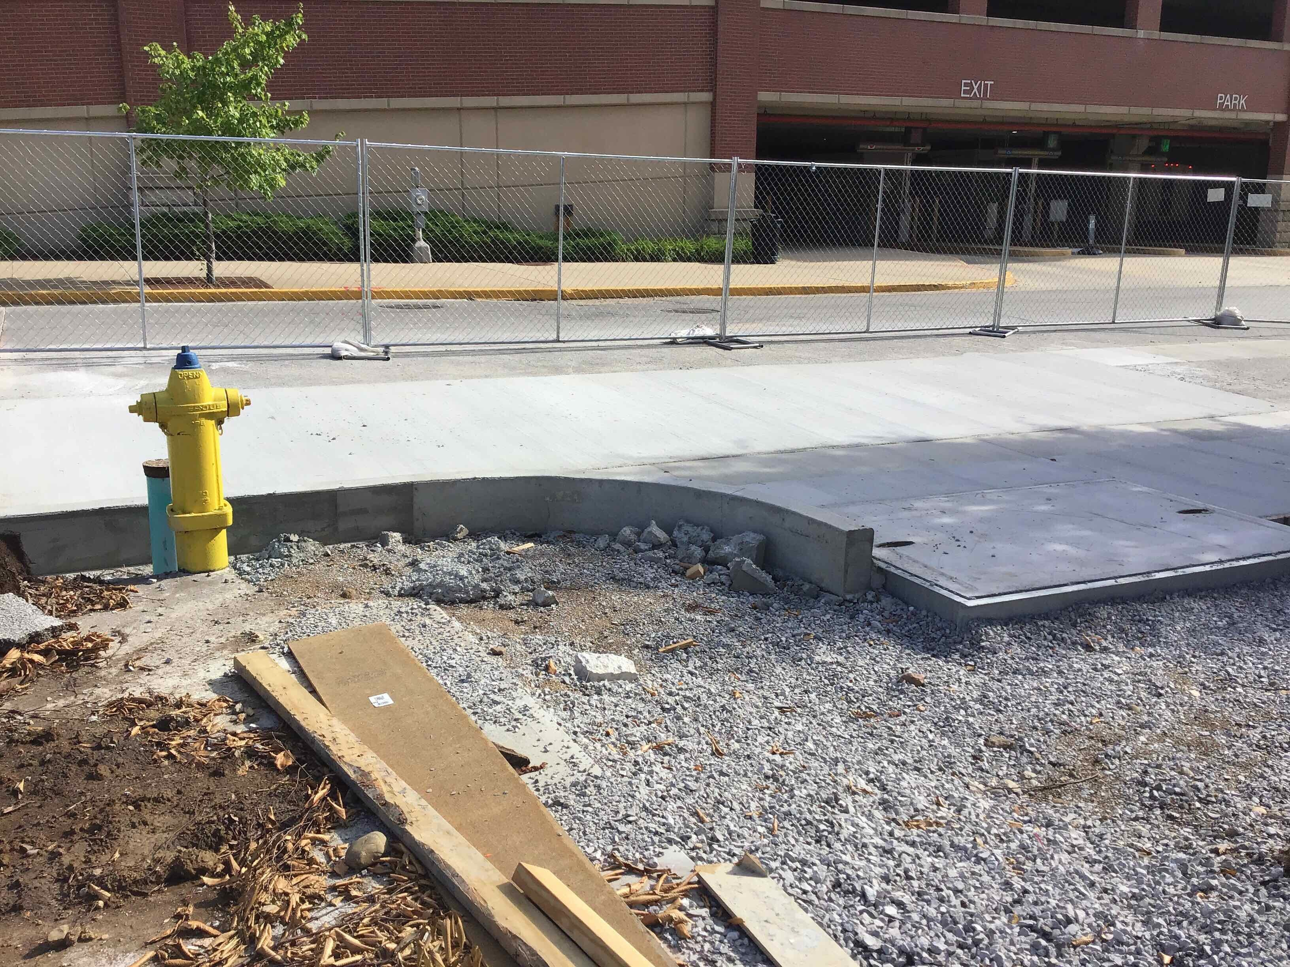
RECENT PROGRESS – Finish Concrete Work around HGI and NW Lot
1
3
2
4

Slide 4
RECENT PROGRESS – State Office Parking Lot
State Office Parking Lot at 8th and Cherry
Closed Lot for tree demolition
Began sewer tap and sewer pipe installation

Slide 5
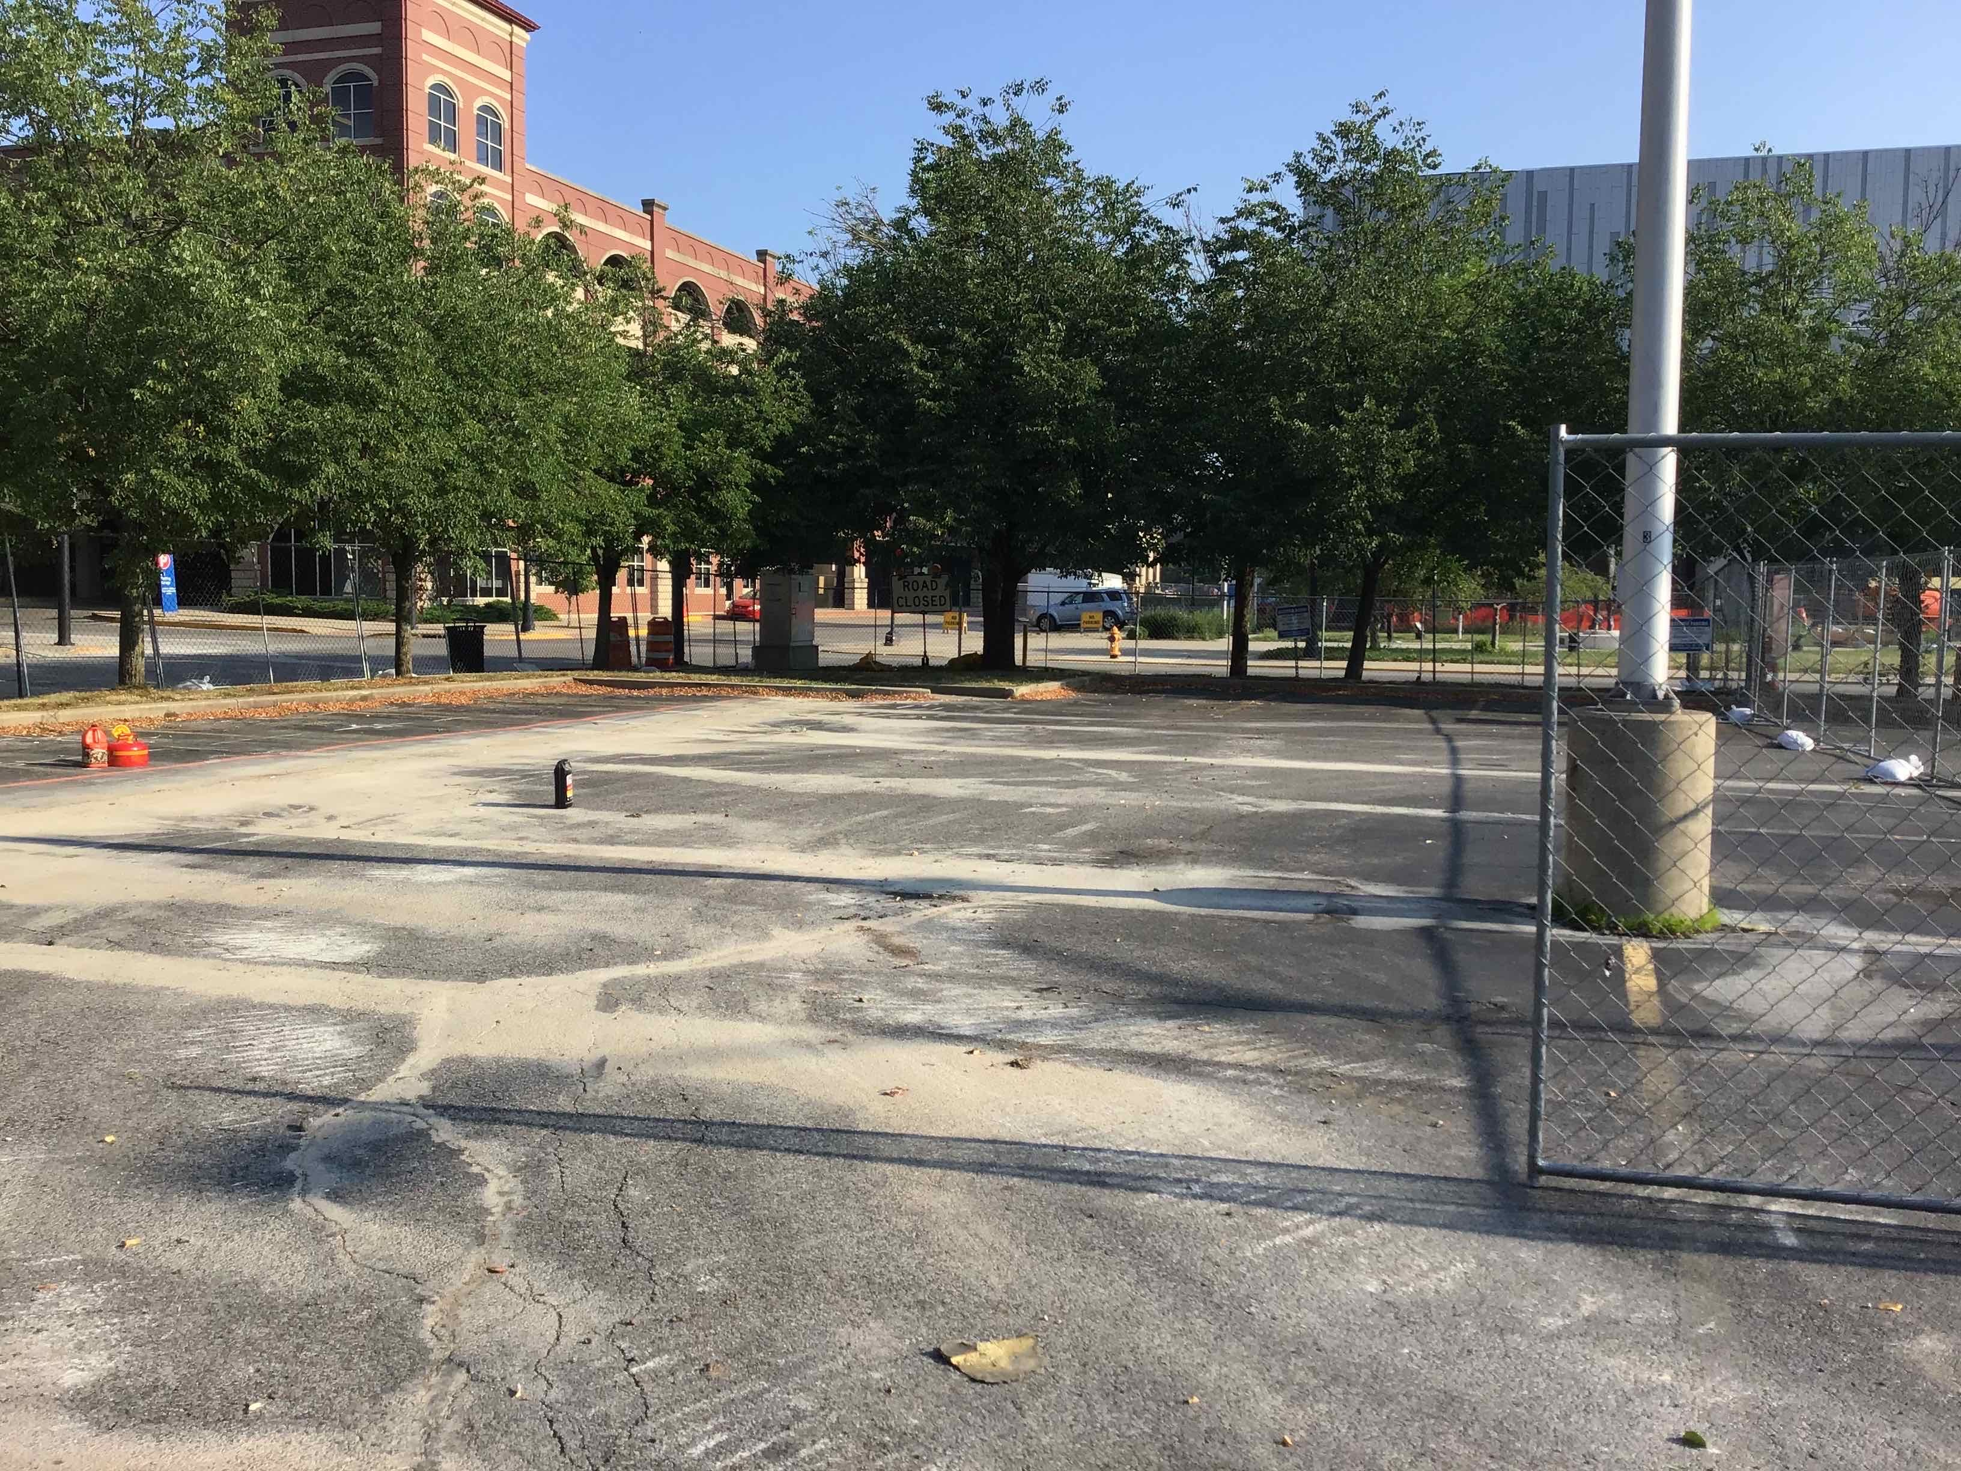
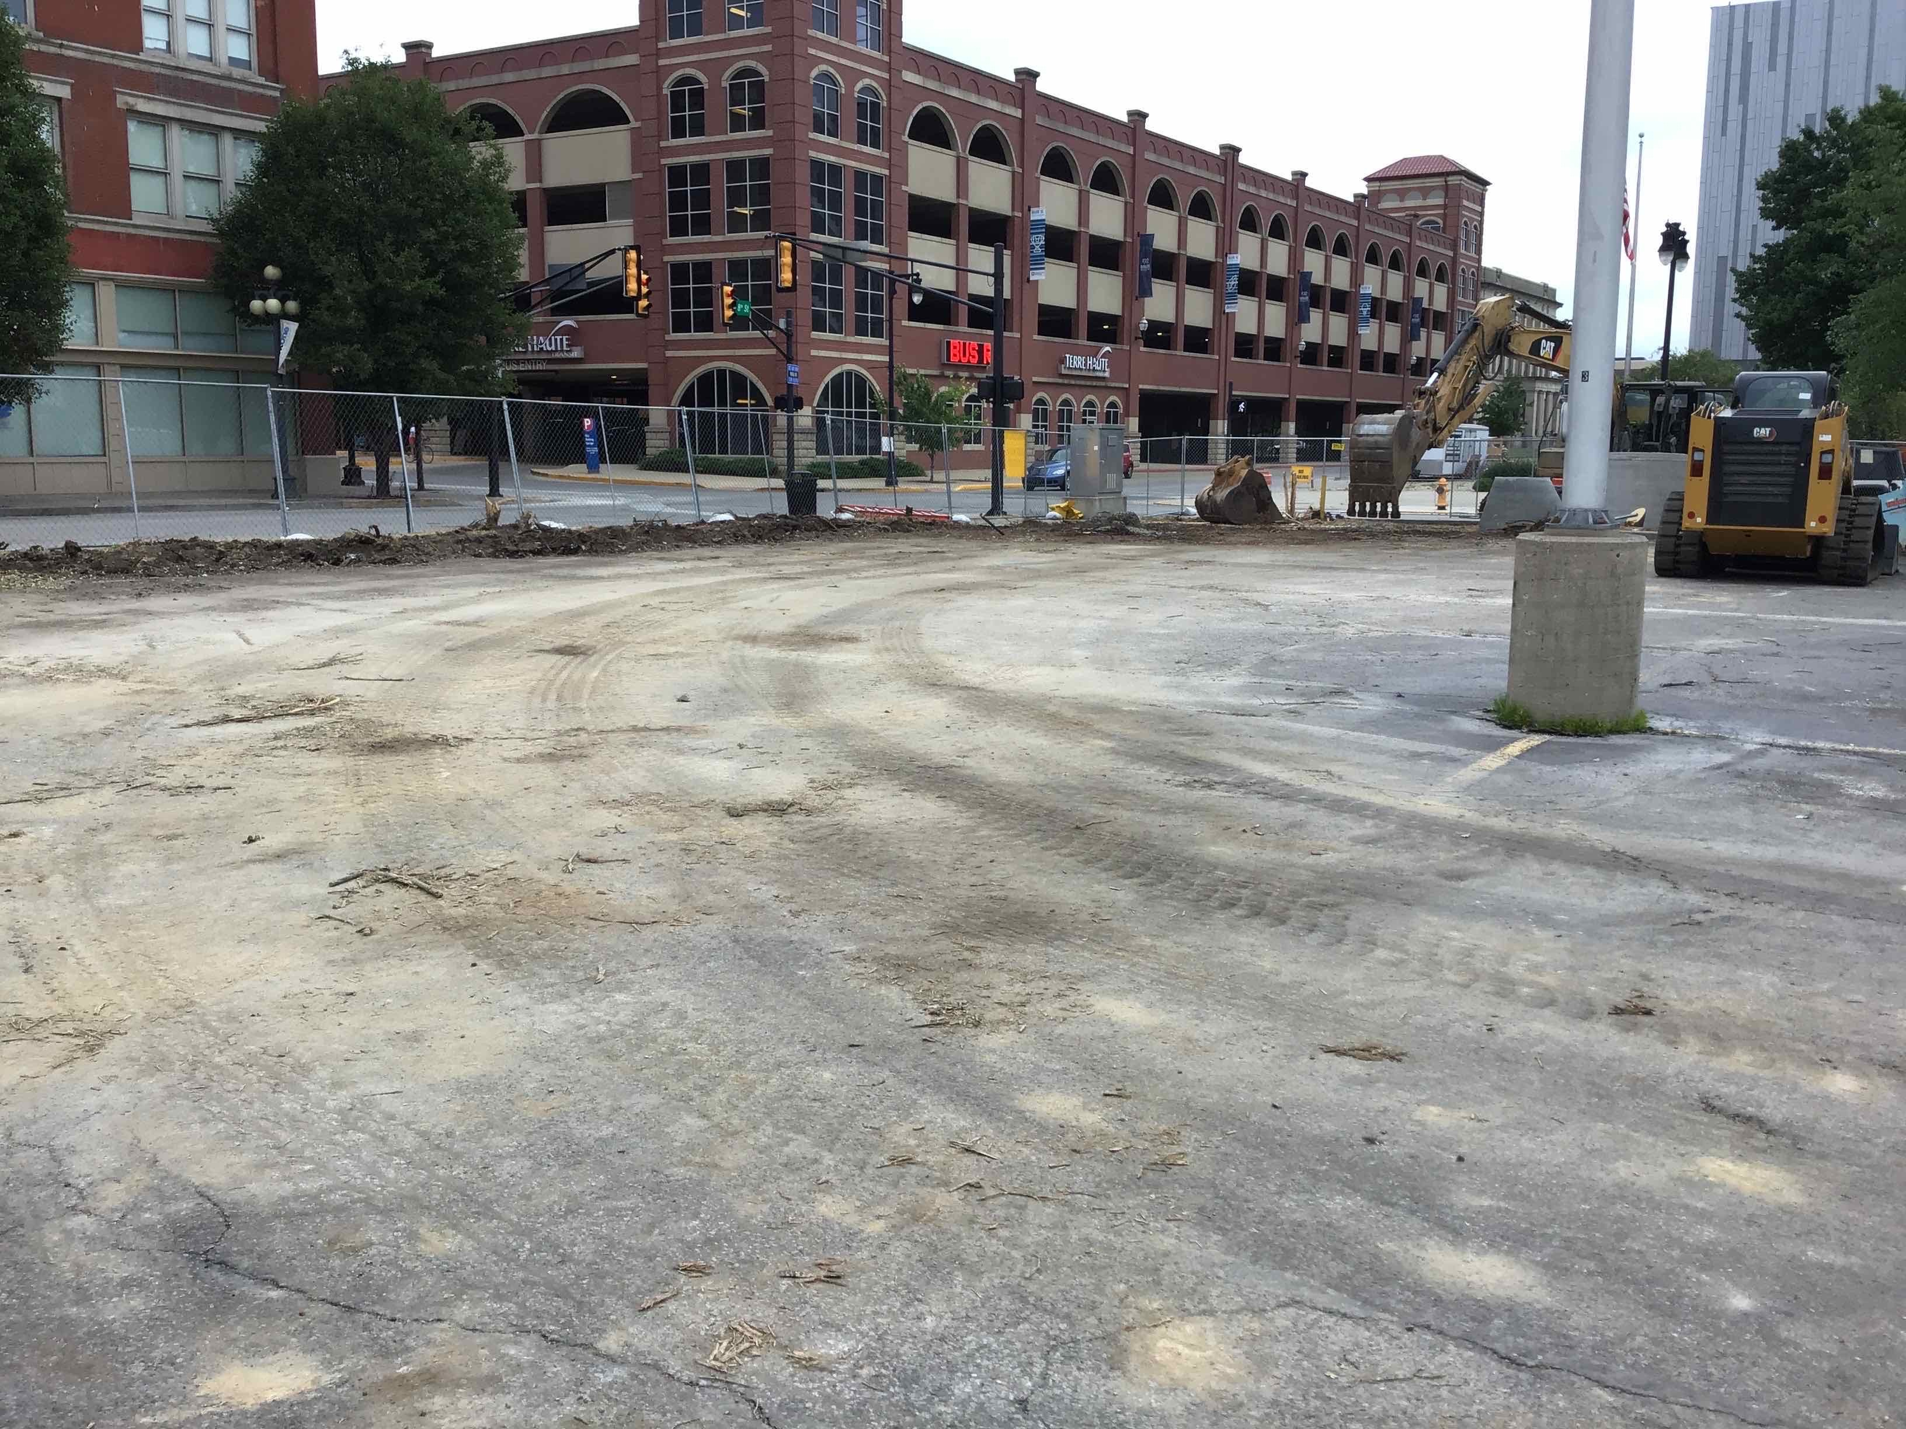
RECENT PROGRESS – State Office Parking Lot – Looking North
Before
After

Slide 6
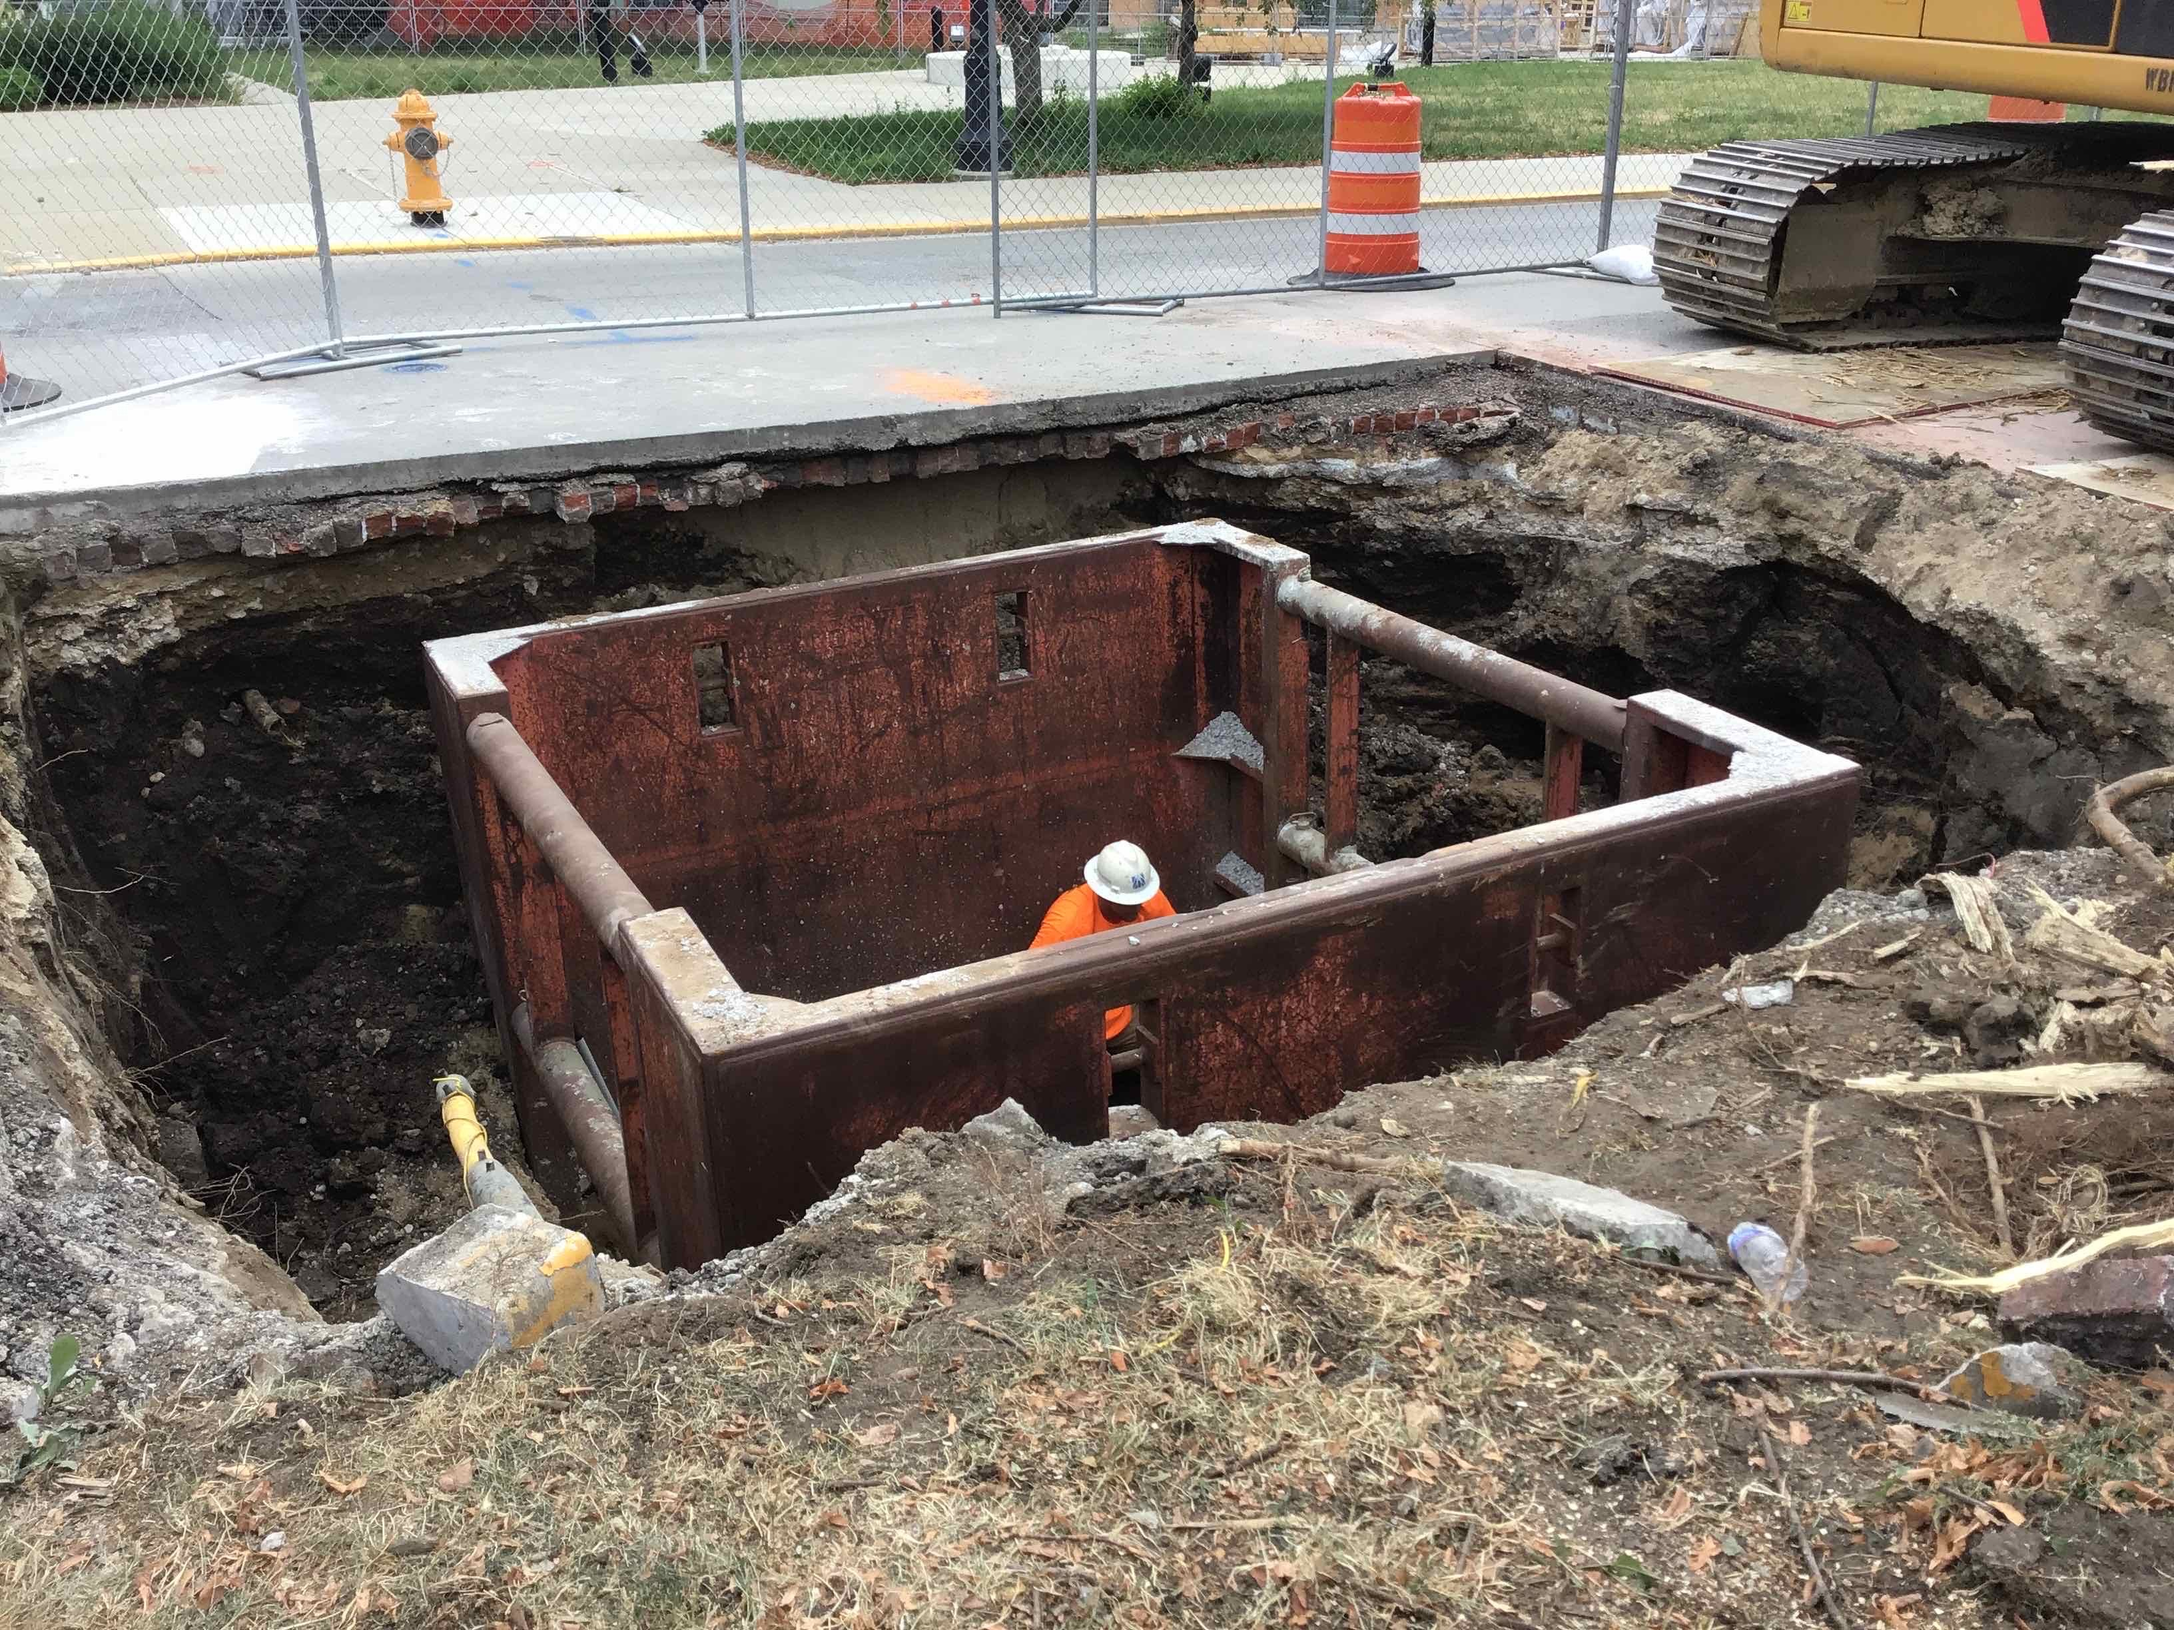
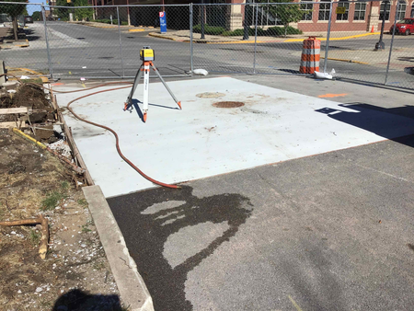
RECENT PROGRESS – 8th and Cherry Sewer Tap Installation
Before
After

Slide 7
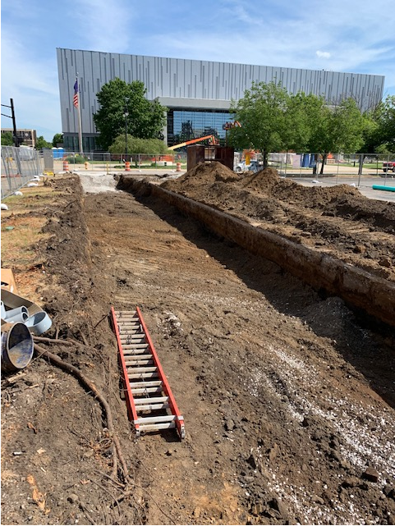
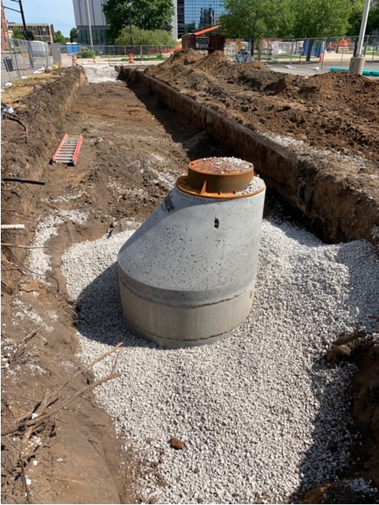
RECENT PROGRESS – 8th and Cherry Sewer Installation

Slide 8
UPCOMING ACTIVITIES
Continuation of utility installations to the east
Demo HGI NW lot, trees, shrubs, curbing, sidewalks, etc.
Install water meter pit at HGI East entrance week of July 20th
Installation of Storm Trap on HGI north lot – Scheduled to begin July 27th
Closing of 8th Street permanently – August 31, 2020
Restoration of HGI north lot complete by September 11, 2020

Slide 9
FAQ’s Regarding Construction Projects
What is a PR? – Proposal Request
Request for pricing that outlines additional work being considered by the owner
What is an ASI? – Architects Supplemental Instructions
Formal notice issued from the architect to provide additional information
What is a CO? – Change Order
Modification to the GMP that alters the scope of work, schedule, and/or pricing
What is an RFI? – Request For Information
Formal process of questions and answers between designers and contractors
What is an Allowance?
Amount specified in the contract for items not fully determined at time of contracting, then reconciled via change order once information is available

Slide 10
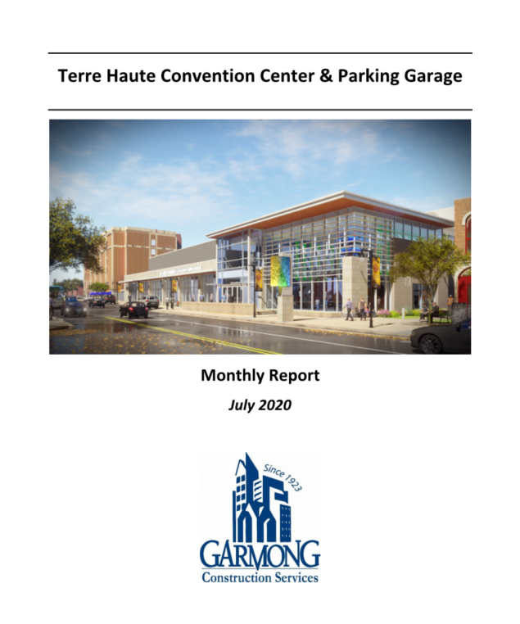
MONTHLY CONSTRUCTION REPORTS
Distribution to all CIB members
Reports contain the following:
Executive Summary
Construction Budget Summary
Updated Schedule
Photos

Slide 11
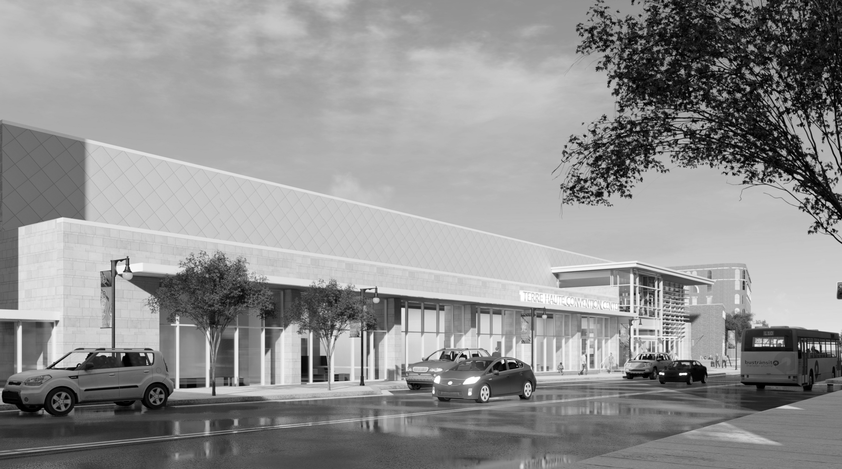
QUESTIONS?

