Slide 1
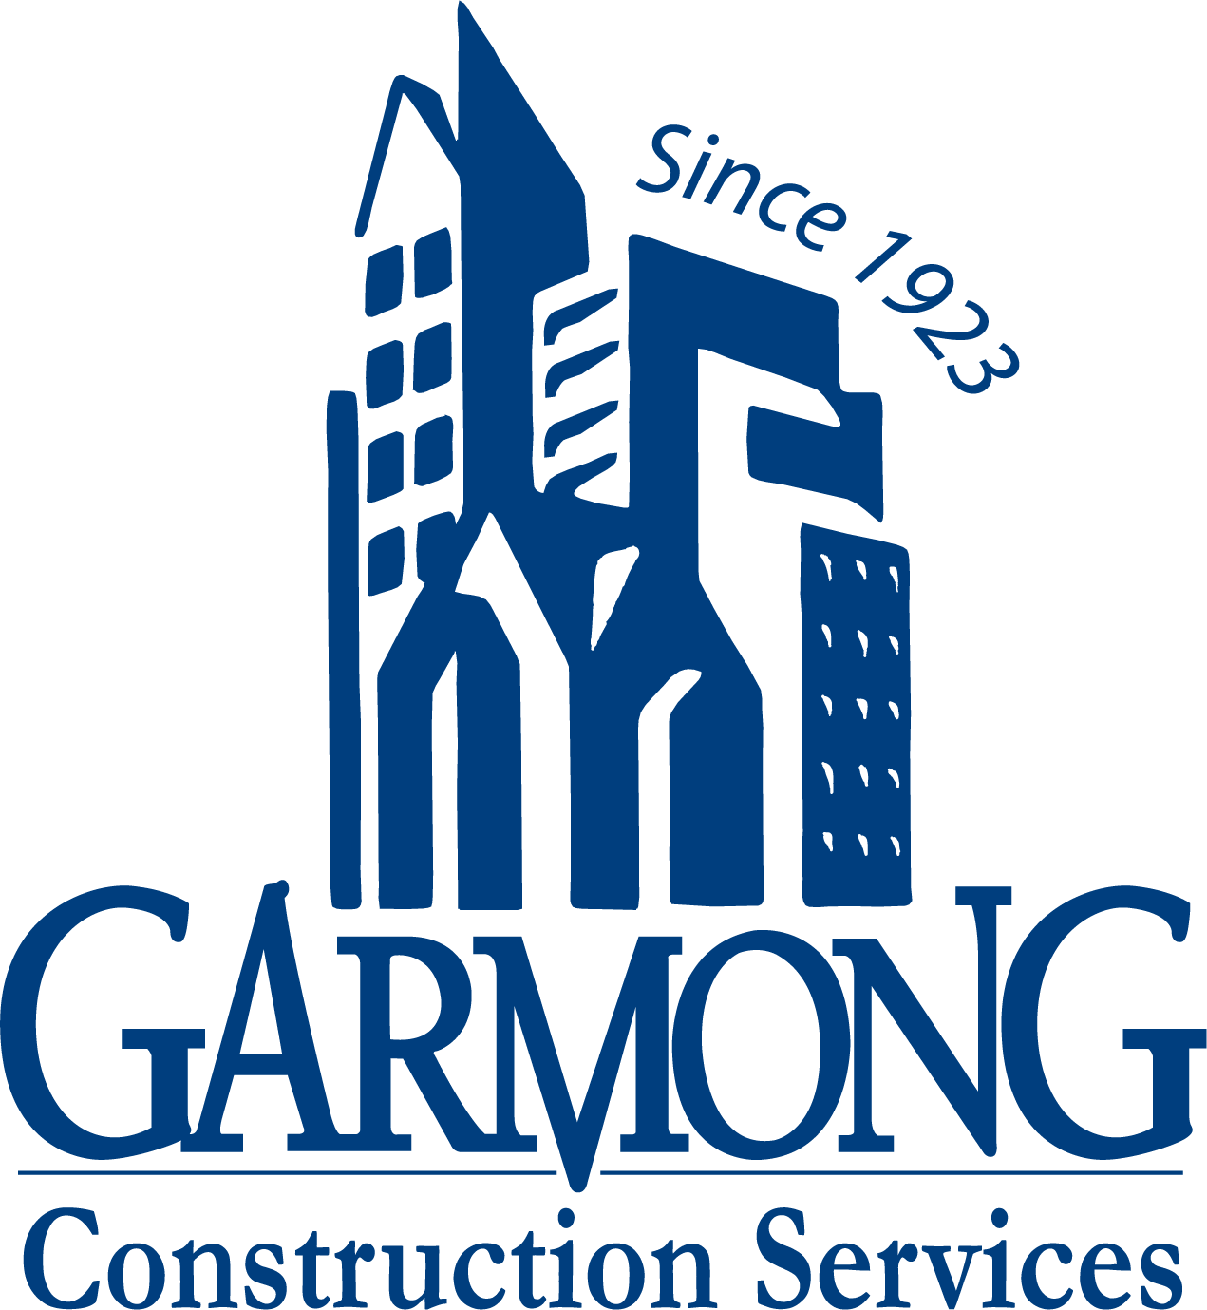
TERRE HAUTE CONVENTION CENTER
CONSTRUCTION UPDATE
March 2021

Slide 2
CONSTRUCTION OVERVIEW
Budget:
Current GMP amount is $26,325,510
Schedule:
Project is on schedule. Substantial completion date is April 27, 2022
Recent progress:
Parking Garage precast panel installation is 50% complete
Convention Center exterior framing and sheathing is 50% complete
Convention Center concrete slabs are complete
Convention Center stairs have been installed

Slide 3
CONSTRUCTION OVERVIEW
Upcoming activities:
NE Garage
Precast concrete installation continues
Convention Center
Roofing begins
Interior framing begins
Masonry – Interior CMU begins
Above-ceiling MEP begins
Exterior framing and sheathing continues
Slab on Deck

Slide 4
RECENT PROGRESS – Convention Center – February 2021

Slide 5
RECENT PROGRESS – Convention Center – March 2021

Slide 6
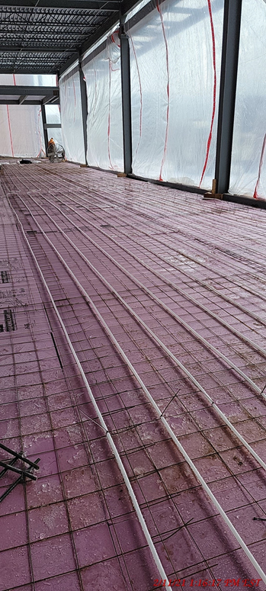
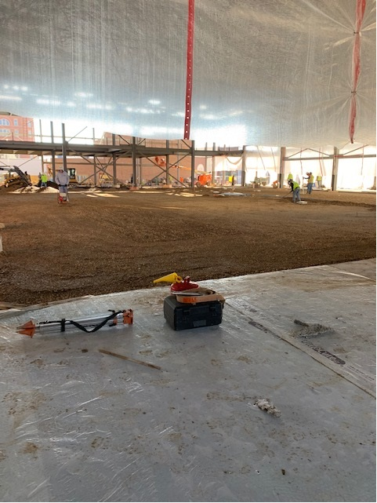
RECENT PROGRESS – Pre-function Area and Ballroom Preparation for concrete

Slide 7
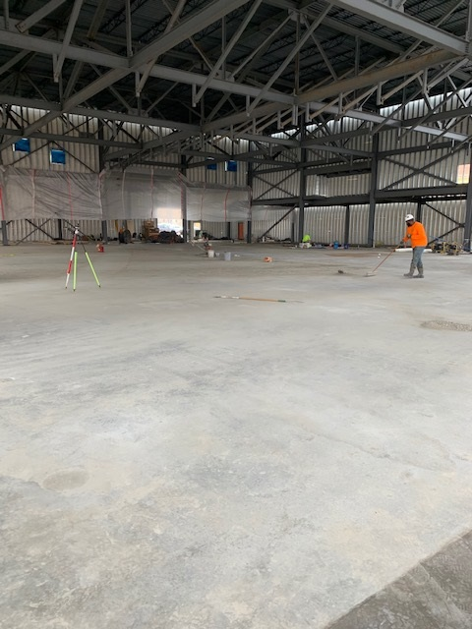
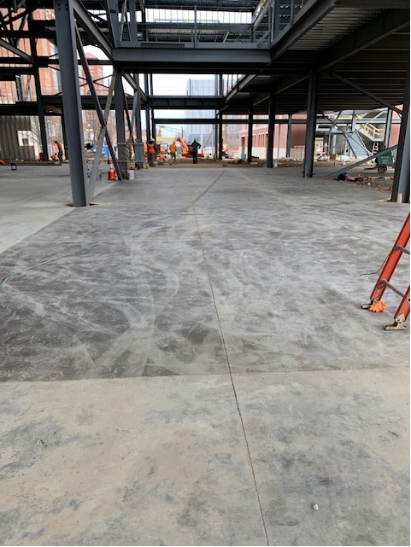
RECENT PROGRESS – Pre-function Area and Ballroom concrete complete

Slide 8
RECENT PROGRESS – Parking Garage – February 2021

Slide 9
RECENT PROGRESS – Parking Garage – March 2021

Slide 10
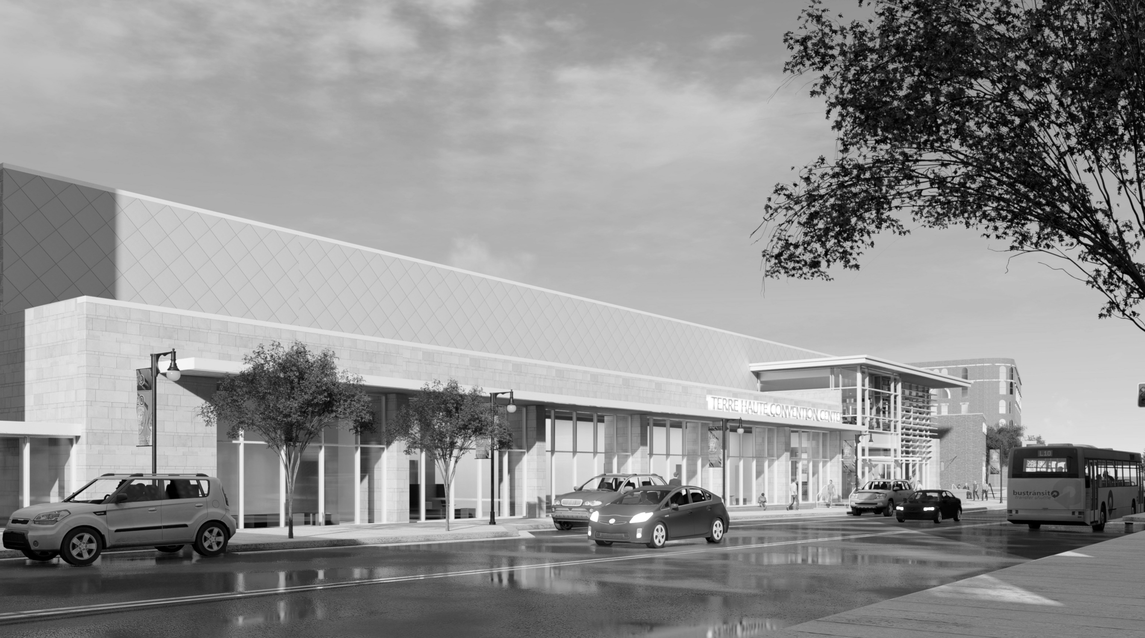
QUESTIONS?

