Slide 1
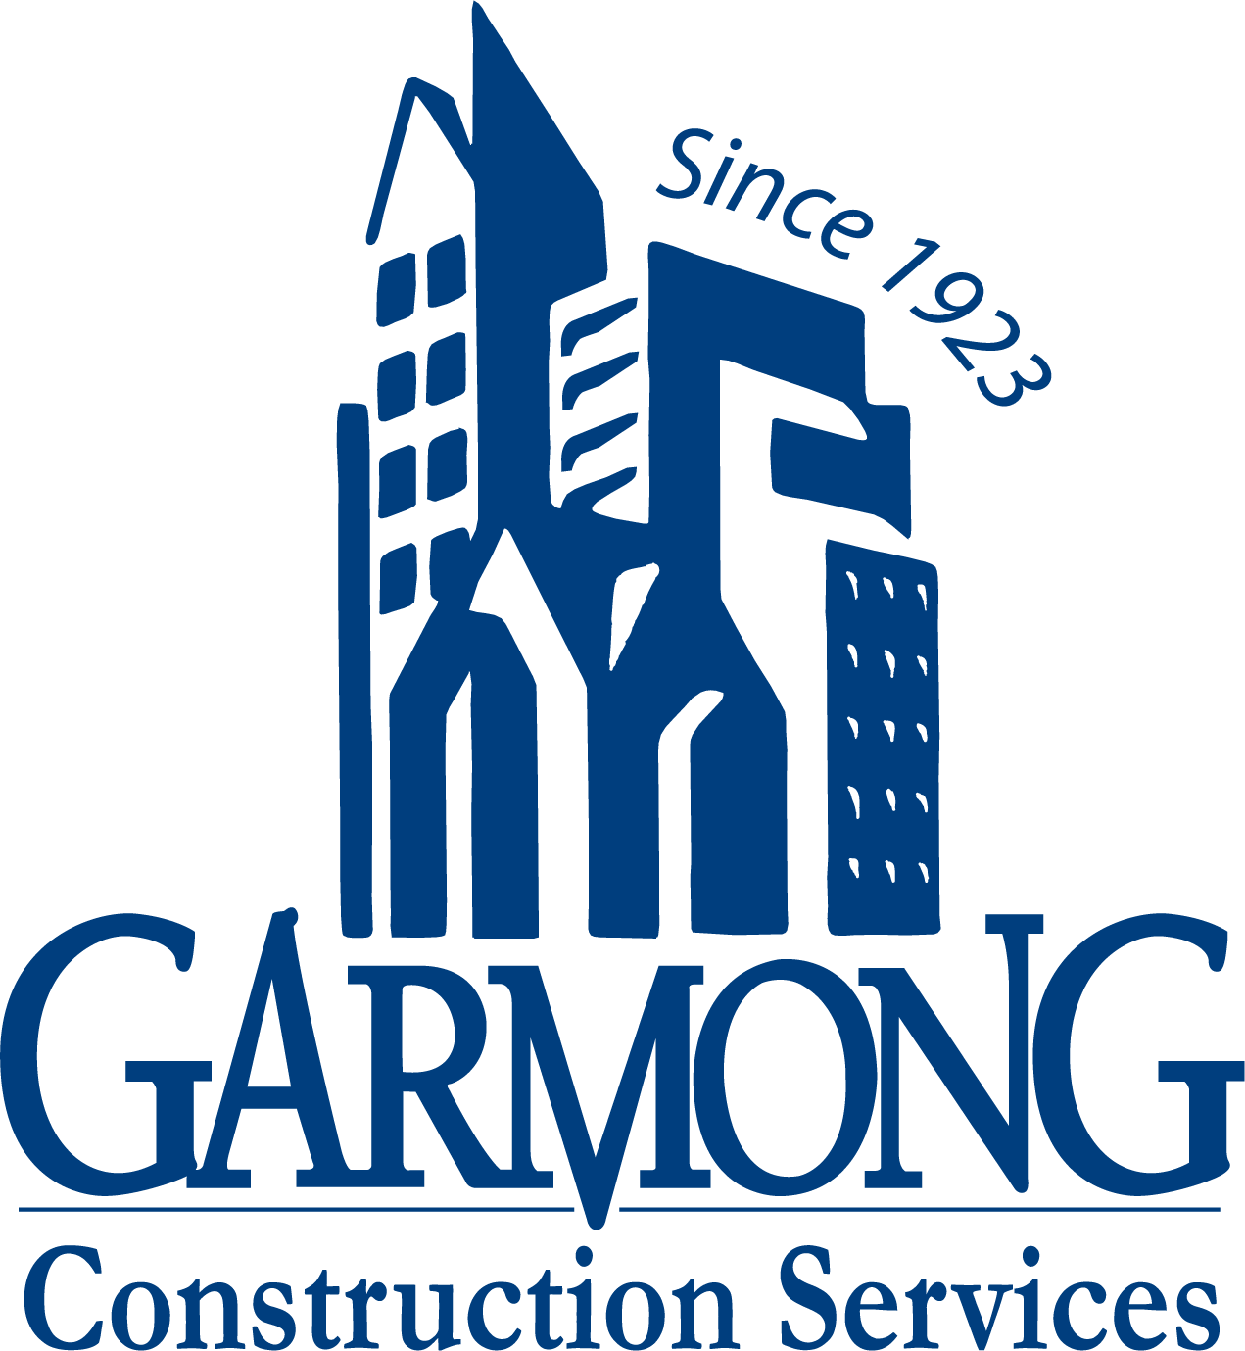
TERRE HAUTE CONVENTION CENTER
CONSTRUCTION UPDATE
April 2021

Slide 2
CONSTRUCTION OVERVIEW
Recent progress:
Parking Garage
Precast panel installation is nearing completion
Convention Center
Exterior framing and sheathing is 75% complete (including air/moisture barrier)
Stairs – concrete infill complete
Interior masonry walls (back of house) - complete
Exterior masonry veneer (west elevation) began
MEP overhead installations are 50% complete
Interior framing is 75% complete

Slide 3
CONSTRUCTION OVERVIEW
Upcoming activities:
NE Garage
Concrete floor slabs
Convention Center
Roofing to be completed this week
Interior framing continues
Exterior framing and sheathing continues
EIFS begins
Masonry – Exterior masonry continues
Limestone veneer on south elevation begins
Above-ceiling MEP continues
Skylight installation begins

Slide 4
RECENT PROGRESS – Convention Center – April 2021

Slide 5
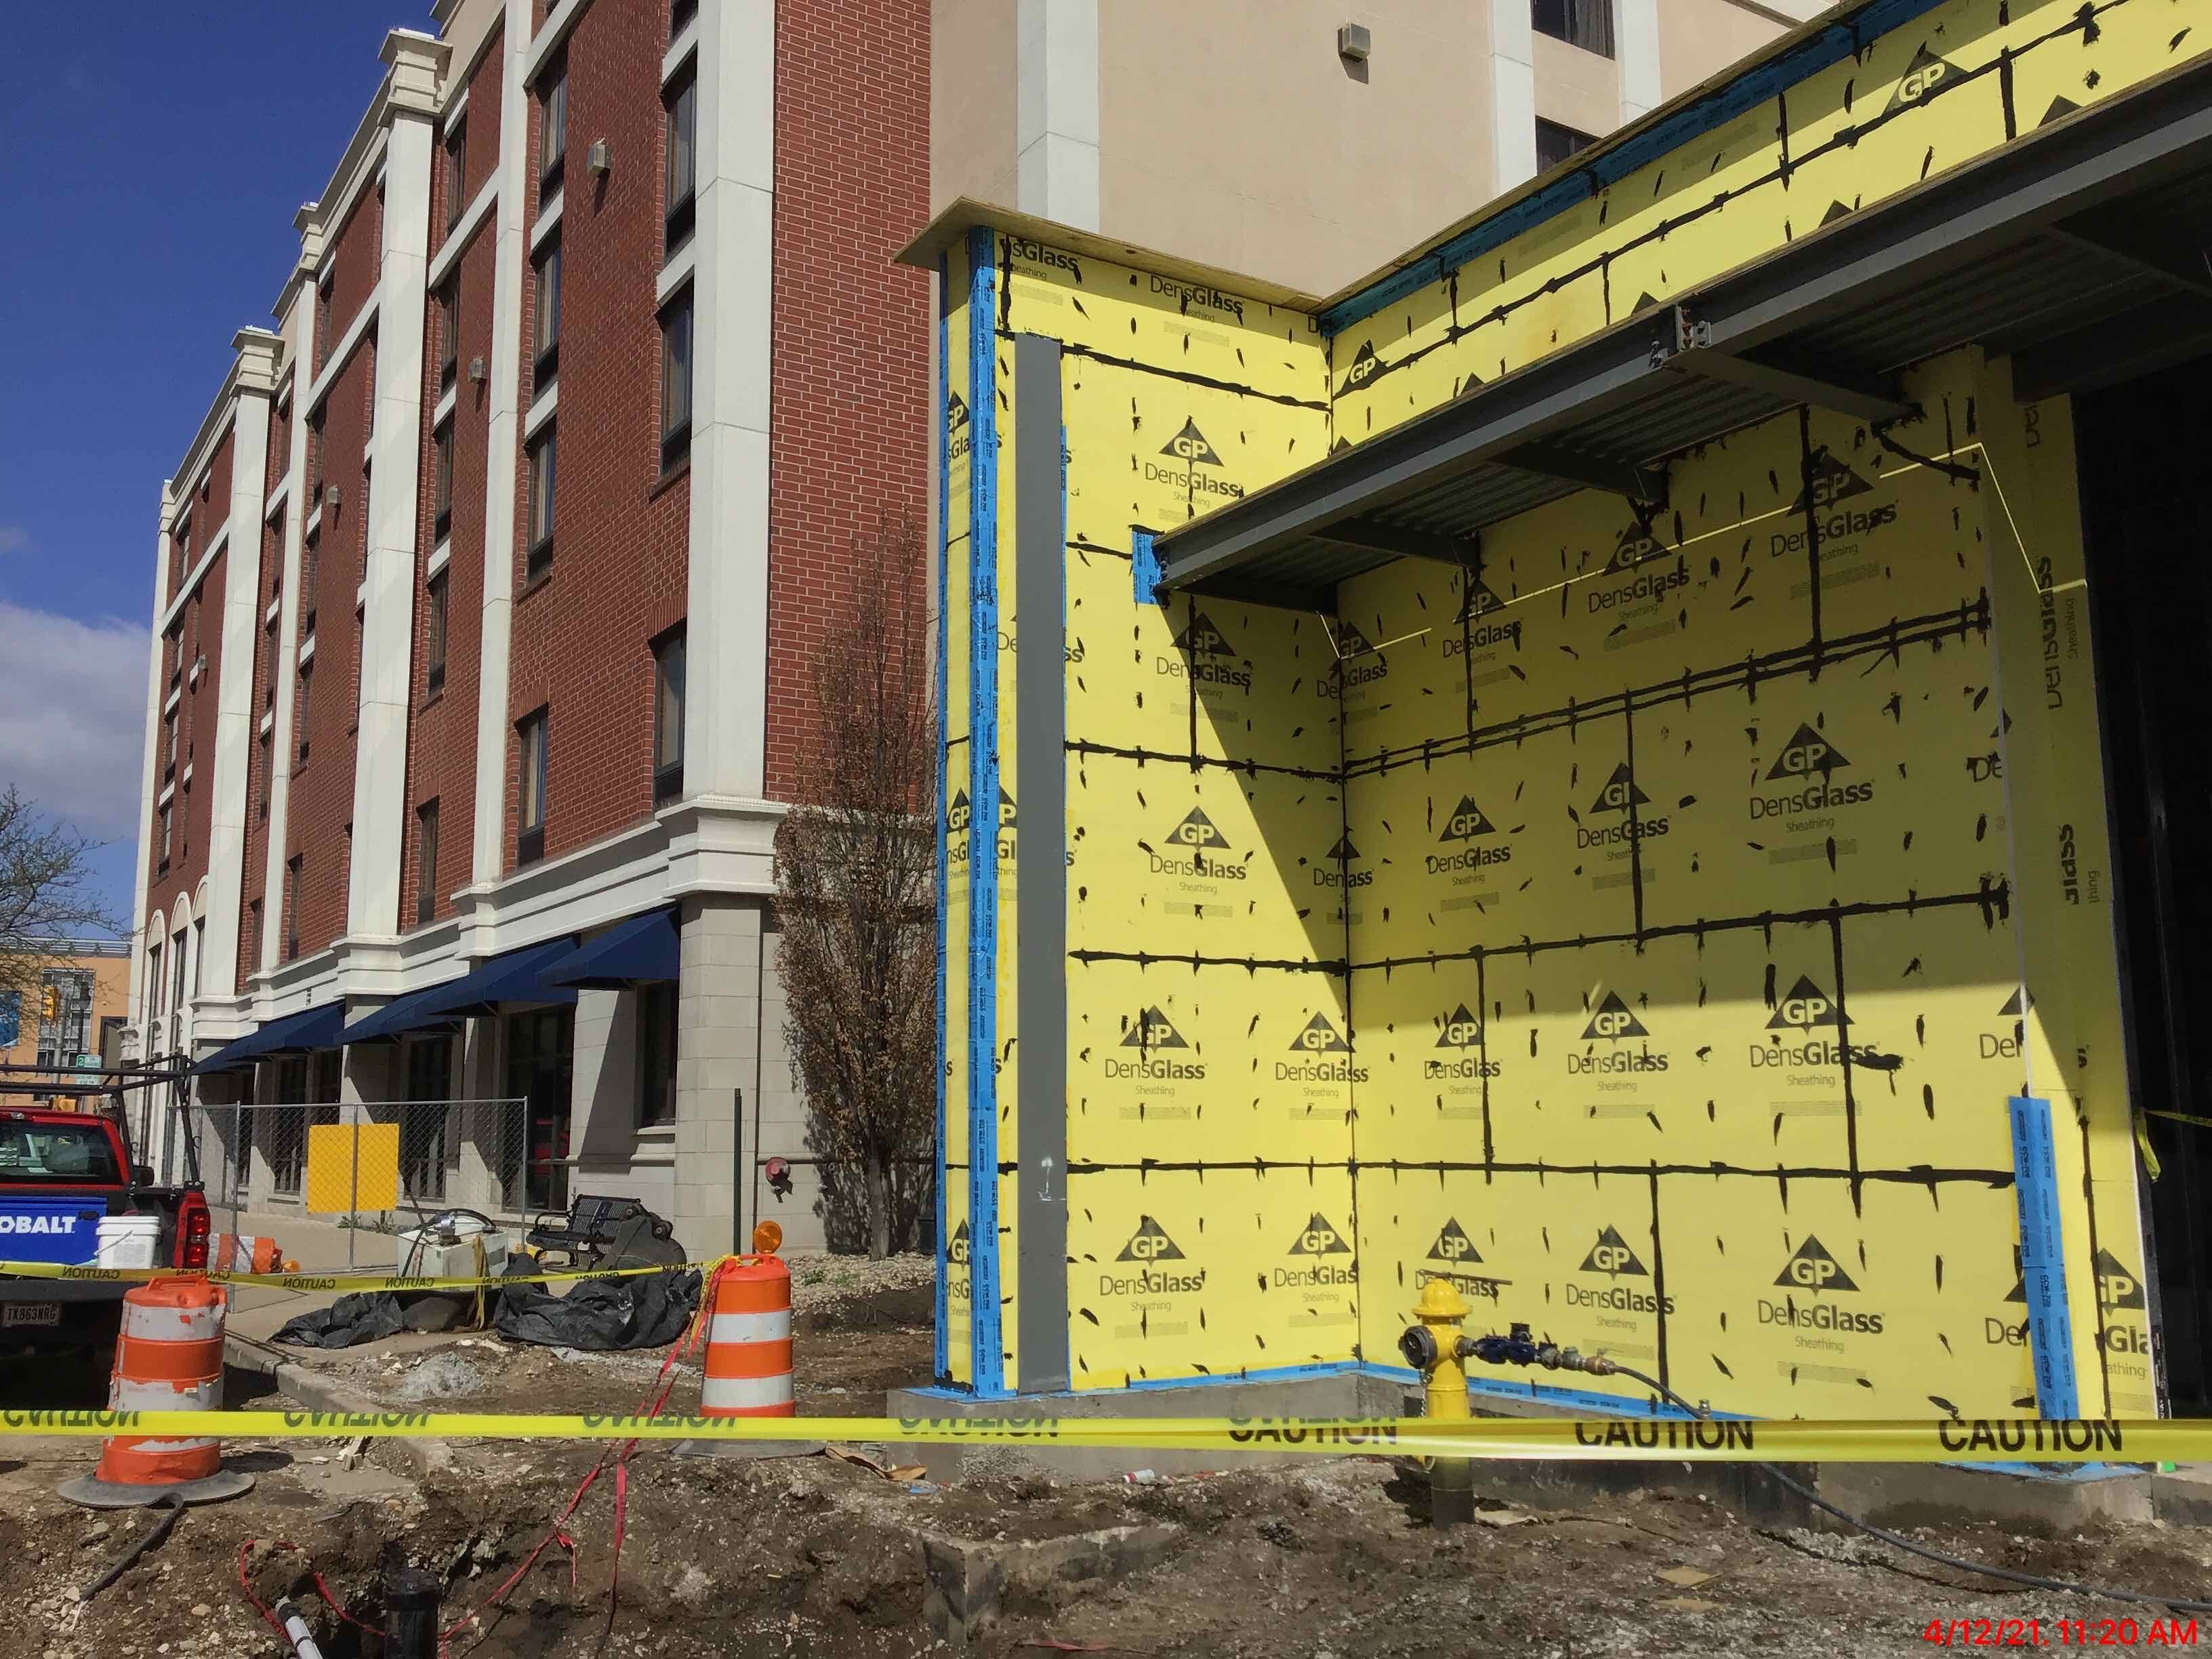
RECENT PROGRESS – Exterior Framing and Sheathing

Slide 6
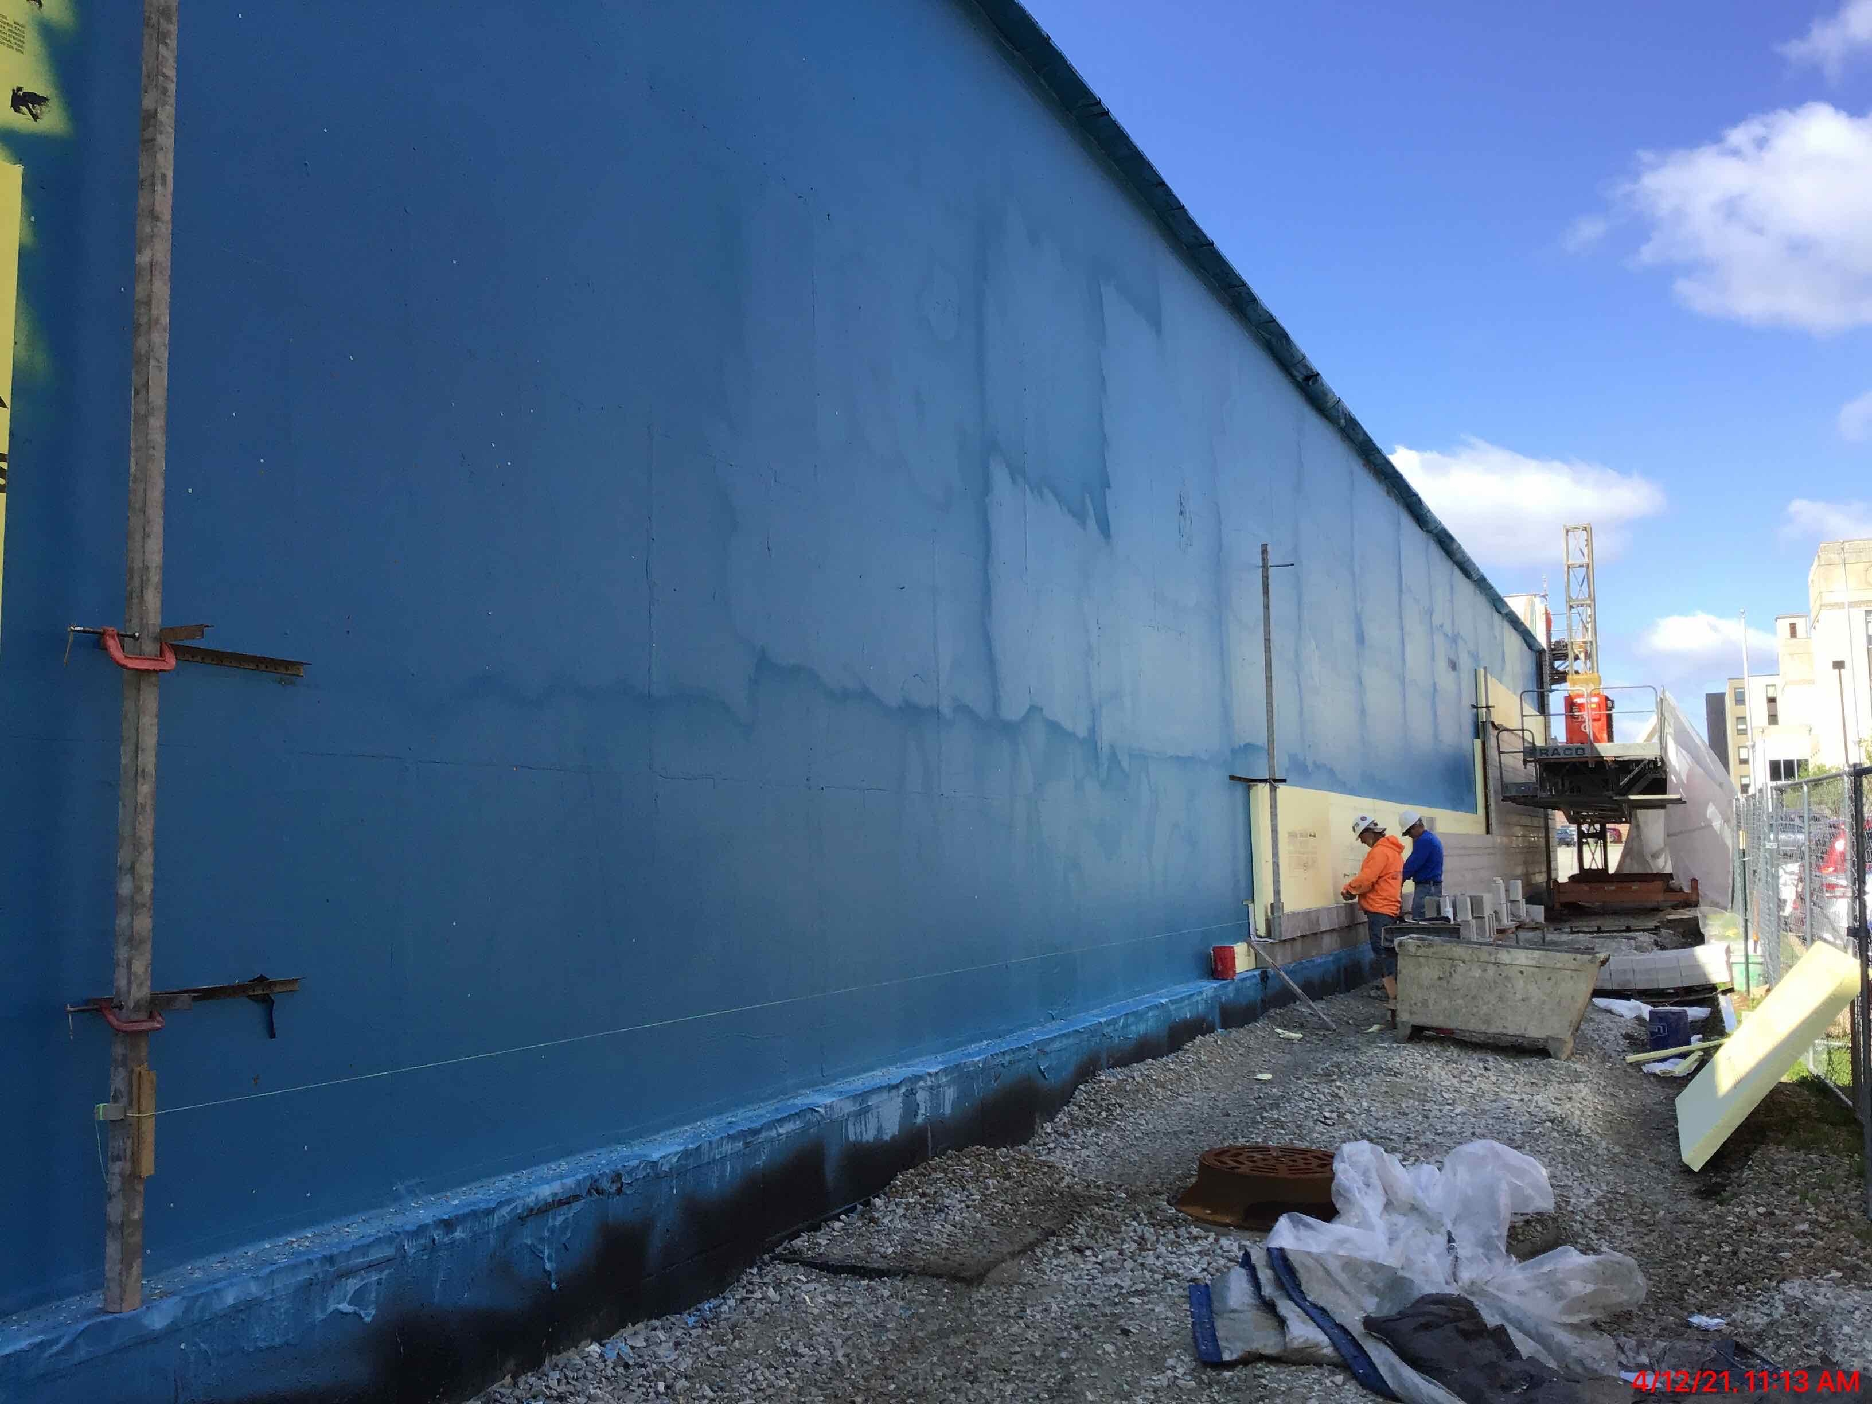
RECENT PROGRESS – Air and Moisture Barrier Application

Slide 7
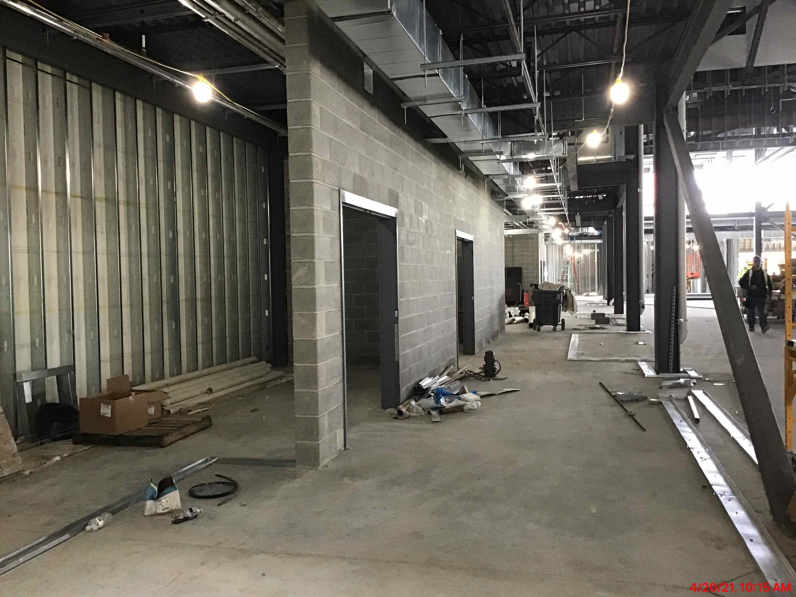
RECENT PROGRESS – Interior Masonry (Back of House)

Slide 8
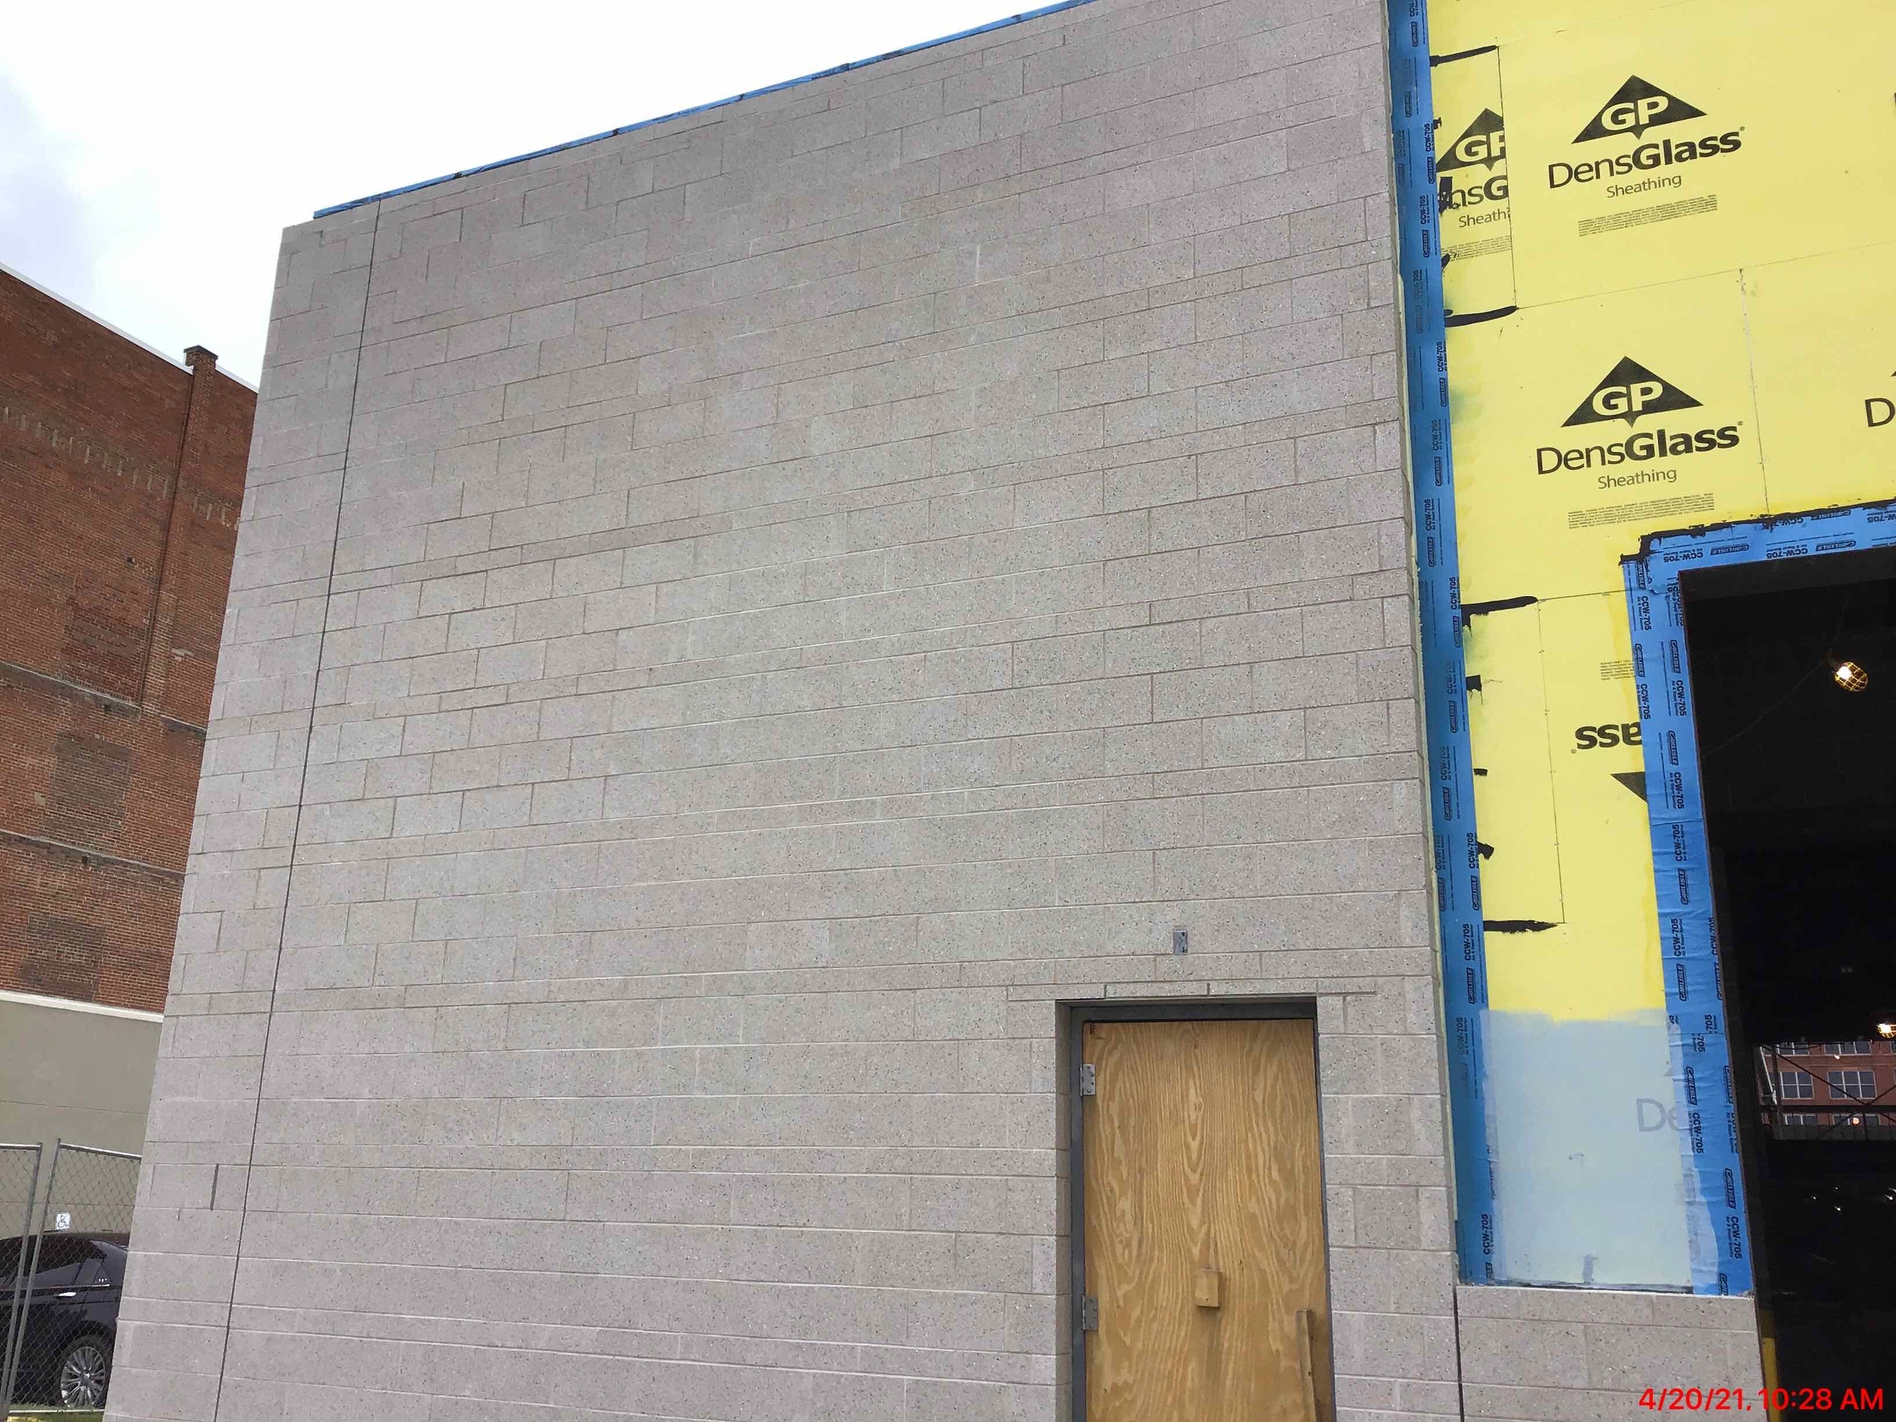
RECENT PROGRESS – Exterior Masonry

Slide 9
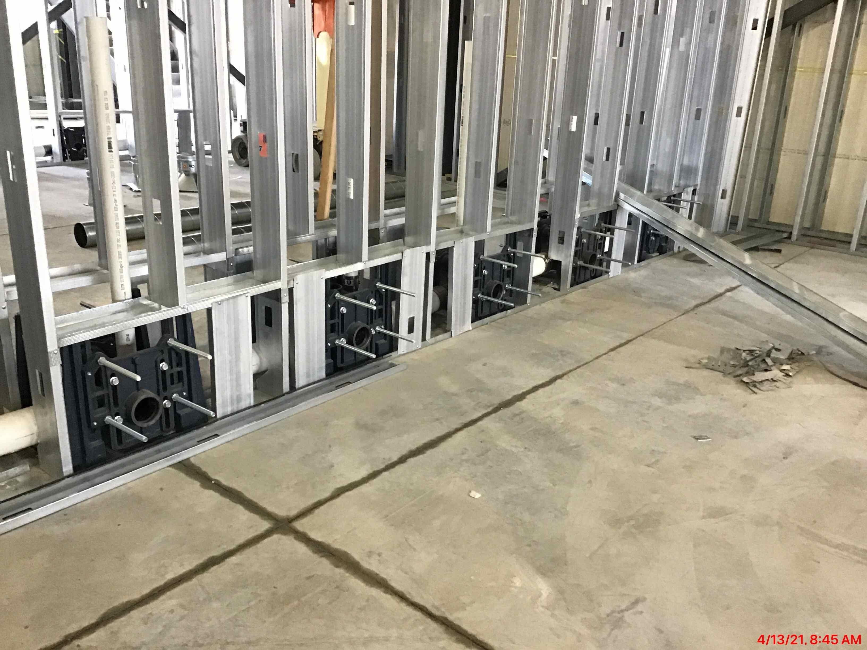
RECENT PROGRESS – Overhead MEP and restroom rough-in

Slide 10
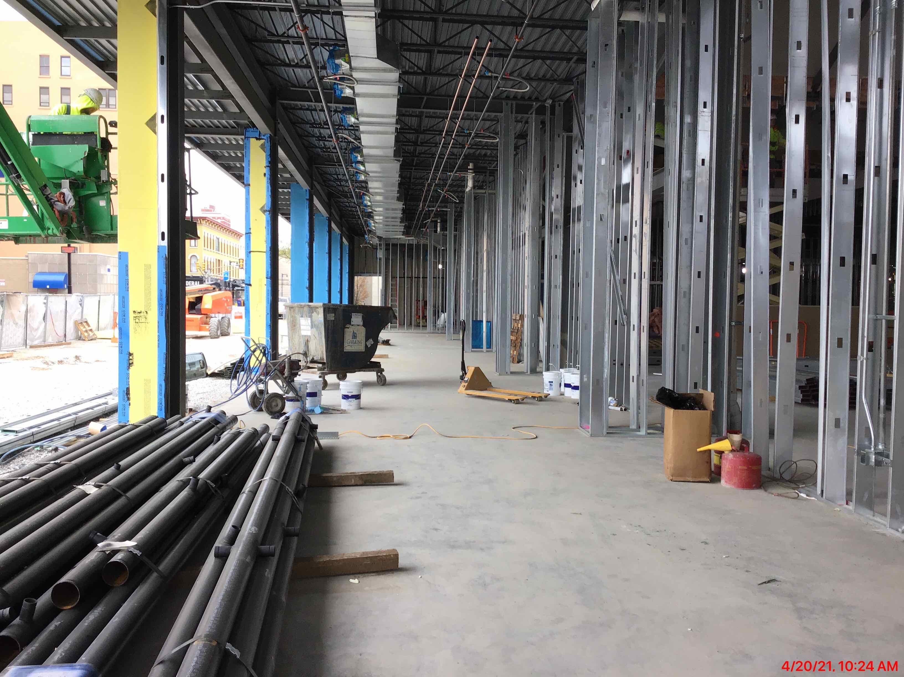
RECENT PROGRESS – Pre-function Area and Ballroom Interior Framing & Drywall

Slide 11
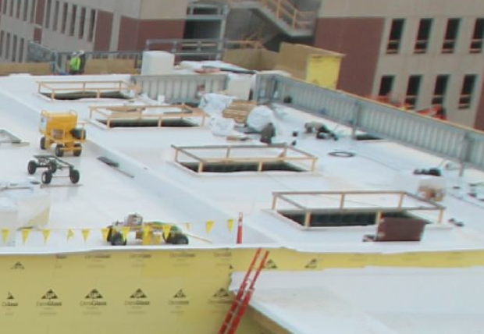
RECENT PROGRESS – Ready for Skylight installation

Slide 12
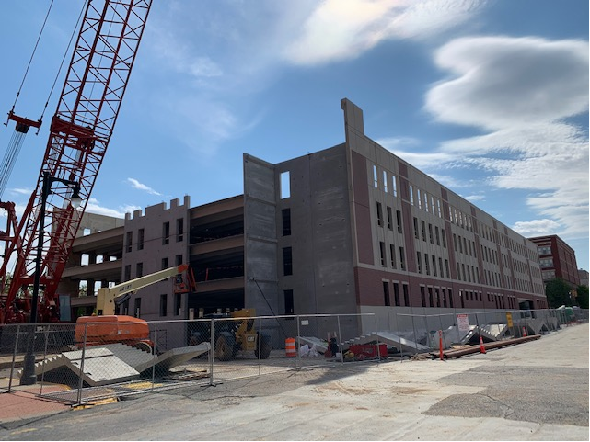
RECENT PROGRESS – Parking Garage – April 2021

Slide 13
CONSTRUCTION OVERVIEW
Budget:
Current GMP amount is $26,392,808
Changes this period – Change Order No. 9: $67,298
Kitchen and Door Revisions: $35,943
HGI Connector Finish Revisions: ($33,232)
Garage Elevator Wall Revision: $15,337
Fabric Wrapped Panel Facing Material Revision: $12,135
Miscellaneous Electrical Revisions: $4,650
Water Service Tap Revision: $41,282
Delete Unnecessary Roof Drains: ($2,861)
Exterior Wall Insulation Revisions: ($5,956)
Schedule:
Project is on schedule. Substantial completion date is April 27, 2022

Slide 14
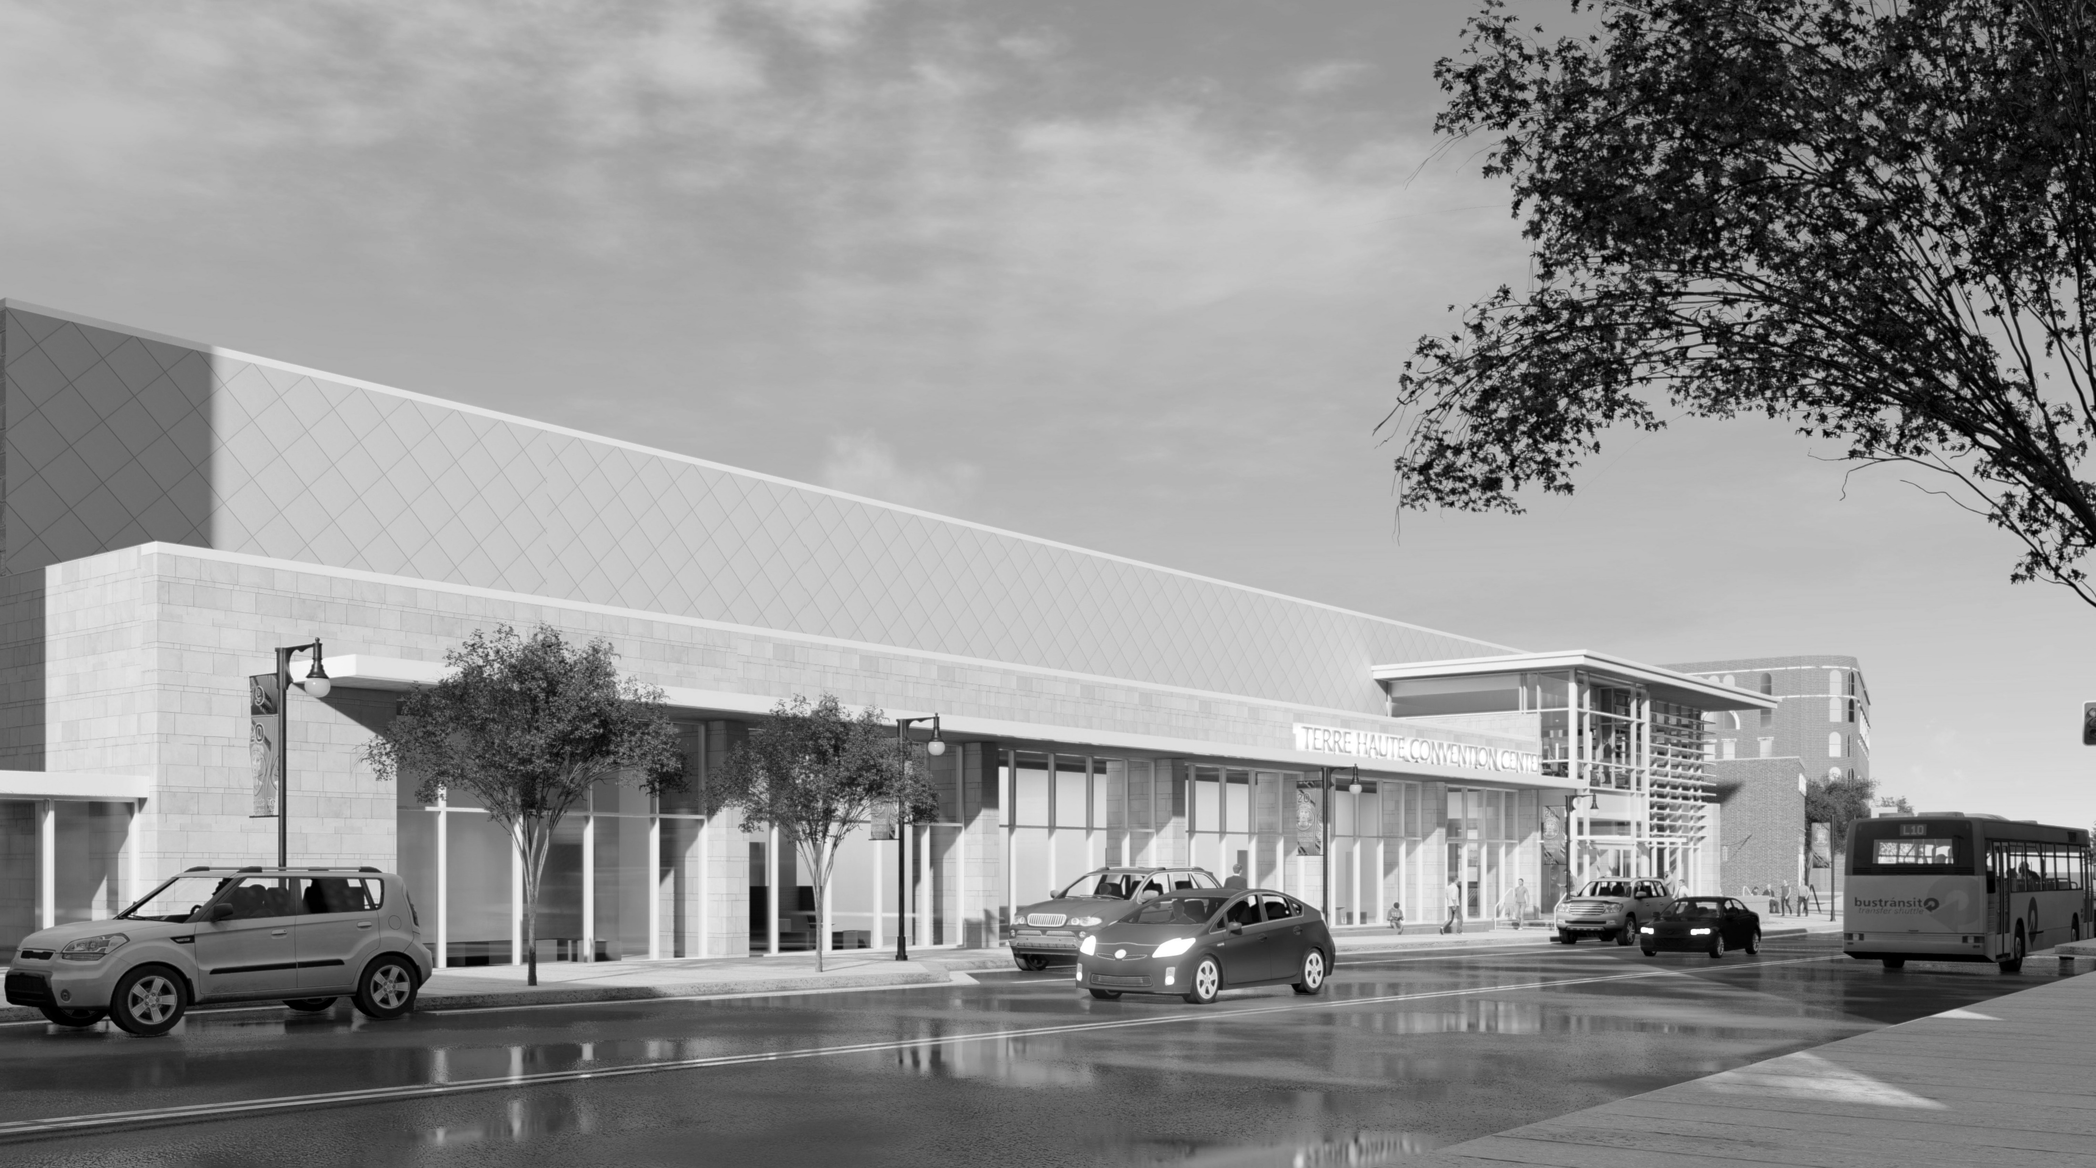
QUESTIONS?

