Slide 1
TERRE HAUTE CONVENTION CENTER
CONSTRUCTION UPDATE
June 2021

Slide 2
CONSTRUCTION OVERVIEW
Budget:
Current GMP amount is $26,392,808. No change this period
Change Order No. 10 is pending final approval: $142,301
Includes the following: added PG storage room, office revisions, added traffic arm, added museum door, fire alarm revisions, DAS site survey, added sanitary wall cleanout, revised north canopy framing, elevator flooring revisions
Schedule:
Project is on schedule. Substantial completion date is April 27, 2022

Slide 3
CONSTRUCTION OVERVIEW
Recent progress:
Convention Center
Exterior masonry veneer complete on north, west, and east elevations
EIFS on West Elevation completed
Storefront framing began along Wabash Ave.
Operable Panel Partitions track installed
Monumental Stair installed
Bulkhead framing and Drywall installation is progressing
MEP Rough-in continues
Parking Garage
Concrete topping slabs have begun
Backfill for slab on grade is underway
Exterior and interior touch ups to pre-cast panels

Slide 4
CONSTRUCTION OVERVIEW
Upcoming activities:
Convention Center
EIFS continues, work now taking place on south elevation
Limestone veneer to be completed
Elevator installation has begun
Glass installation to begin along Wabash Ave.
Window frame installation on east and north elevations
Drywall hanging will progress as building becomes enclosed
MEP rough-in continues
Exterior hardscape and HGI connector
Parking Garage
Concrete topping slabs will continue
Elevator installation begins

Slide 5
RECENT PROGRESS – Convention Center – June 2021

Slide 6
RECENT PROGRESS – East Elevation

Slide 7
RECENT PROGRESS – Ballroom Ceiling Framing

Slide 8
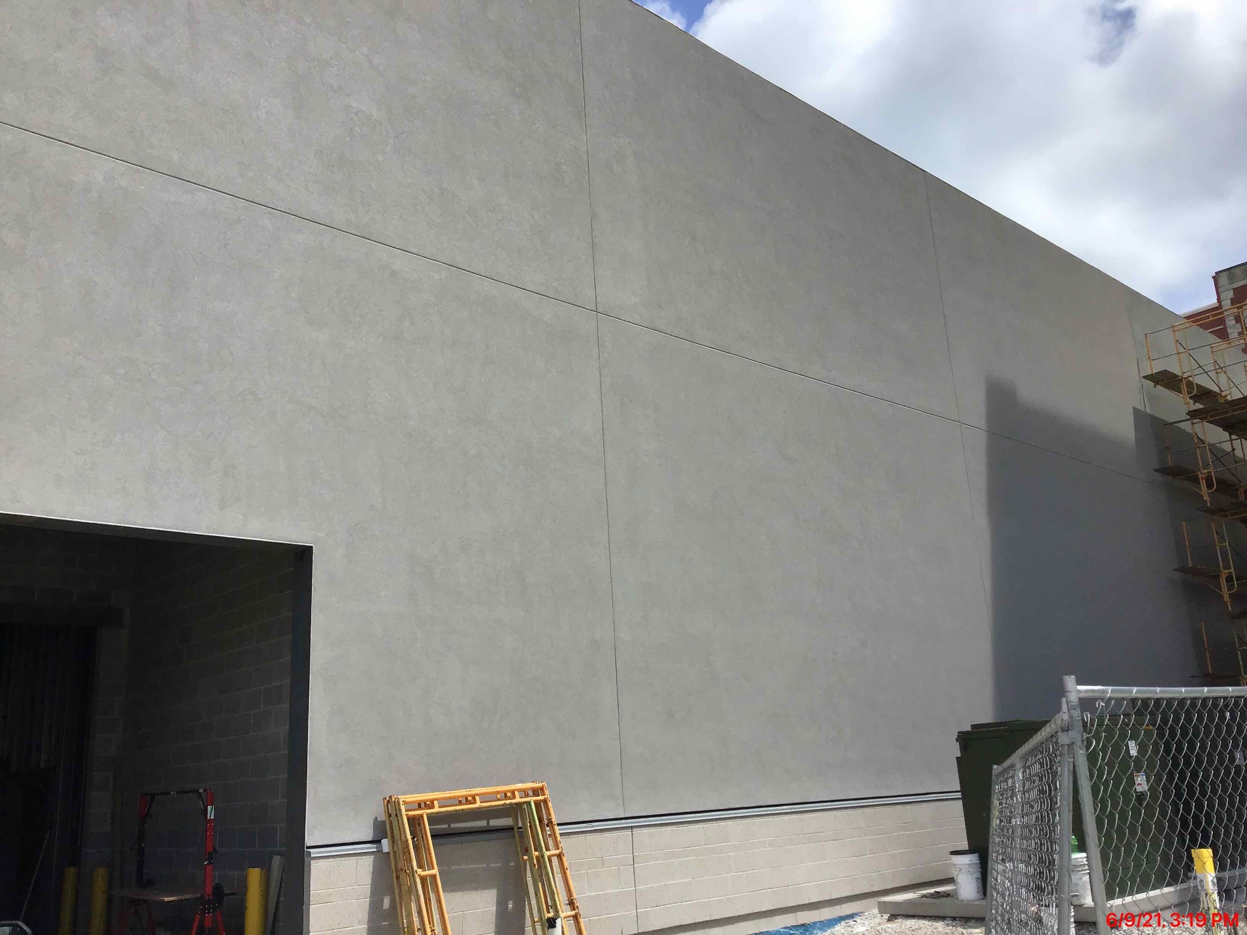
RECENT PROGRESS – Exterior Insulation and Finish System (EIFS) – West Elevation

Slide 9
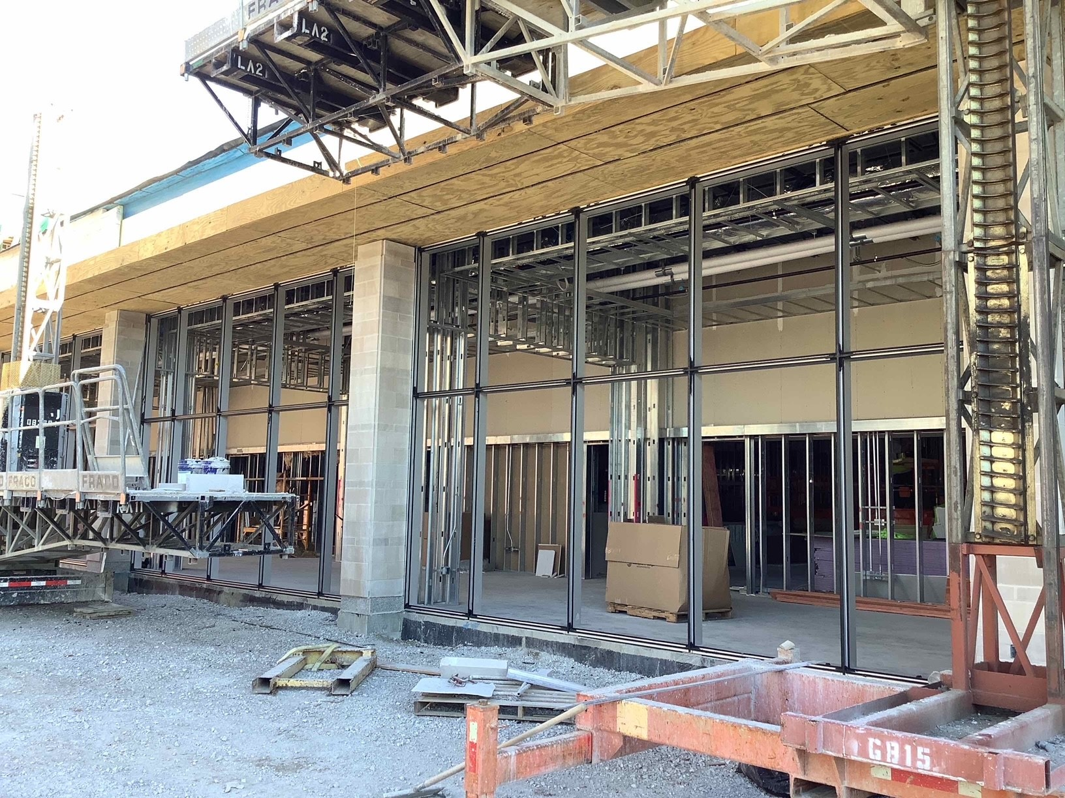
RECENT PROGRESS – South Elevation – Window Framing

Slide 10
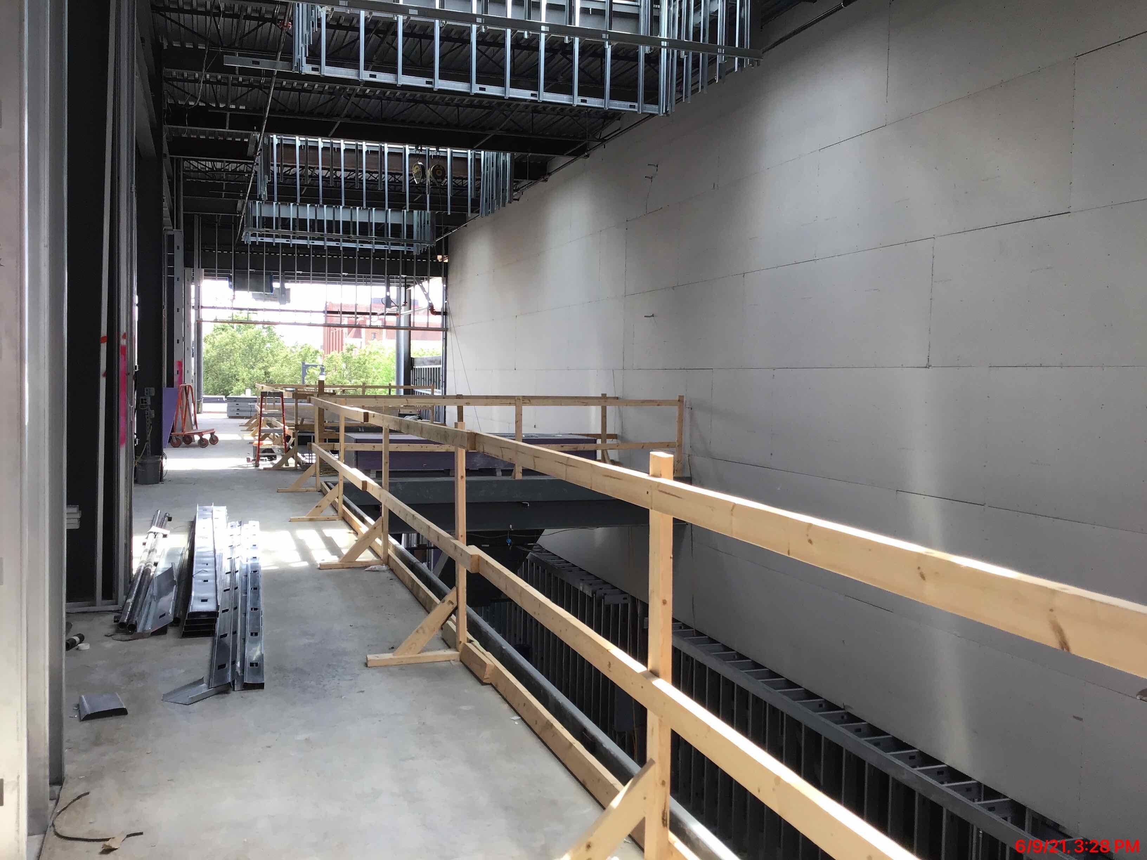
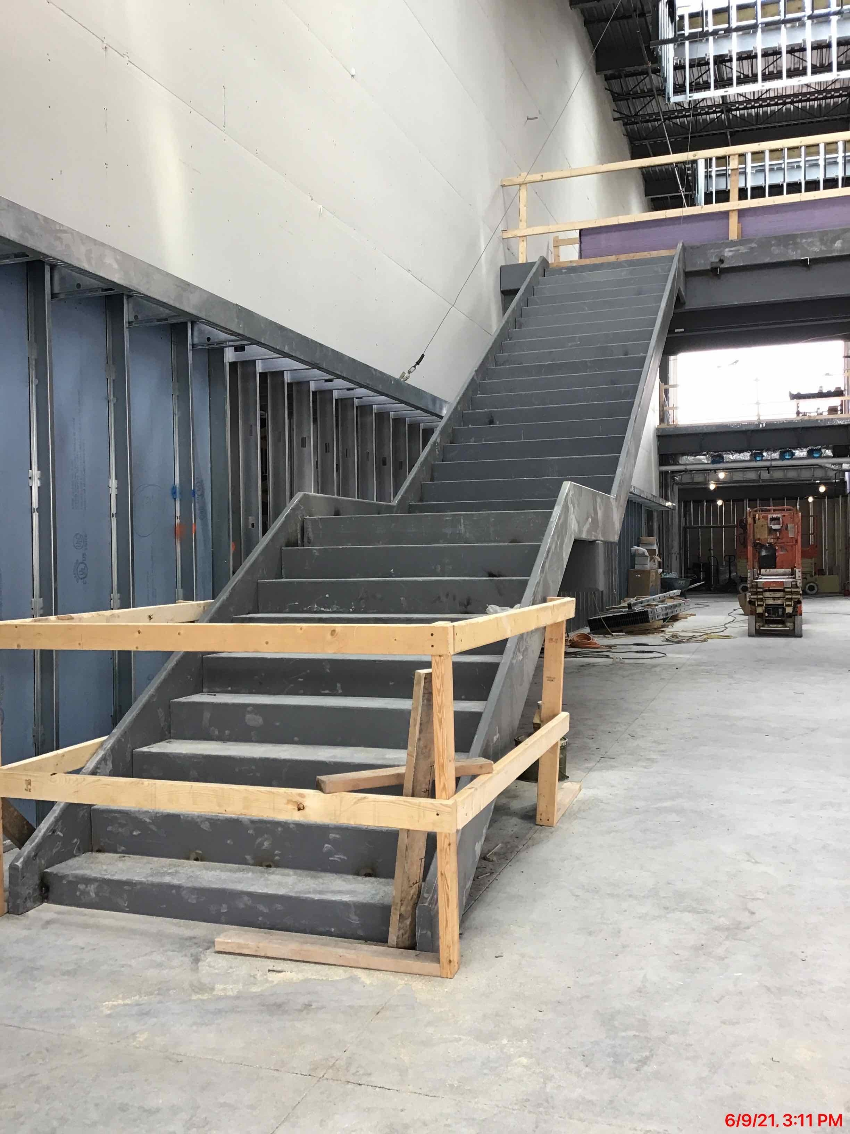
RECENT PROGRESS – Interior Drywall and Monumental Stair Installation

Slide 11
RECENT PROGRESS – Parking Garage Level 4 Reinforcing Steel

Slide 12
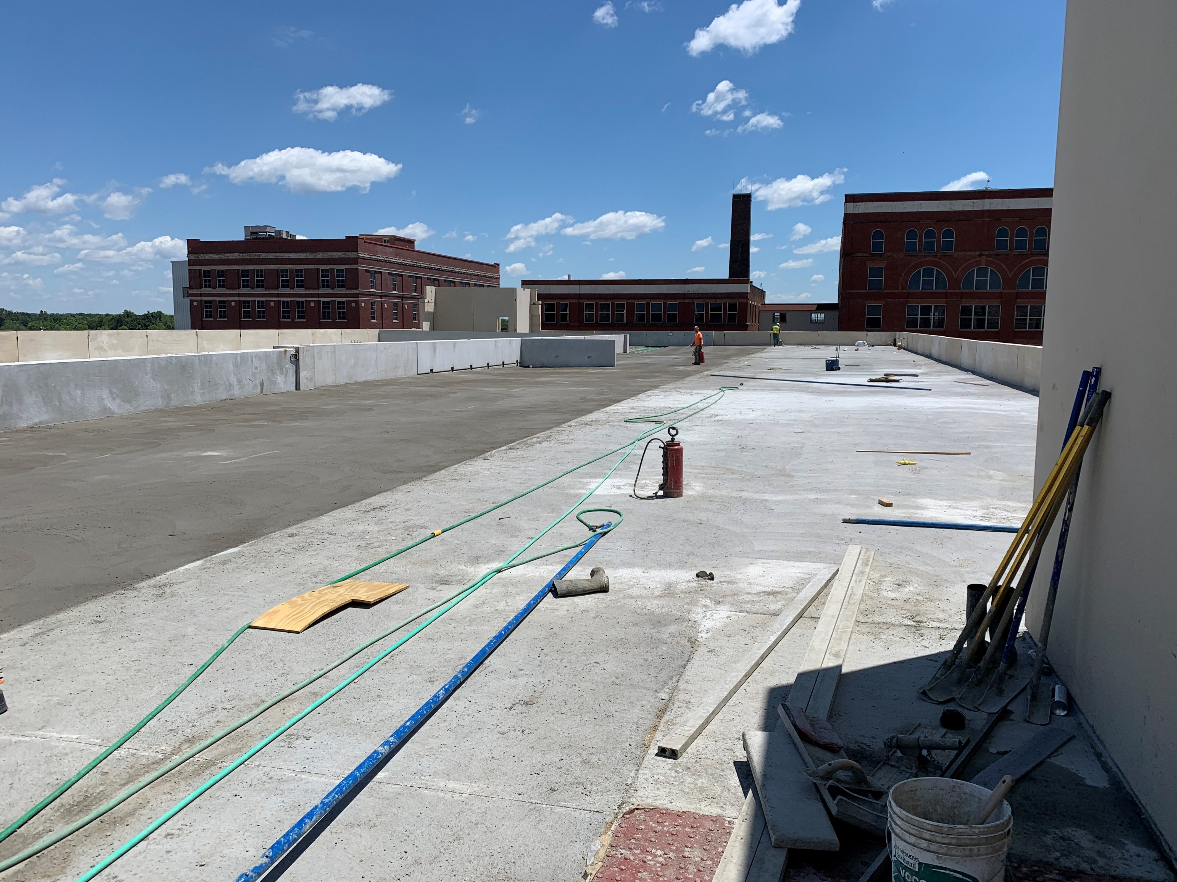
RECENT PROGRESS – Parking Garage Rooftop Concrete Slab

Slide 13
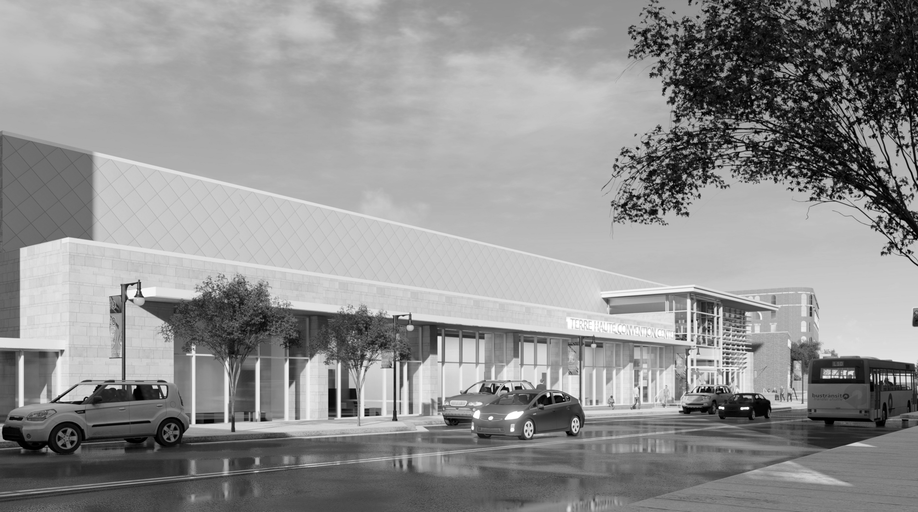
QUESTIONS?

