Slide 1
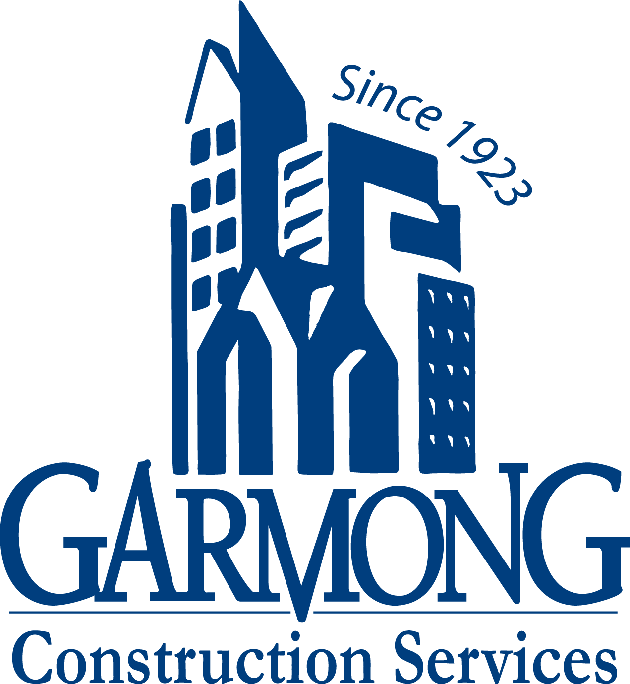
TERRE HAUTE CONVENTION CENTER
CONSTRUCTION UPDATE
December 2021

Slide 2
CONSTRUCTION OVERVIEW
Budget:
Current GMP amount is $27,108,324 (as of December 14th, 2021)
Changes from previous GMP: CO NO. 14; $33,290 (Graffiti sealer, added door, decorative panel at N entrance)
Schedule:
Project is on schedule. Original substantial completion date is April 27, 2022
Anticipated new substantial completion date is March 3, 2022.
Design:
Museum underslab electrical design received 12/14. Pricing is being developed.

Slide 3
CONSTRUCTION OVERVIEW
Recent progress:
Convention Center
Ceiling tile installation
Wood/fabric paneling substantially complete
Terrazzo flooring complete
Light fixture installation complete
Interior storefront and glazing complete
Sitework 95% complete
Asphalt paving complete
Irrigation and planting 95% complete, sod installation
HGI Connector dried-in and drywall hung
Decorative railing installation
Parking Garage
Parking Garage Elevators nearing completion
Parking Garage stairwell painting complete
Parking striping complete

Slide 4
CONSTRUCTION OVERVIEW
Upcoming activities:
Convention Center
Finish coat paint
Complete ceiling tile installation
Install restroom vanities
Install carpet
Install kitchen equipment
Install decorative panels
Begin door/hardware install
Mechanical equipment startup
Irrigation/planting complete
Connector substantially complete
Elevator inspection and final permit
Parking Garage
Elevator inspection and final permit
Parking garage completion

Slide 5
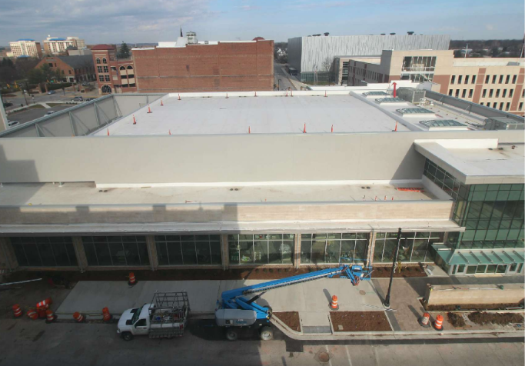
RECENT PROGRESS – Convention Center – November 2021

Slide 6
RECENT PROGRESS – Main entrance

Slide 7
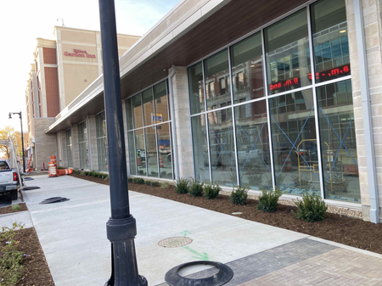
RECENT PROGRESS – South Elevation

Slide 8
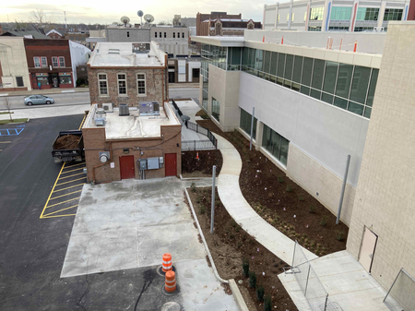
RECENT PROGRESS – East Elevation

Slide 9
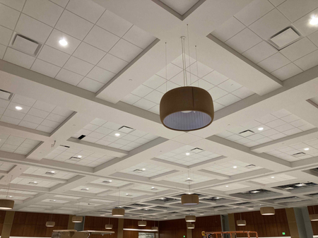
RECENT PROGRESS – Ballroom

Slide 10
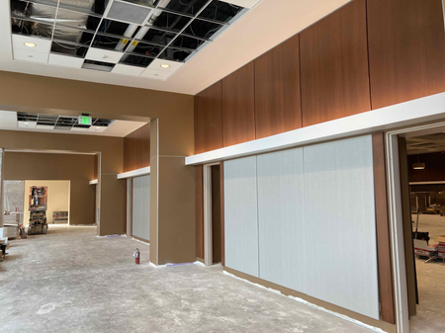
RECENT PROGRESS – Pre-function Area

Slide 11
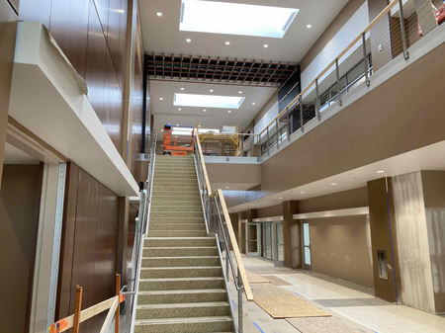
RECENT PROGRESS – Lobby

Slide 12
RECENT PROGRESS – Monumental Stair & Decorative Railing

Slide 13
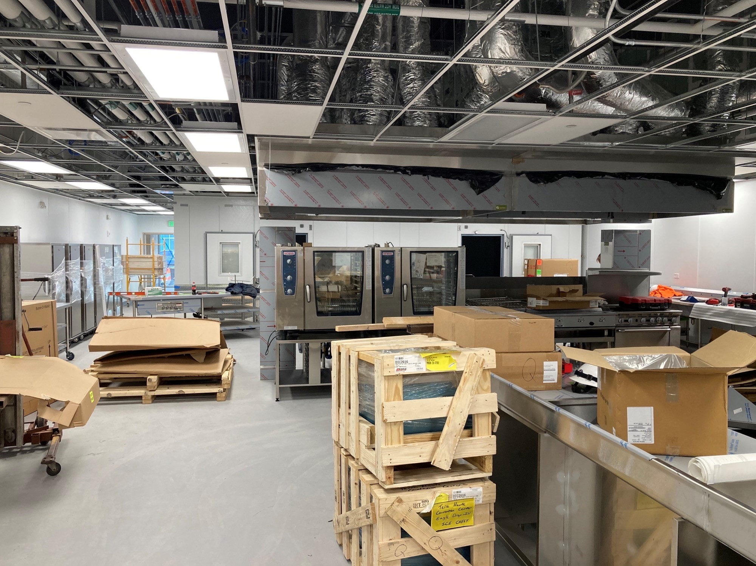
RECENT PROGRESS – Kitchen Equipment Installation

Slide 14
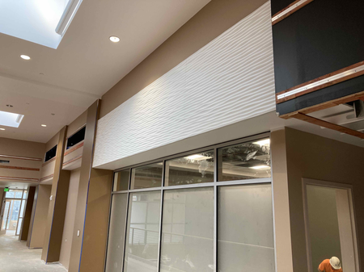
RECENT PROGRESS – Lobby Decorative Panels

Slide 15
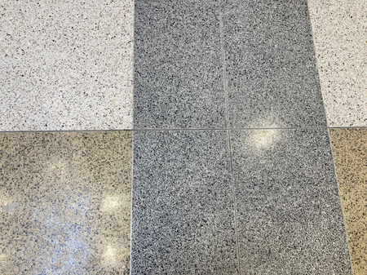
RECENT PROGRESS – Terrazzo Flooring

Slide 16
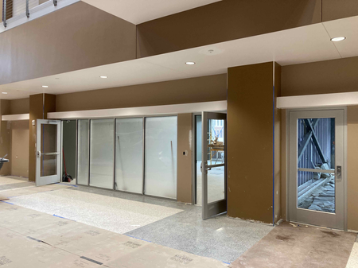
RECENT PROGRESS – Meeting Room Mullions

Slide 17
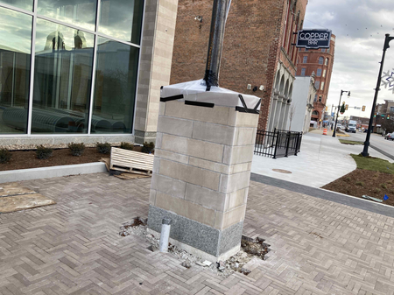
RECENT PROGRESS – Limestone Sign

Slide 18
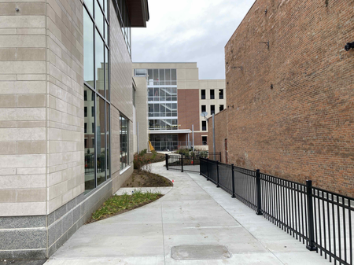
RECENT PROGRESS – East Elevation

Slide 19
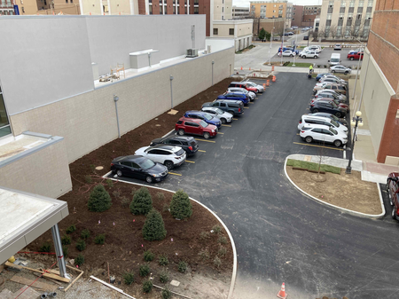
RECENT PROGRESS – Convention Center North Parking

Slide 20
RECENT PROGRESS – Parking Garage West Elevation

Slide 21
RECENT PROGRESS – Parking Garage North Elevation

Slide 22
RECENT PROGRESS – Parking Garage East Elevation

Slide 23
RECENT PROGRESS – Parking Garage South Elevation

Slide 24
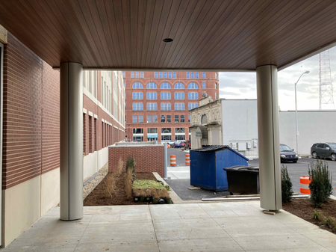
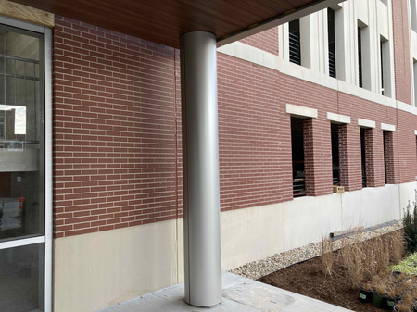
RECENT PROGRESS – Parking Garage South Entrance Canopy Column Covers

Slide 25
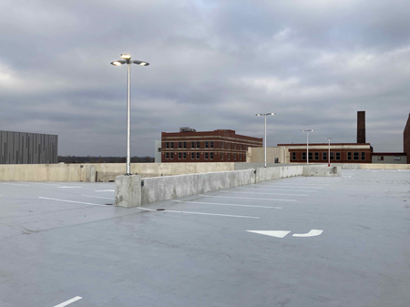
RECENT PROGRESS – Parking Garage 5th Floor

Slide 26
RECENT PROGRESS – HGI Connector

Slide 27
RECENT PROGRESS – HGI Connector Interior

Slide 28
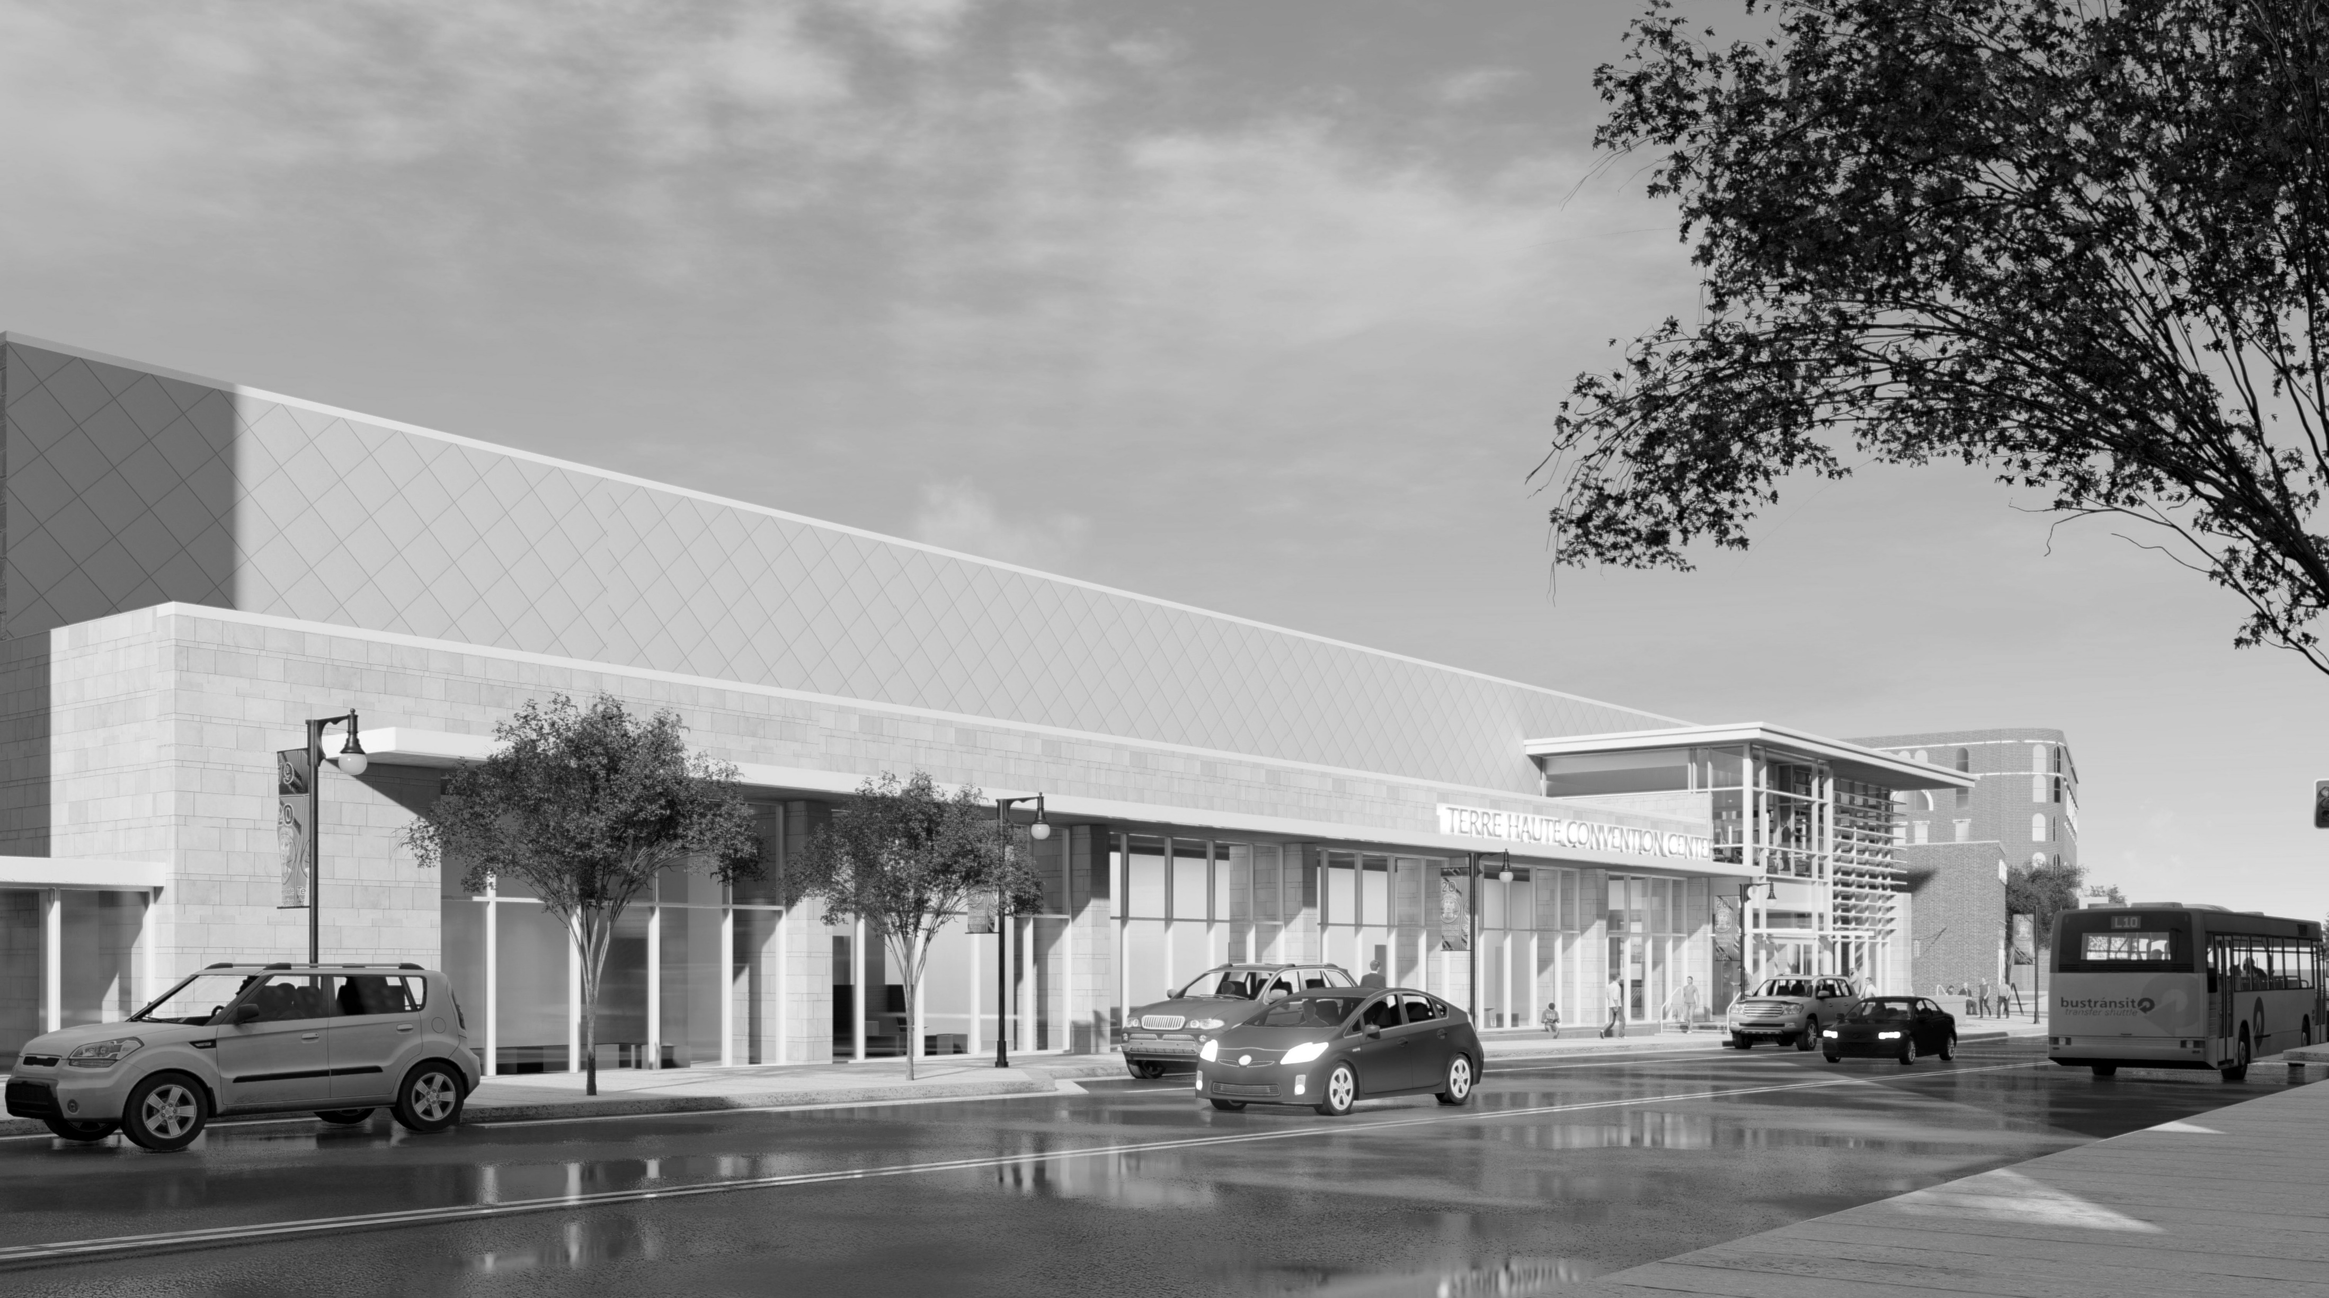
QUESTIONS?

