Slide 1
TERRE HAUTE CONVENTION CENTER
CONSTRUCTION UPDATE
JUNE 2020

Slide 2
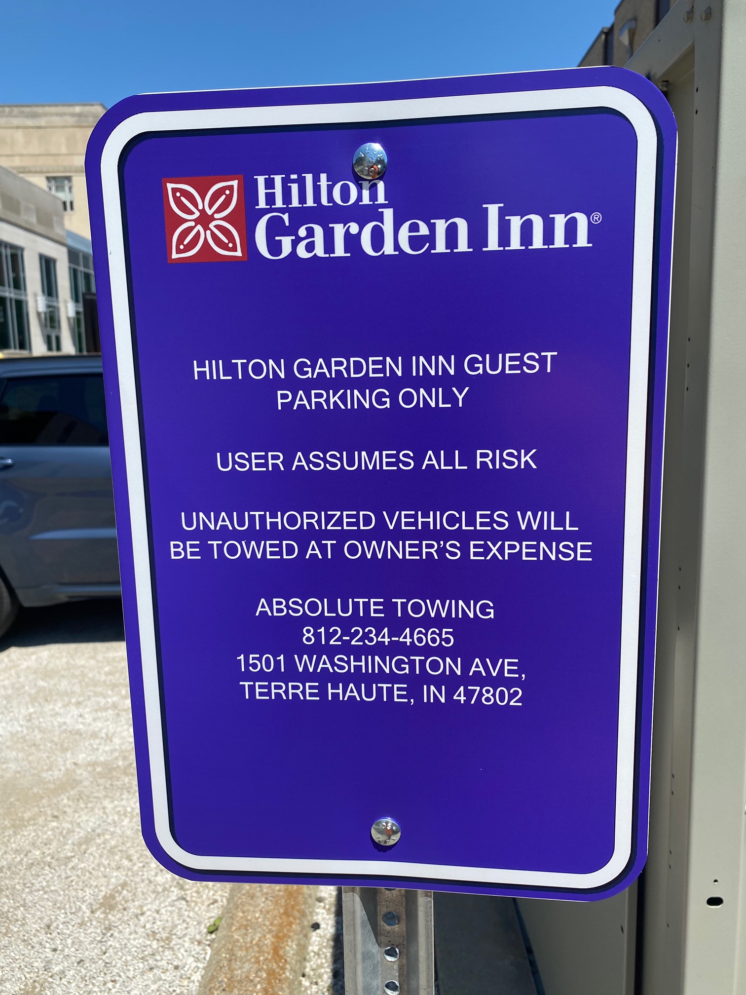
RECENT PROGRESS
Phase One Utilities
Sanitary sewer
Grease trap
Storm sewer
Electrical conduits
Transformer bases
Gas service
Installation of HGI signage on VCSC lots

Slide 3
RECENT PROGRESS – Plan View

Slide 4
RECENT PROGRESS – Plan View

Slide 5
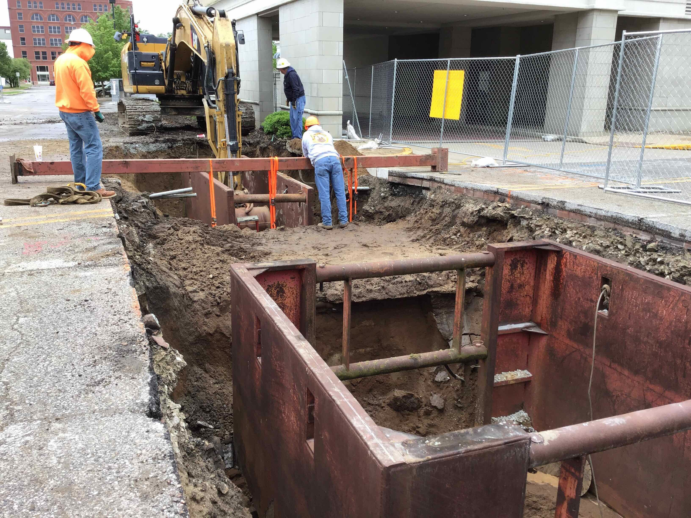
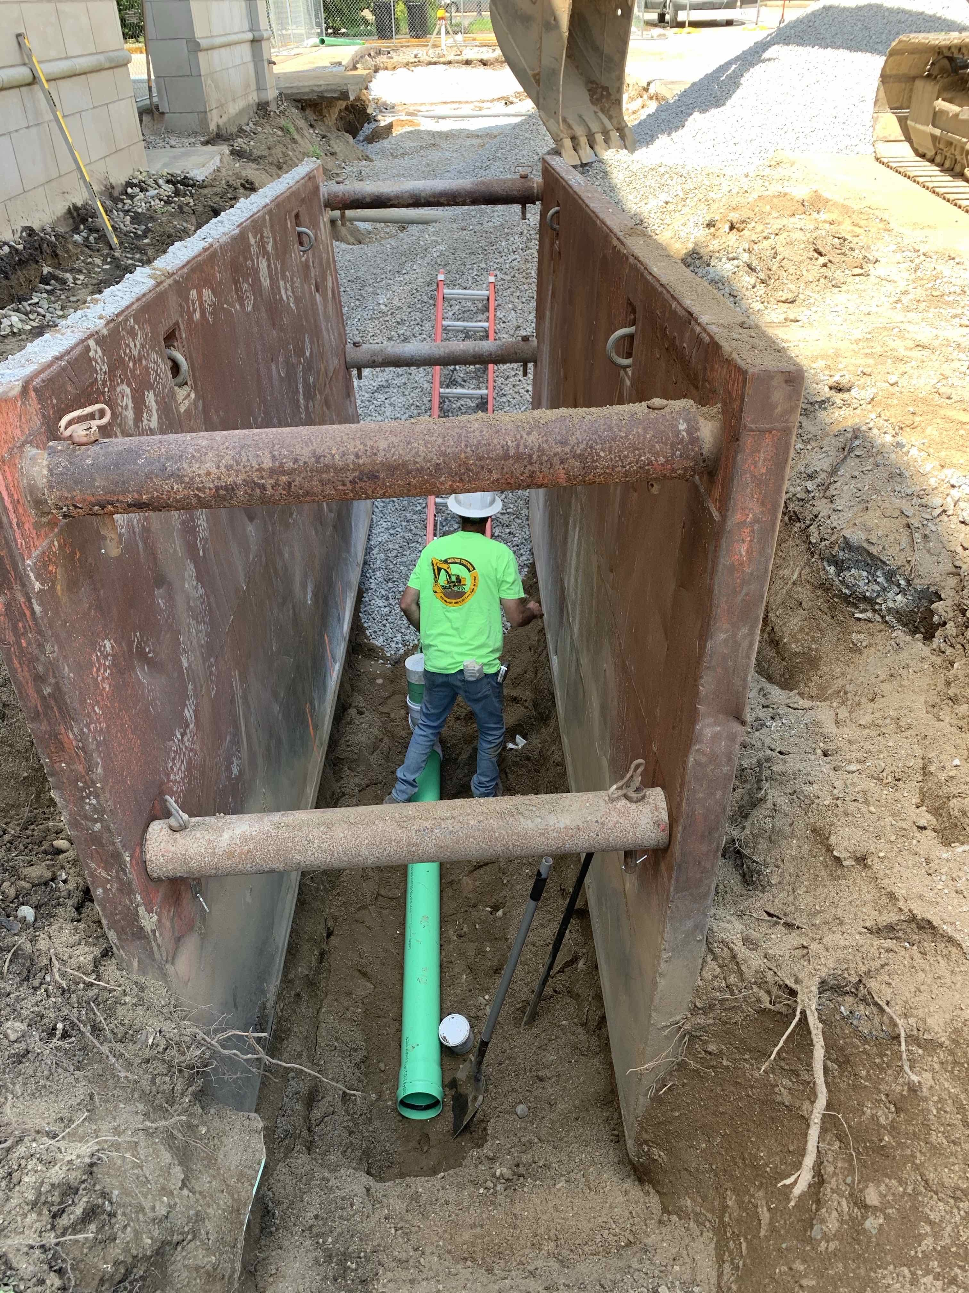
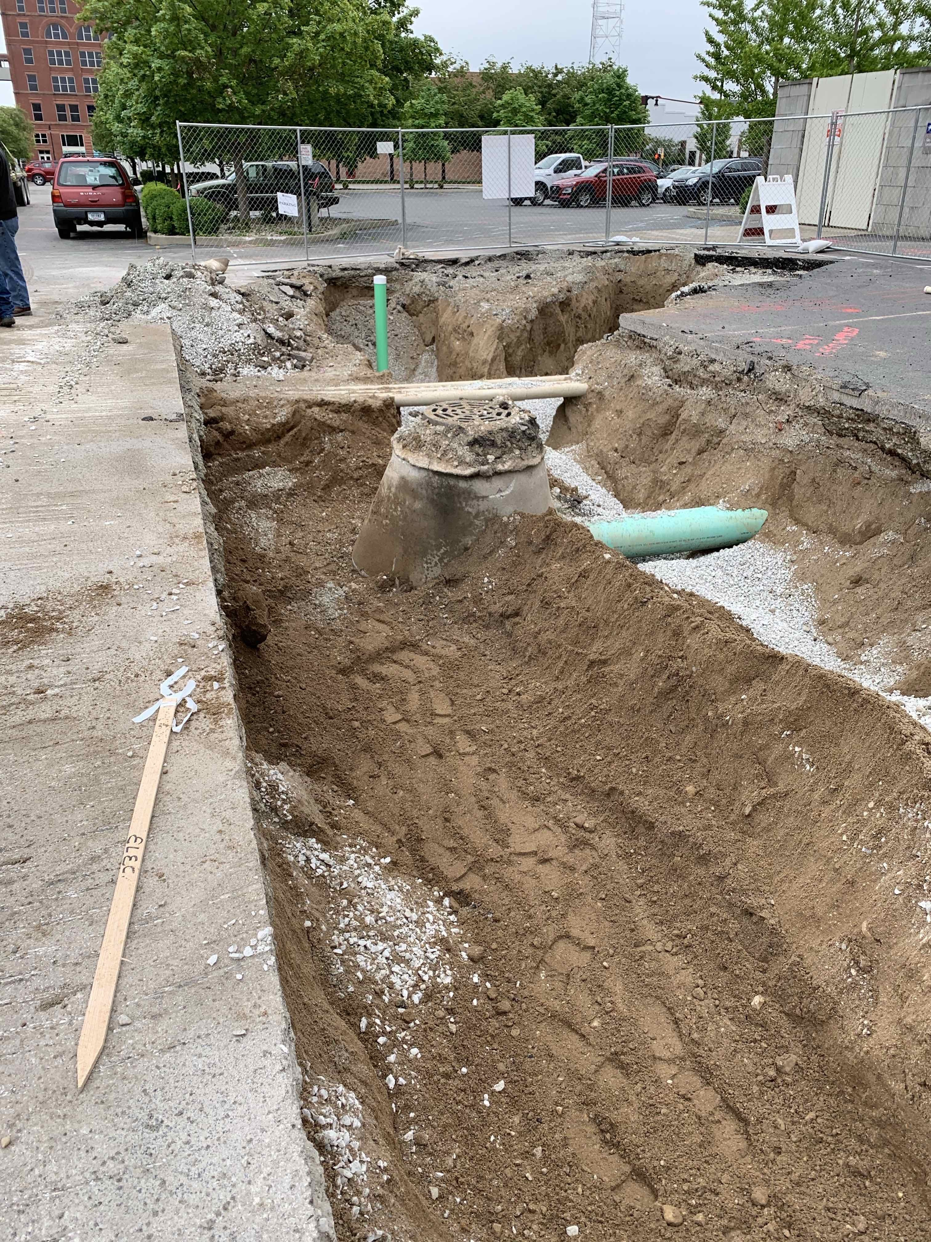
RECENT PROGRESS – Sanitary Sewer

Slide 6
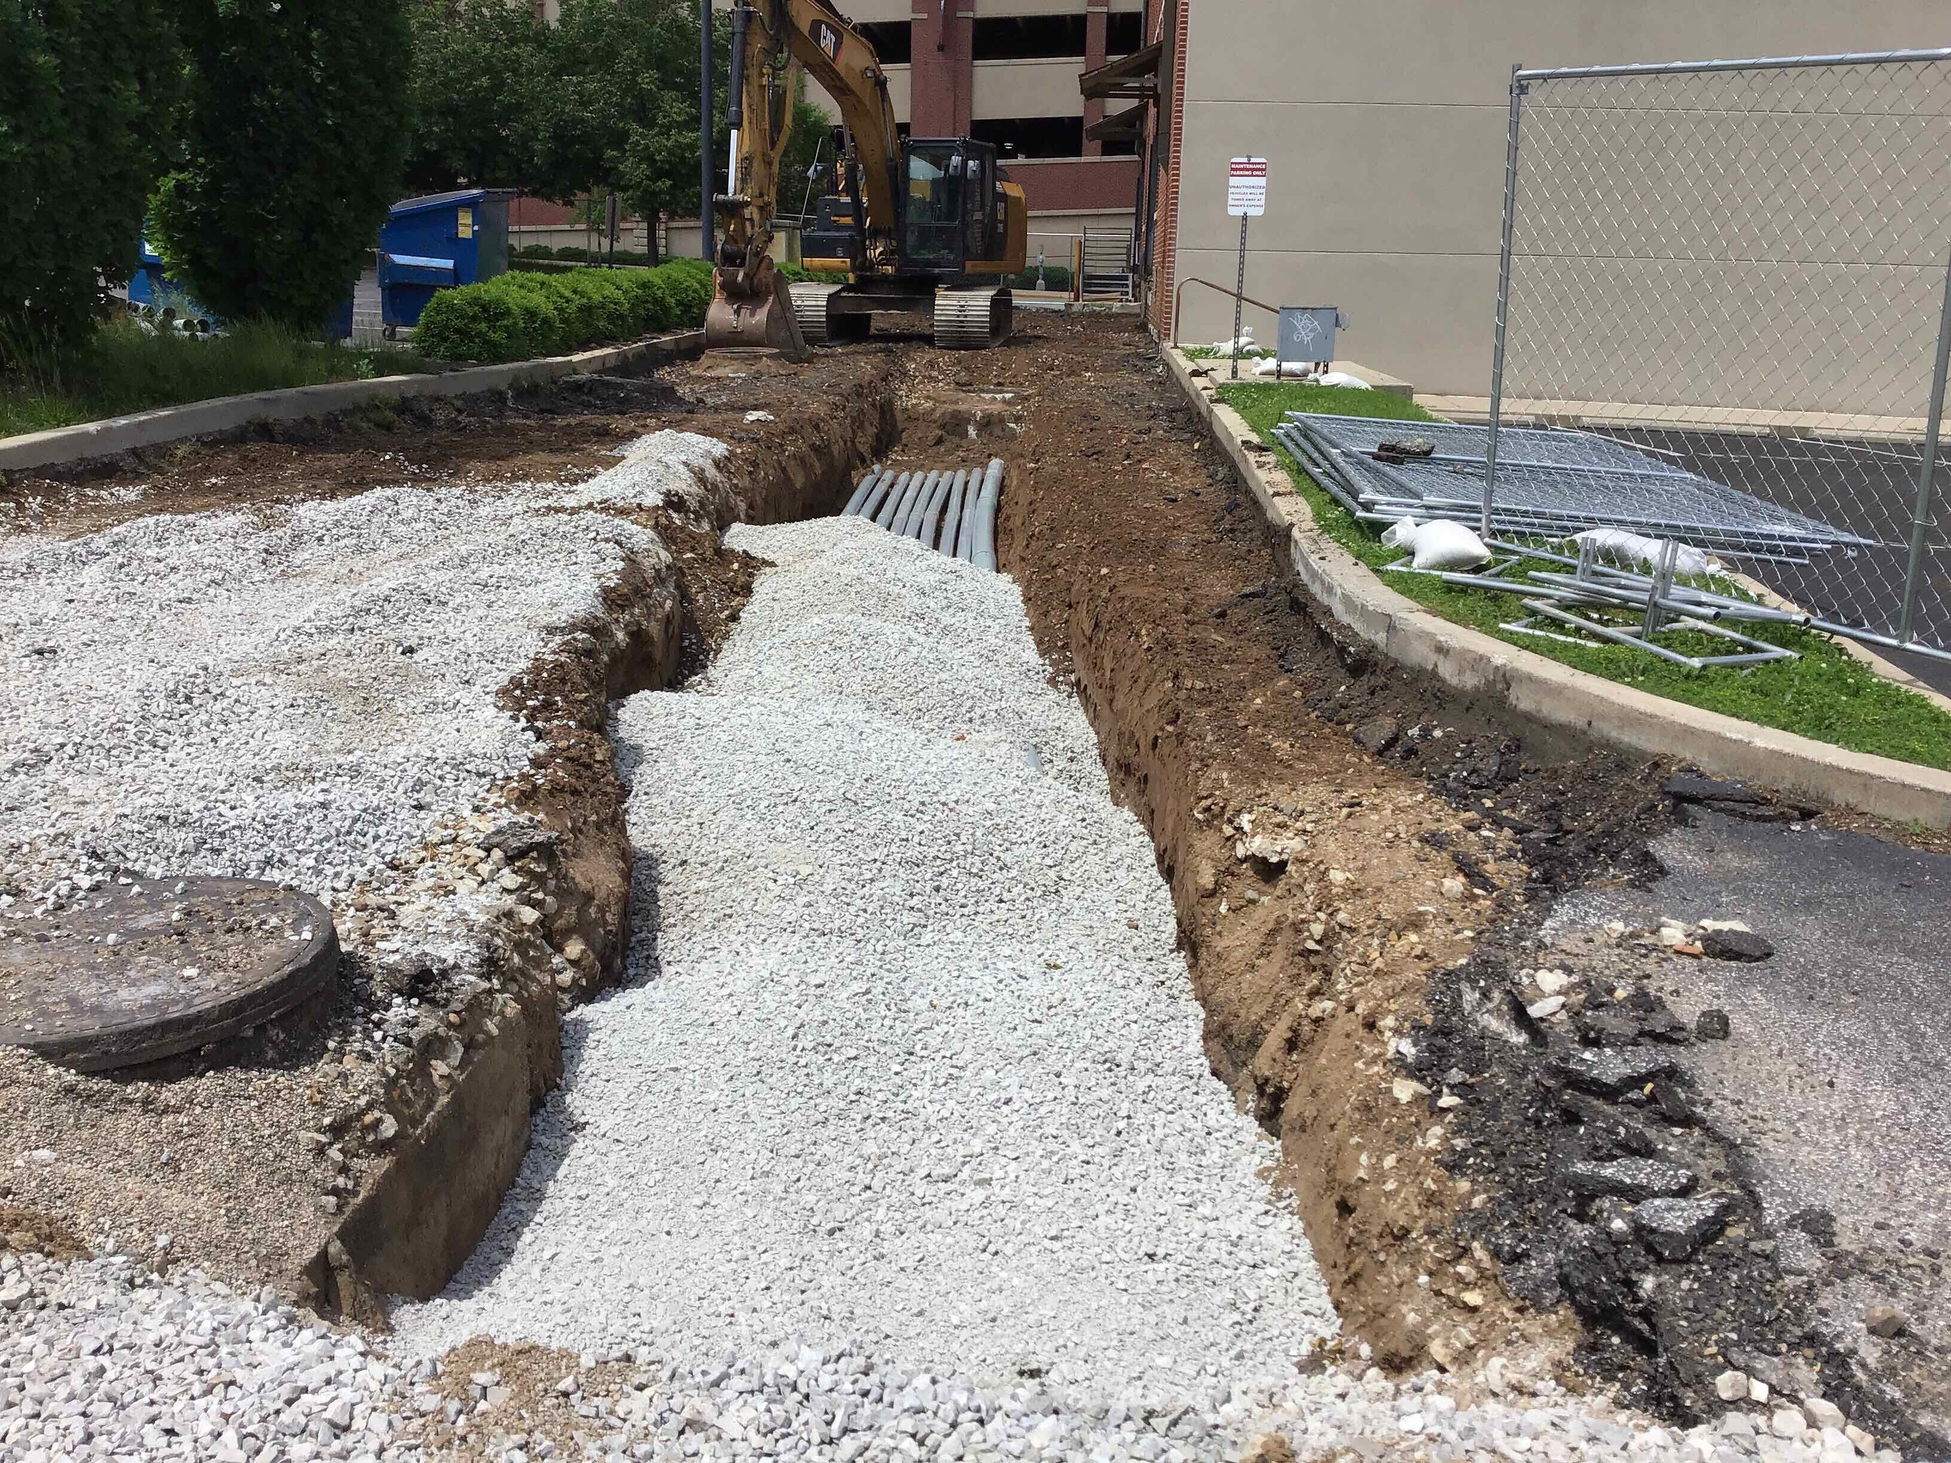
RECENT PROGRESS – Electrical Conduits

Slide 7
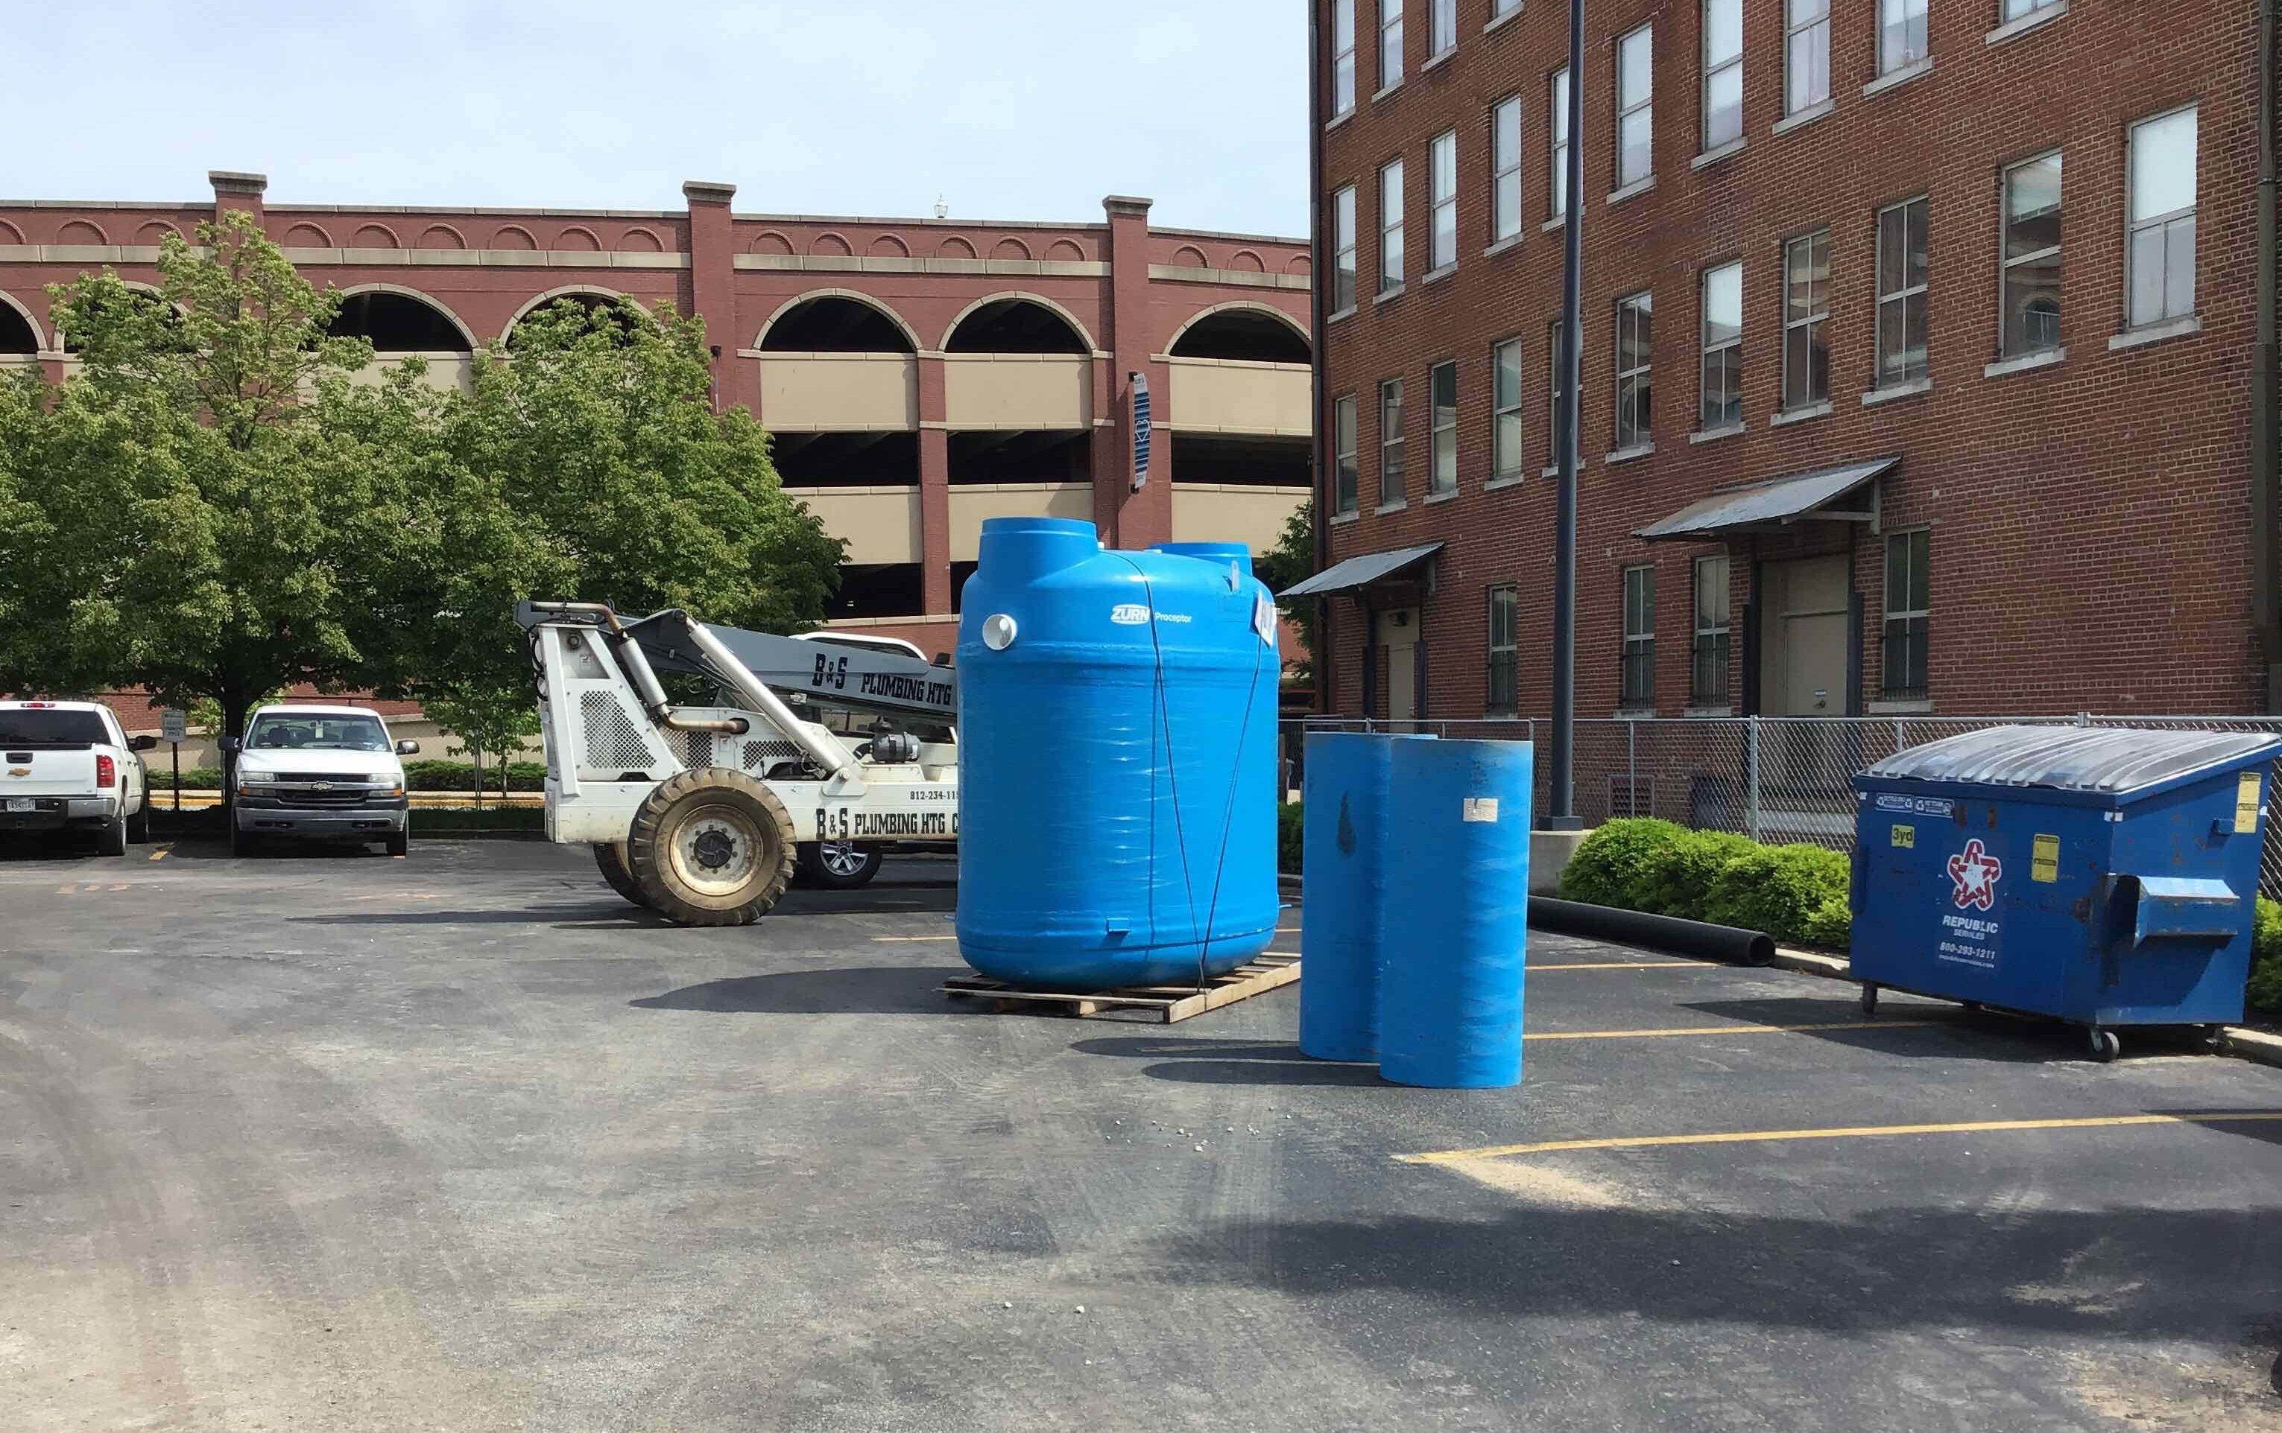
RECENT PROGRESS – Grease Trap

Slide 8
UPCOMING ACTIVITIES
Continuation of utility installations to the east
Installation of Storm Trap on HGI north lot
Restoration of HGI north lot
Closing of 8th Street permanently

Slide 9
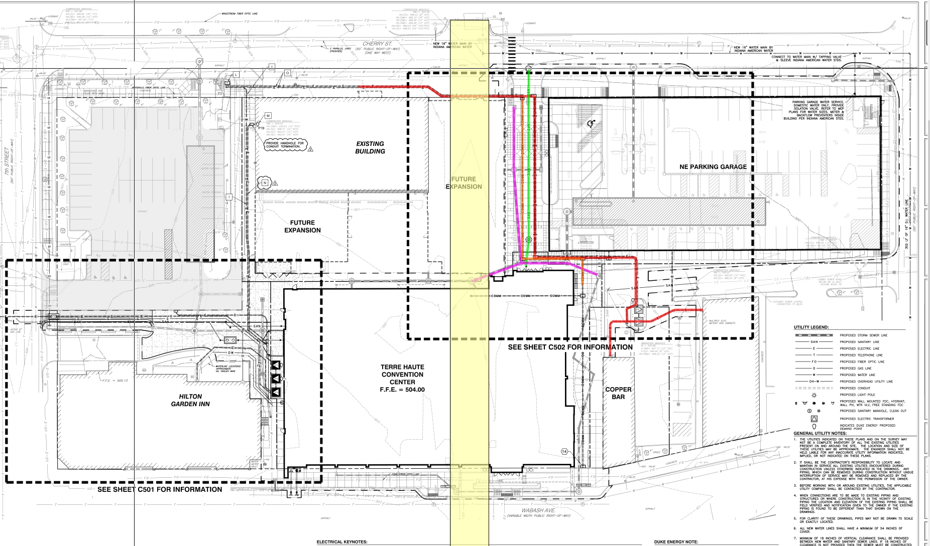
UPCOMING ACTIVITIES – Plan View

Slide 10
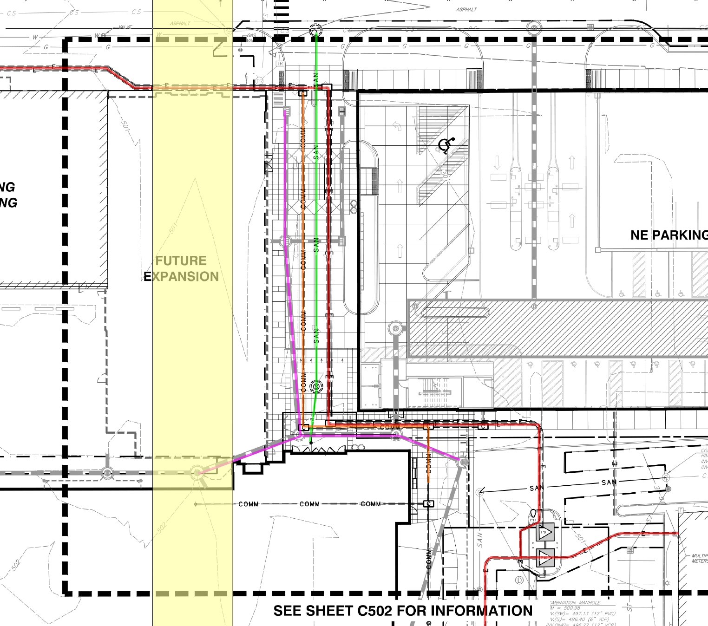
UPCOMING ACTIVITIES – Plan View

Slide 11
STORM TRAPS

Slide 12
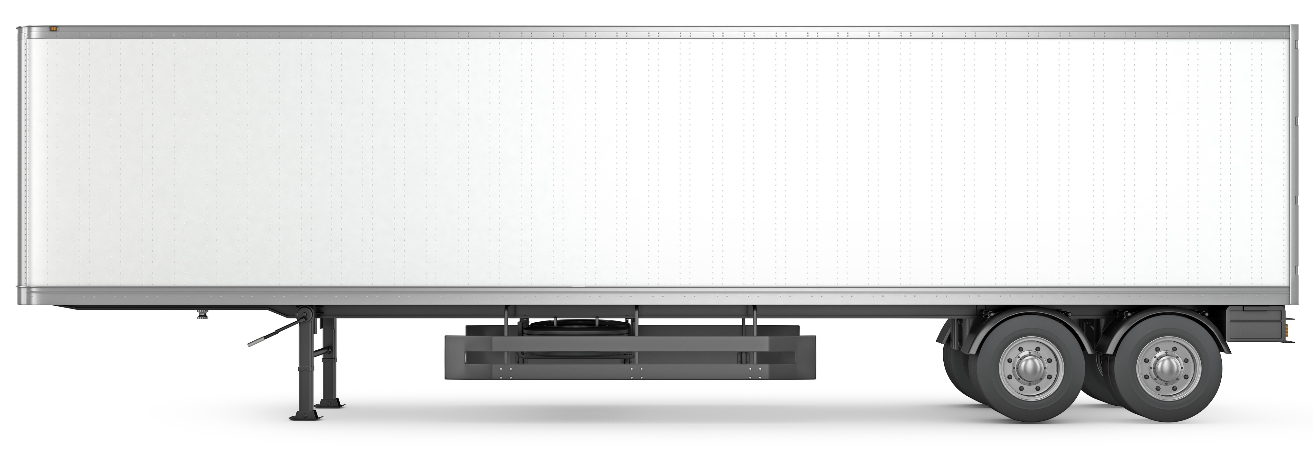
WHAT IS A STORM TRAP?
Storm Trap is the manufacturer’s name
Underground storm water containment & discharge system
Provides storm drainage solutions where retention ponds or discharging off-site is not feasible
HGI north lot: 25’ x 100’ x 9’
CC parking garage: 25’ x 150’ x 9’

Slide 13
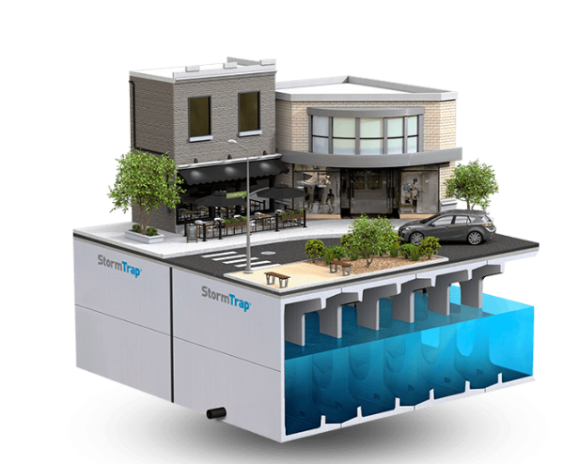
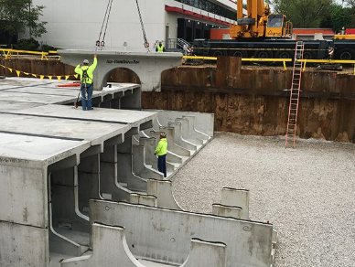
WHAT IS A STORM TRAP?

Slide 14
PROJECT SCHEDULE
Start date: April 22, 2020
Completion date: April 27, 2022
Project is on schedule
Upcoming Milestones:
North lot storm trap delivery: July 27
Close 8th street permanently: August 31
Phase One work complete, returned to HGI: September 11
Begin Phase Two work: September 15

Slide 15
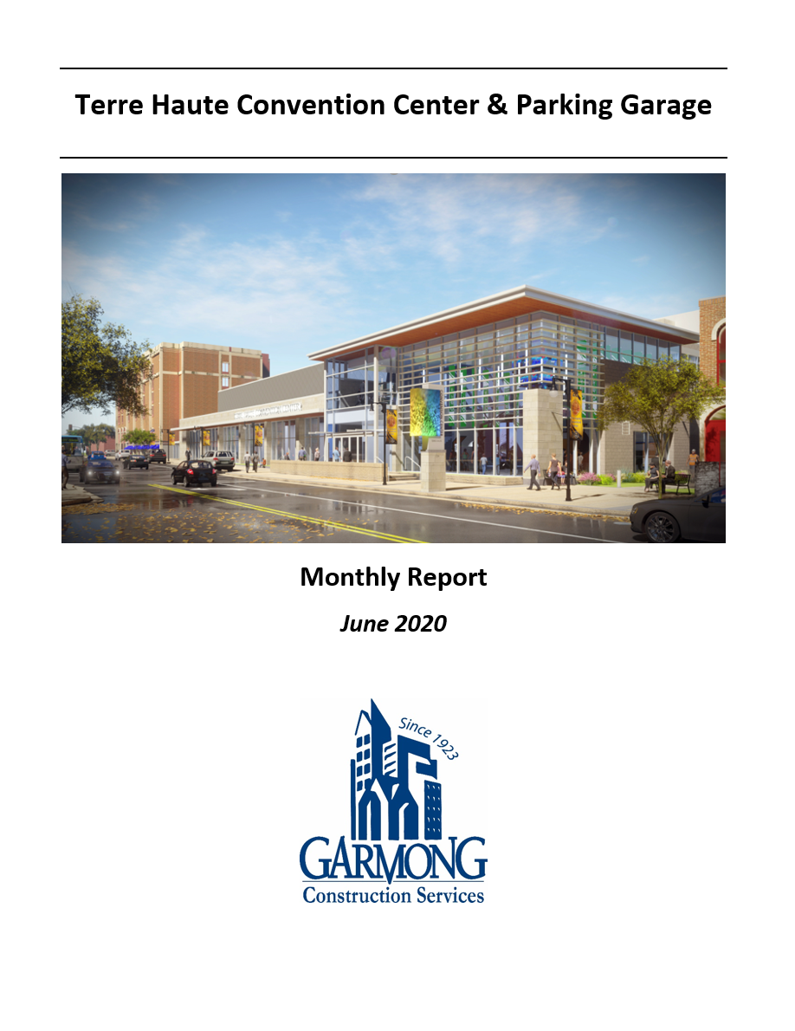
MONTHLY CONSTRUCTION REPORTS
Distribution now includes all CIB members
Reports contain the following:
Executive Summary
Construction Budget Summary
Updated Schedule
Photos

Slide 16
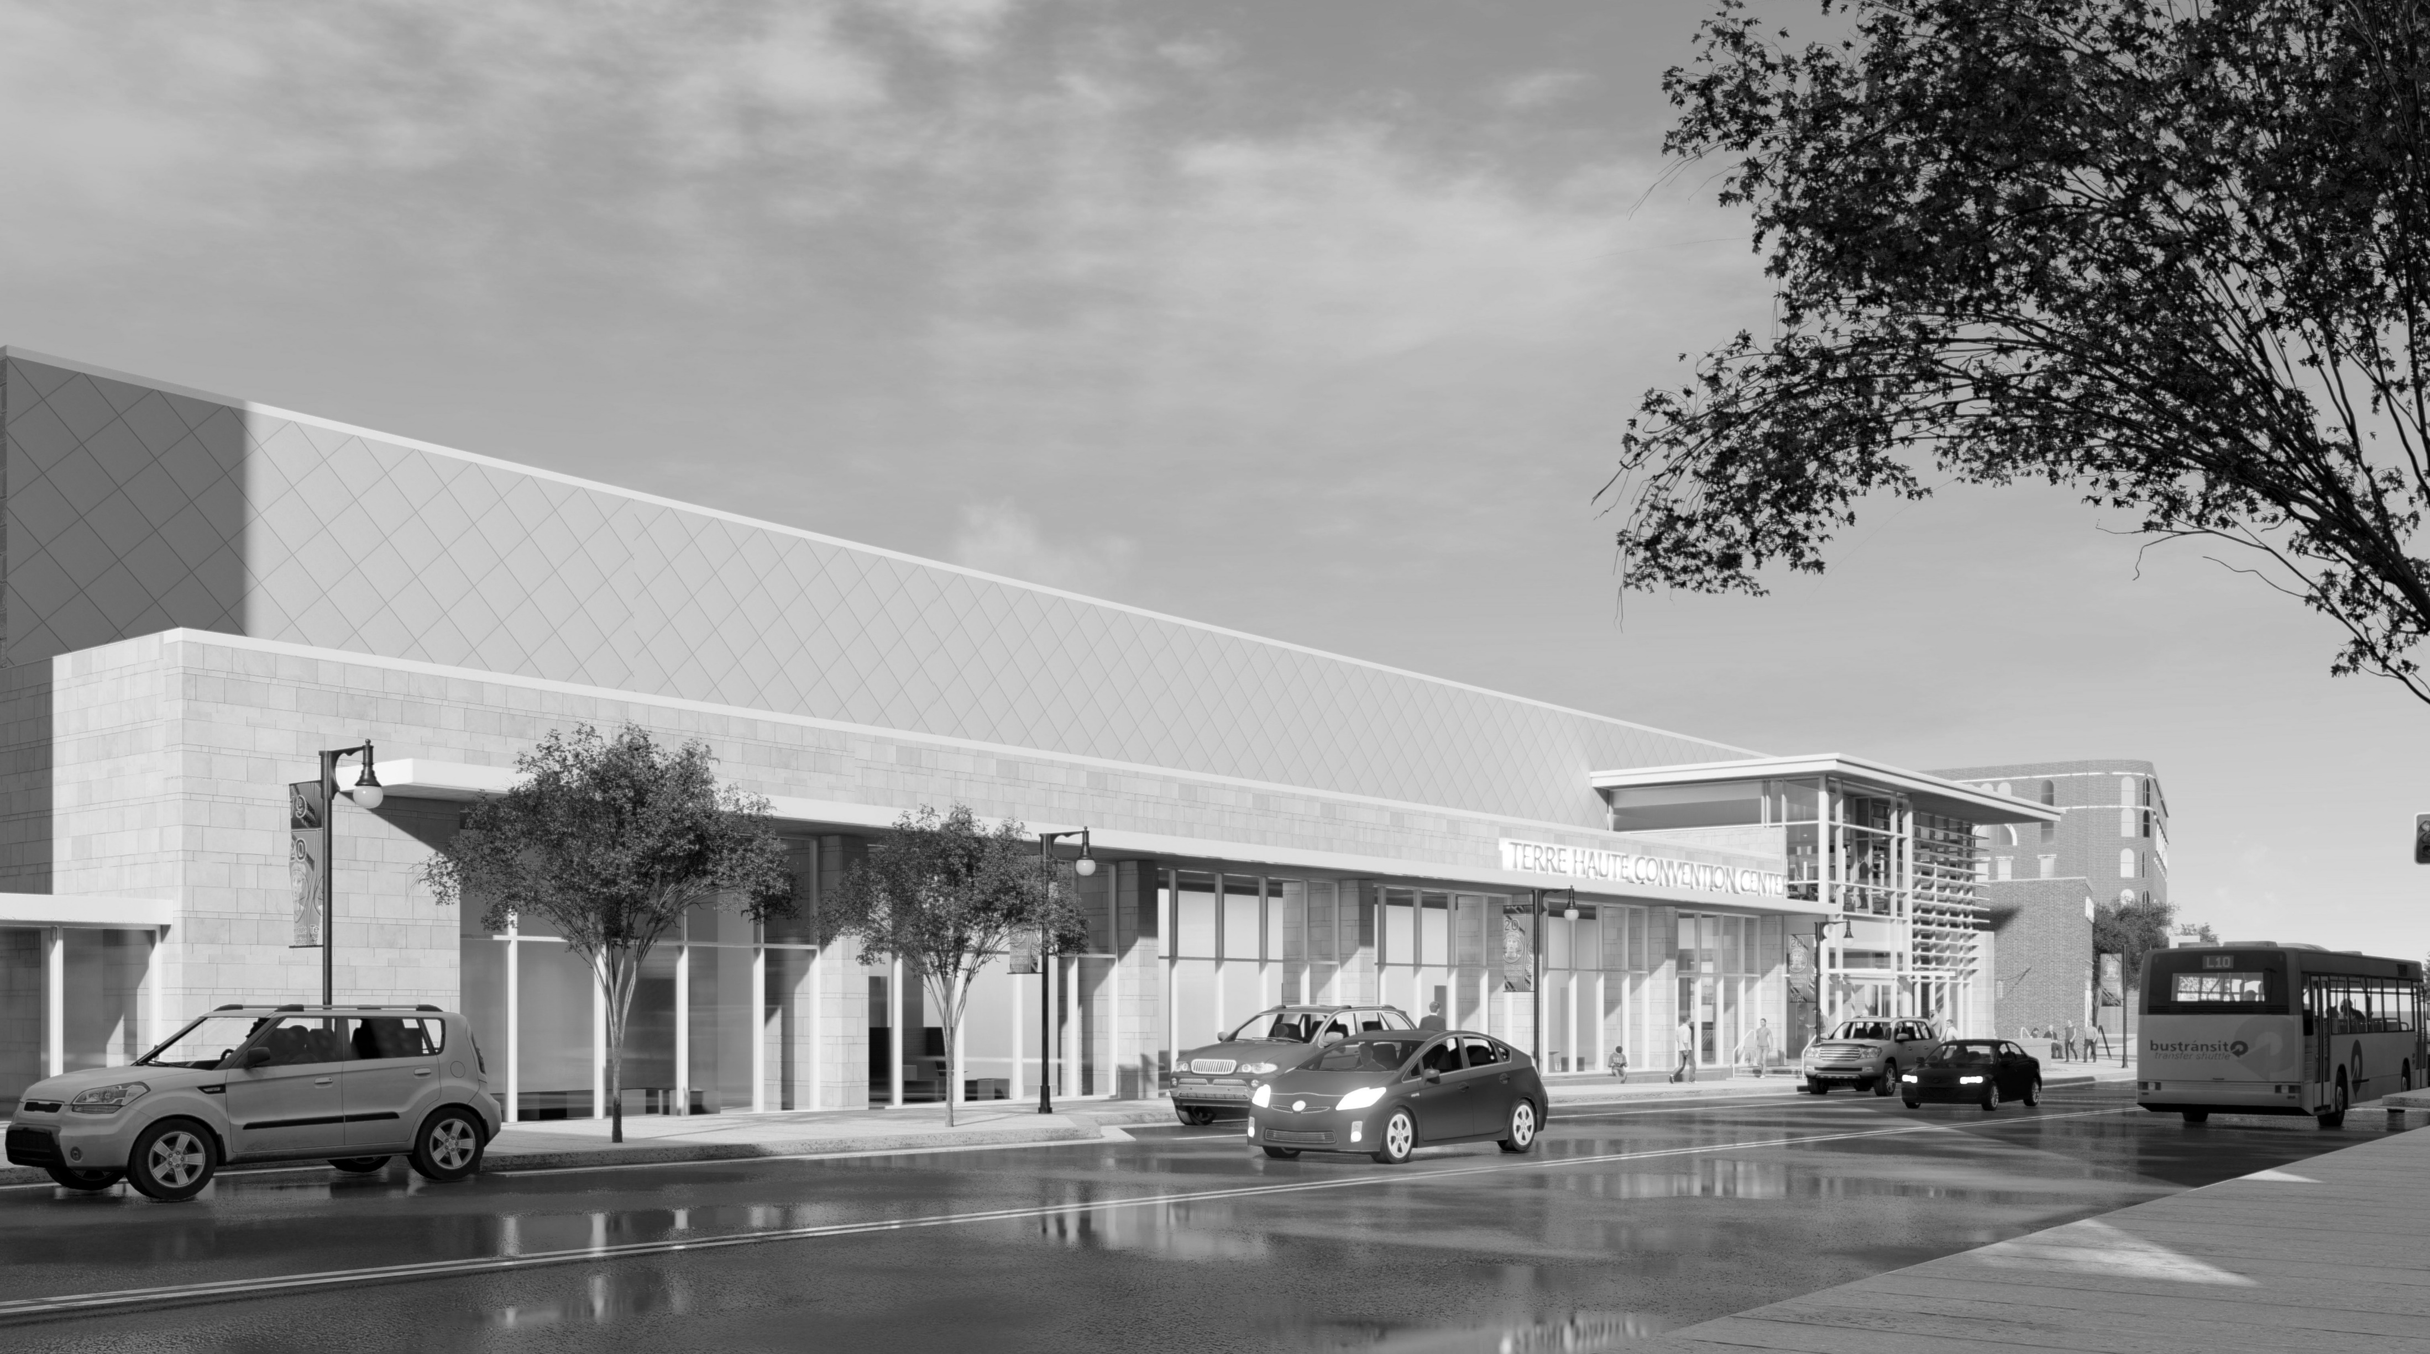
QUESTIONS?

