Slide 1
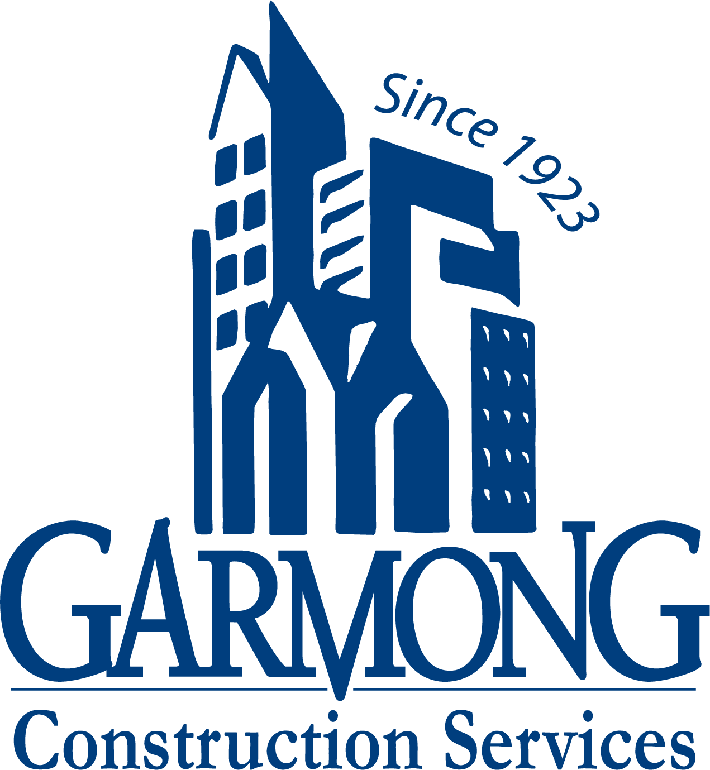
TERRE HAUTE CONVENTION CENTER
CONSTRUCTION UPDATE
February 2021

Slide 2
CONSTRUCTION OVERVIEW
Budget:
Current GMP amount is $26,325,510
Schedule:
Project is on schedule. Substantial completion date is April 27, 2022
Recent progress:
NE Garage precast panel installation has begun (25 of 370 pieces erected)
Structural Steel work is complete at Convention Center with detailing and decking ongoing
Convention Center exterior framing and sheathing has begun
Convention Center Slab on Grade and underslab MEP work continues
Mock-up has undergone architectural review

Slide 3
CONSTRUCTION OVERVIEW
Upcoming activities:
NE Garage
Precast concrete installation
Convention Center
Completion of under slab plumbing
Concrete slab on grade
Steel stair installation
Exterior framing and sheathing

Slide 4
RECENT PROGRESS – Convention Center Structural Steel nearing completion

Slide 5
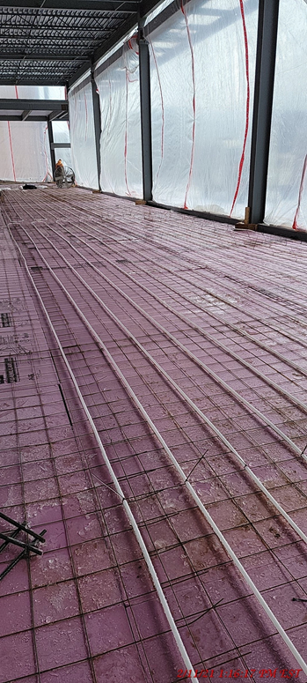
RECENT PROGRESS – Convention Center Framing & Sheathing And Radiant Heat Flooring in Pre-function Area

Slide 6
RECENT PROGRESS – NE Garage Pre-cast panel erection has begun

Slide 7
RECENT PROGRESS – Mock-up for architectural review

Slide 8
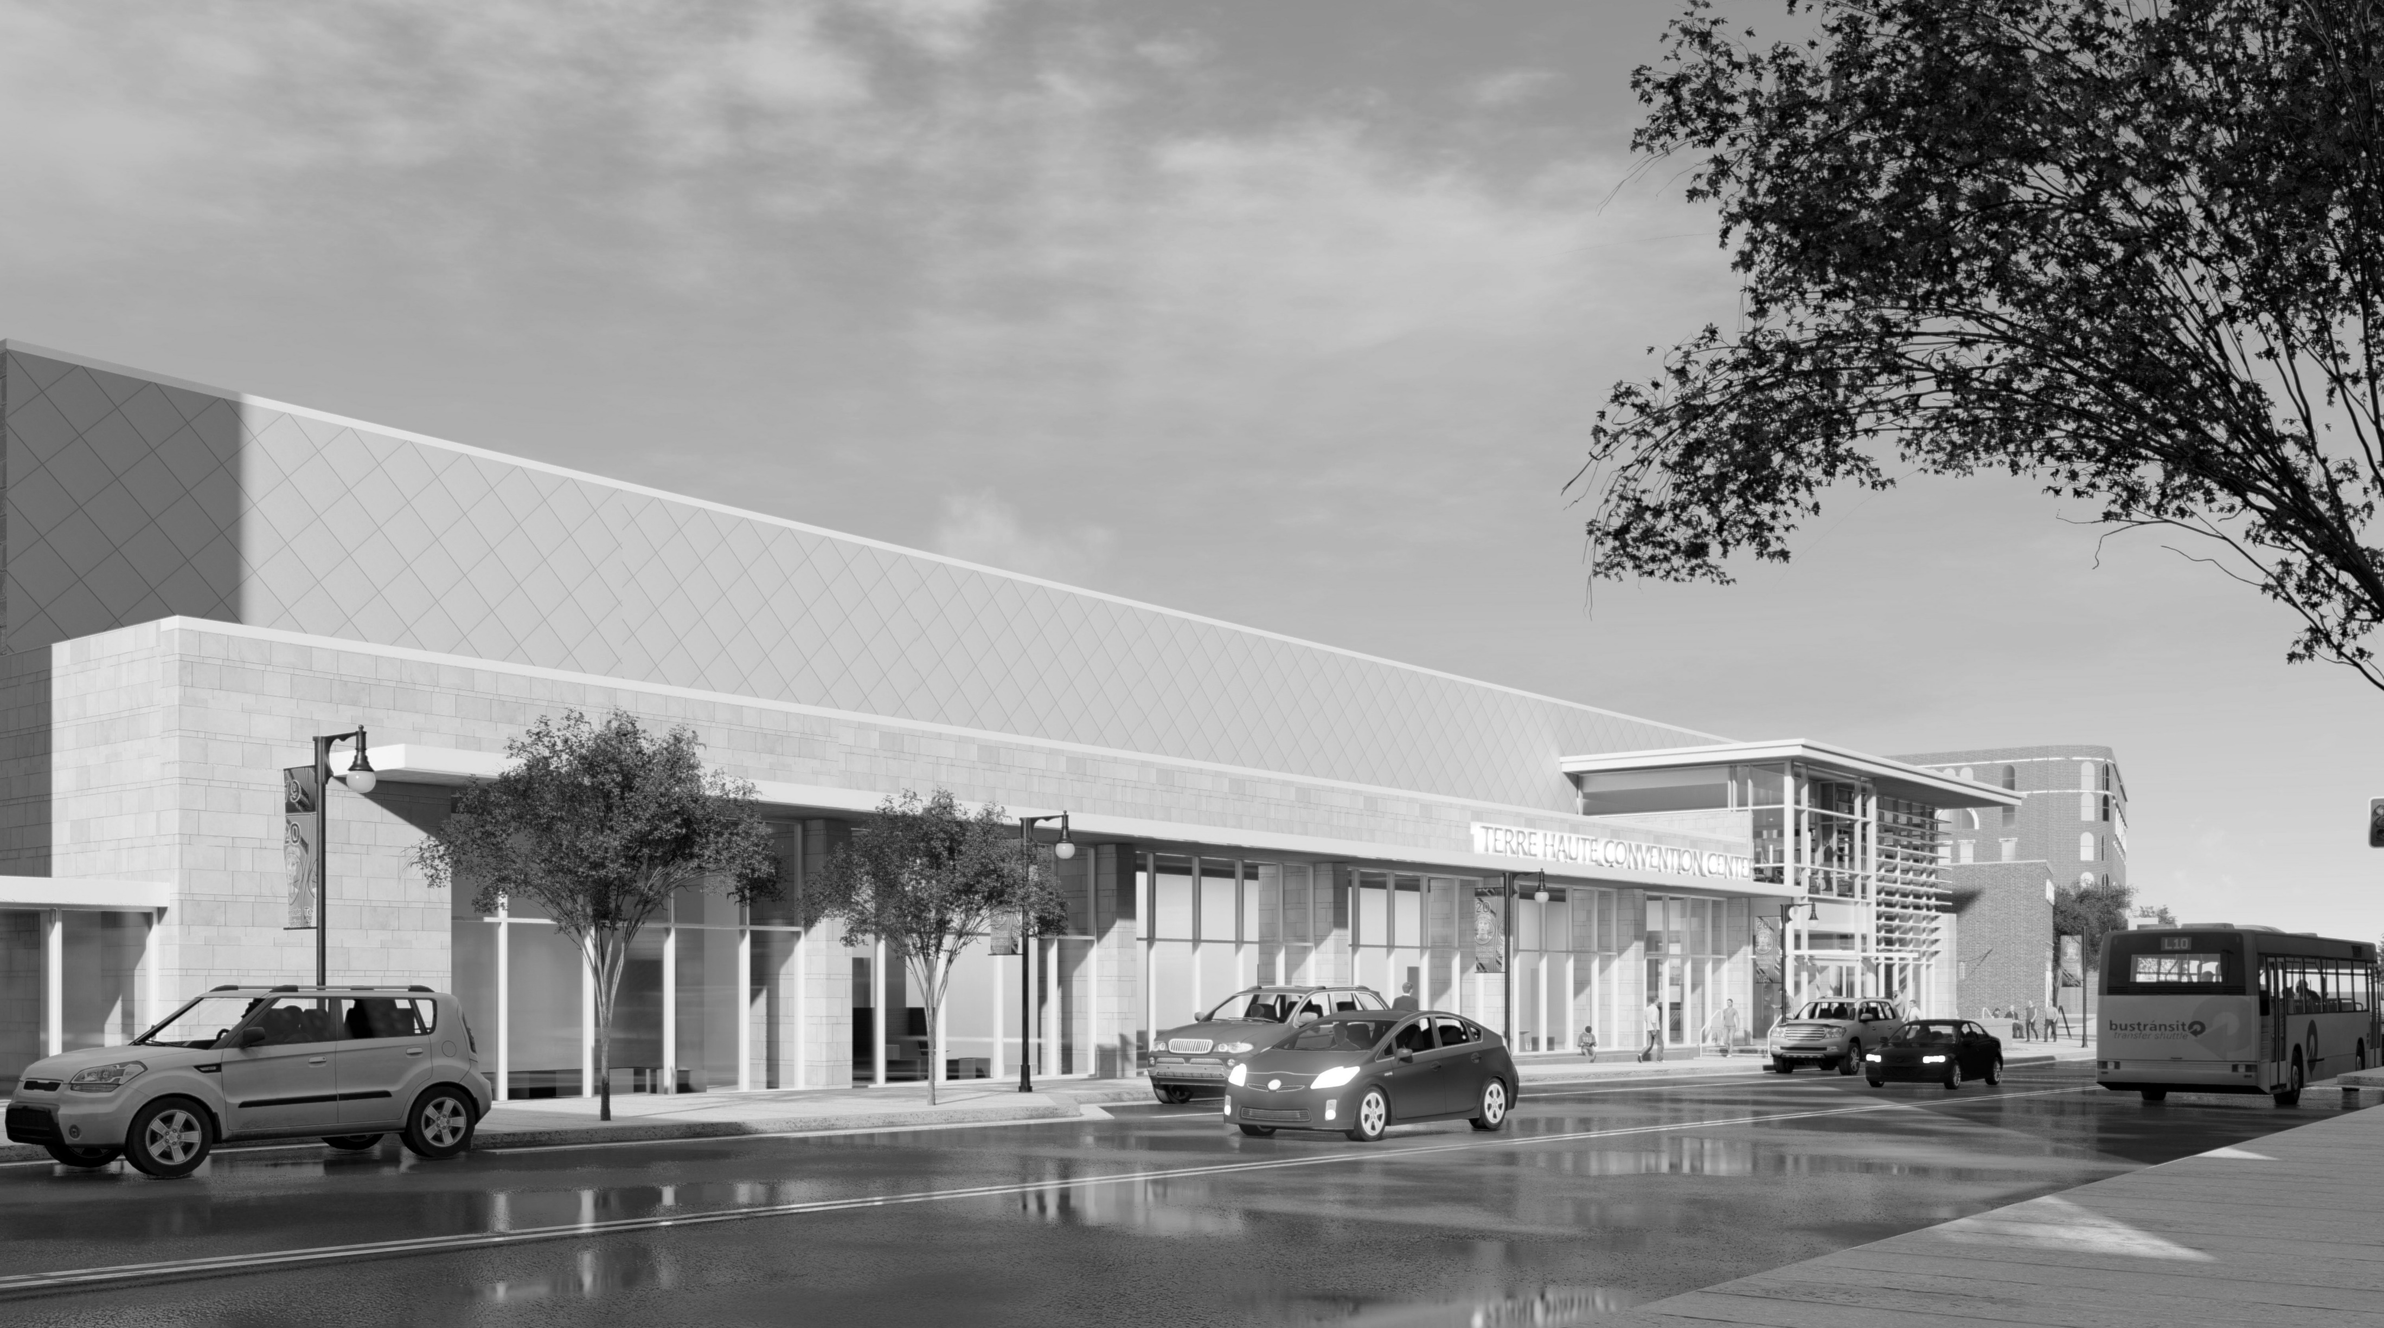
QUESTIONS?

