Slide 1
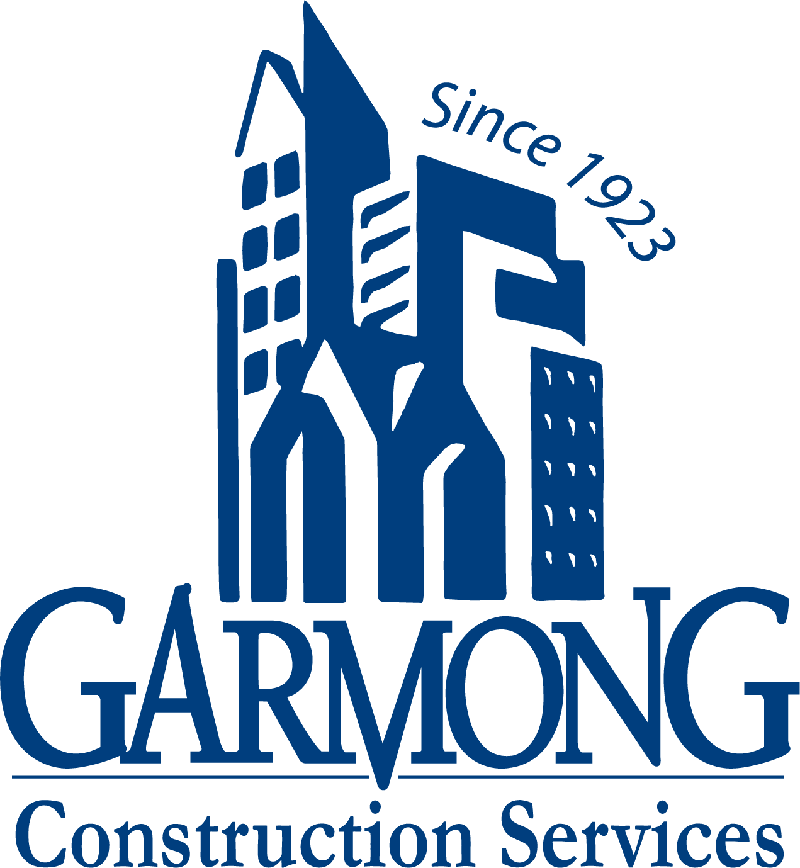
TERRE HAUTE CONVENTION CENTER
CONSTRUCTION UPDATE
September 2020

Slide 2
CONSTRUCTION OVERVIEW
Project remains on schedule and within budget
Recent progress:
Restoration of HGI north lot completed by September 11, 2020
Permanent closing of 8th Street occurred on September 14, 2020
New fencing erected from HGI to Copper Bar
Upcoming activities:
Convention Center site demolition (East lot of HGI to Copper Bar)
HGI water meter pit switchover
Auger cast piles: Mobilization taking place Monday, September 21st
NE Garage site demo and prep for Storm Trap (delivery in early October)

Slide 3
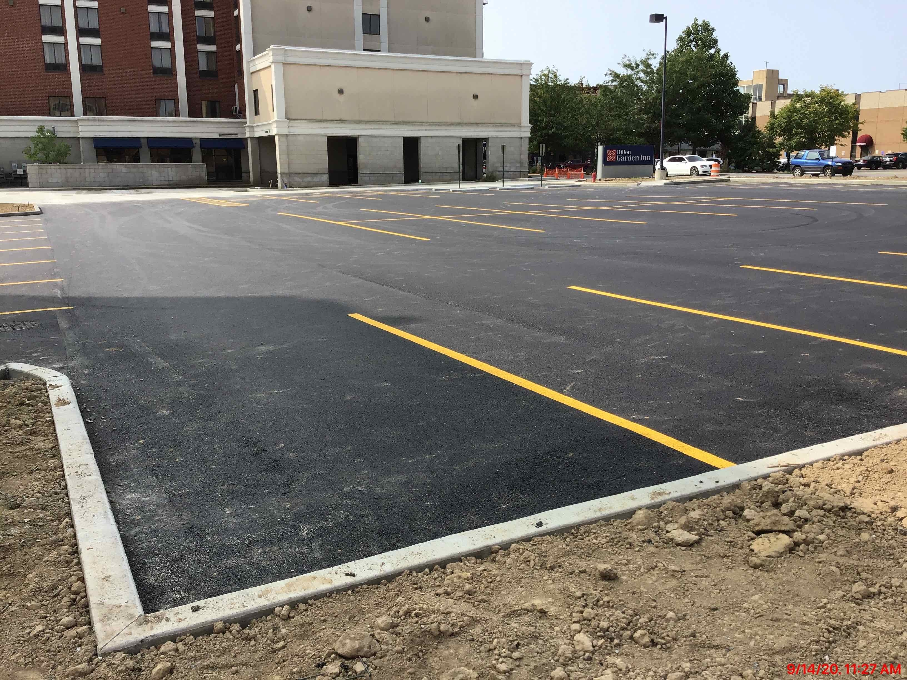
RECENT PROGRESS – Restoration of HGI North Lot

Slide 4
RECENT PROGRESS – Closing of 8th Street

Slide 5
RECENT PROGRESS – Fencing of Conv. Center Site

Slide 6
PROJECT MILESTONES
Turnover HGI NW Parking Lot: September 14, 2020
Close 8th Street & Gain Access to HGI East Lot: September 14, 2020
Auger Cast Piling Work Begins: September 21, 2020
Duke Switch Over Service to HGI: September 22, 2020
Parking Garage Substantial Completion: August 9, 2021
Convention Center Substantial Completion: March 10, 2022

Slide 7
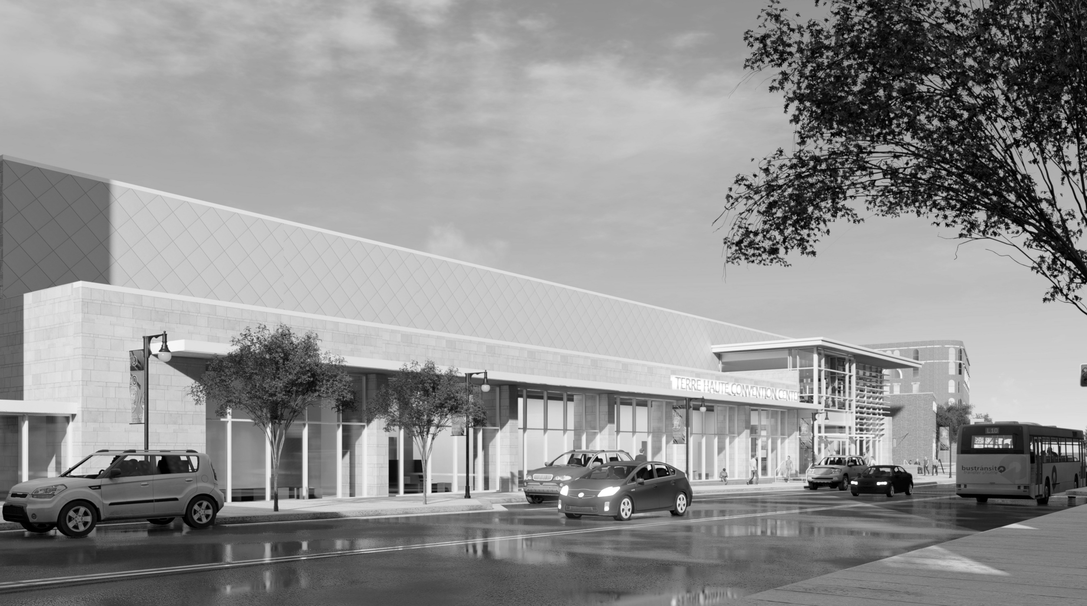
QUESTIONS?

