Slide 1
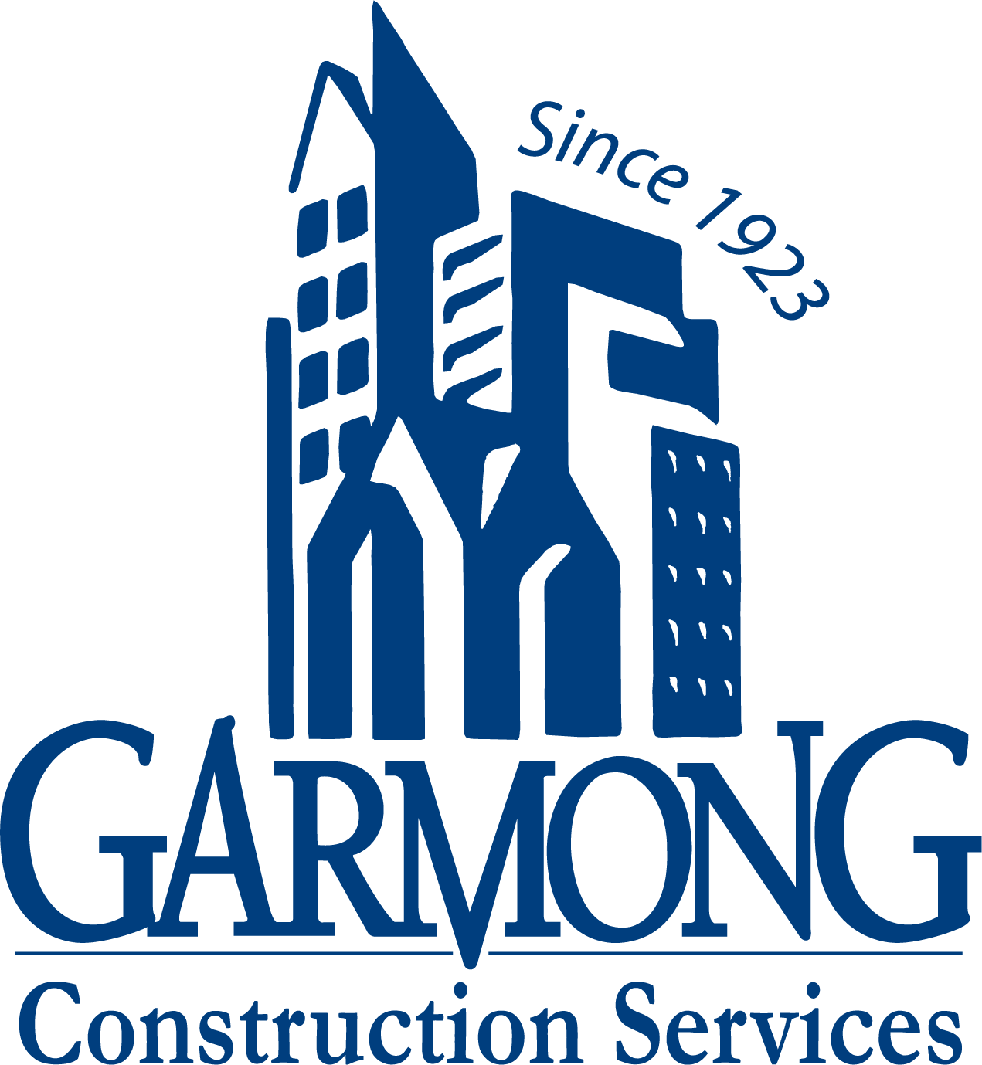
TERRE HAUTE CONVENTION CENTER
CONSTRUCTION UPDATE
October 2020

Slide 2
CONSTRUCTION OVERVIEW
Project remains on schedule and within budget
Recent progress:
Convention Center site demolition (East lot of HGI to Copper Bar) complete
Electrical switchover is complete (old underground network de-energized 10/12/2020)
Auger cast piles: Mobilization and test piles have begun
NE Garage site demo and prep for Storm Trap is complete
Upcoming activities:
Install NE Garage Storm Trap
Begin Convention Center and NE Garage production auger cast piles

Slide 3
RECENT PROGRESS – Site Demolition – 9/15/2020

Slide 4
RECENT PROGRESS – Site Demolition – 9/27/2020

Slide 5
RECENT PROGRESS – NE Garage StormTrap prep

Slide 6
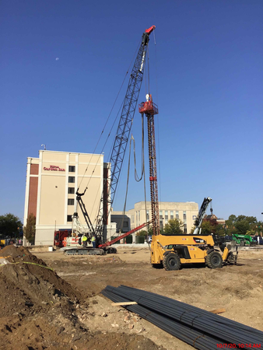
RECENT PROGRESS – Auger Cast Test Piles

Slide 7
RECENT PROGRESS – Auger Cast Piles – Testing

Slide 8
PROJECT MILESTONES
Auger Cast Pile Installation begins October 20, 2020
StormTrap Delivery: October 20, 2020
Concrete Foundations begin October 26, 2020
Structural Steel Delivery: November 13, 2020

Slide 9
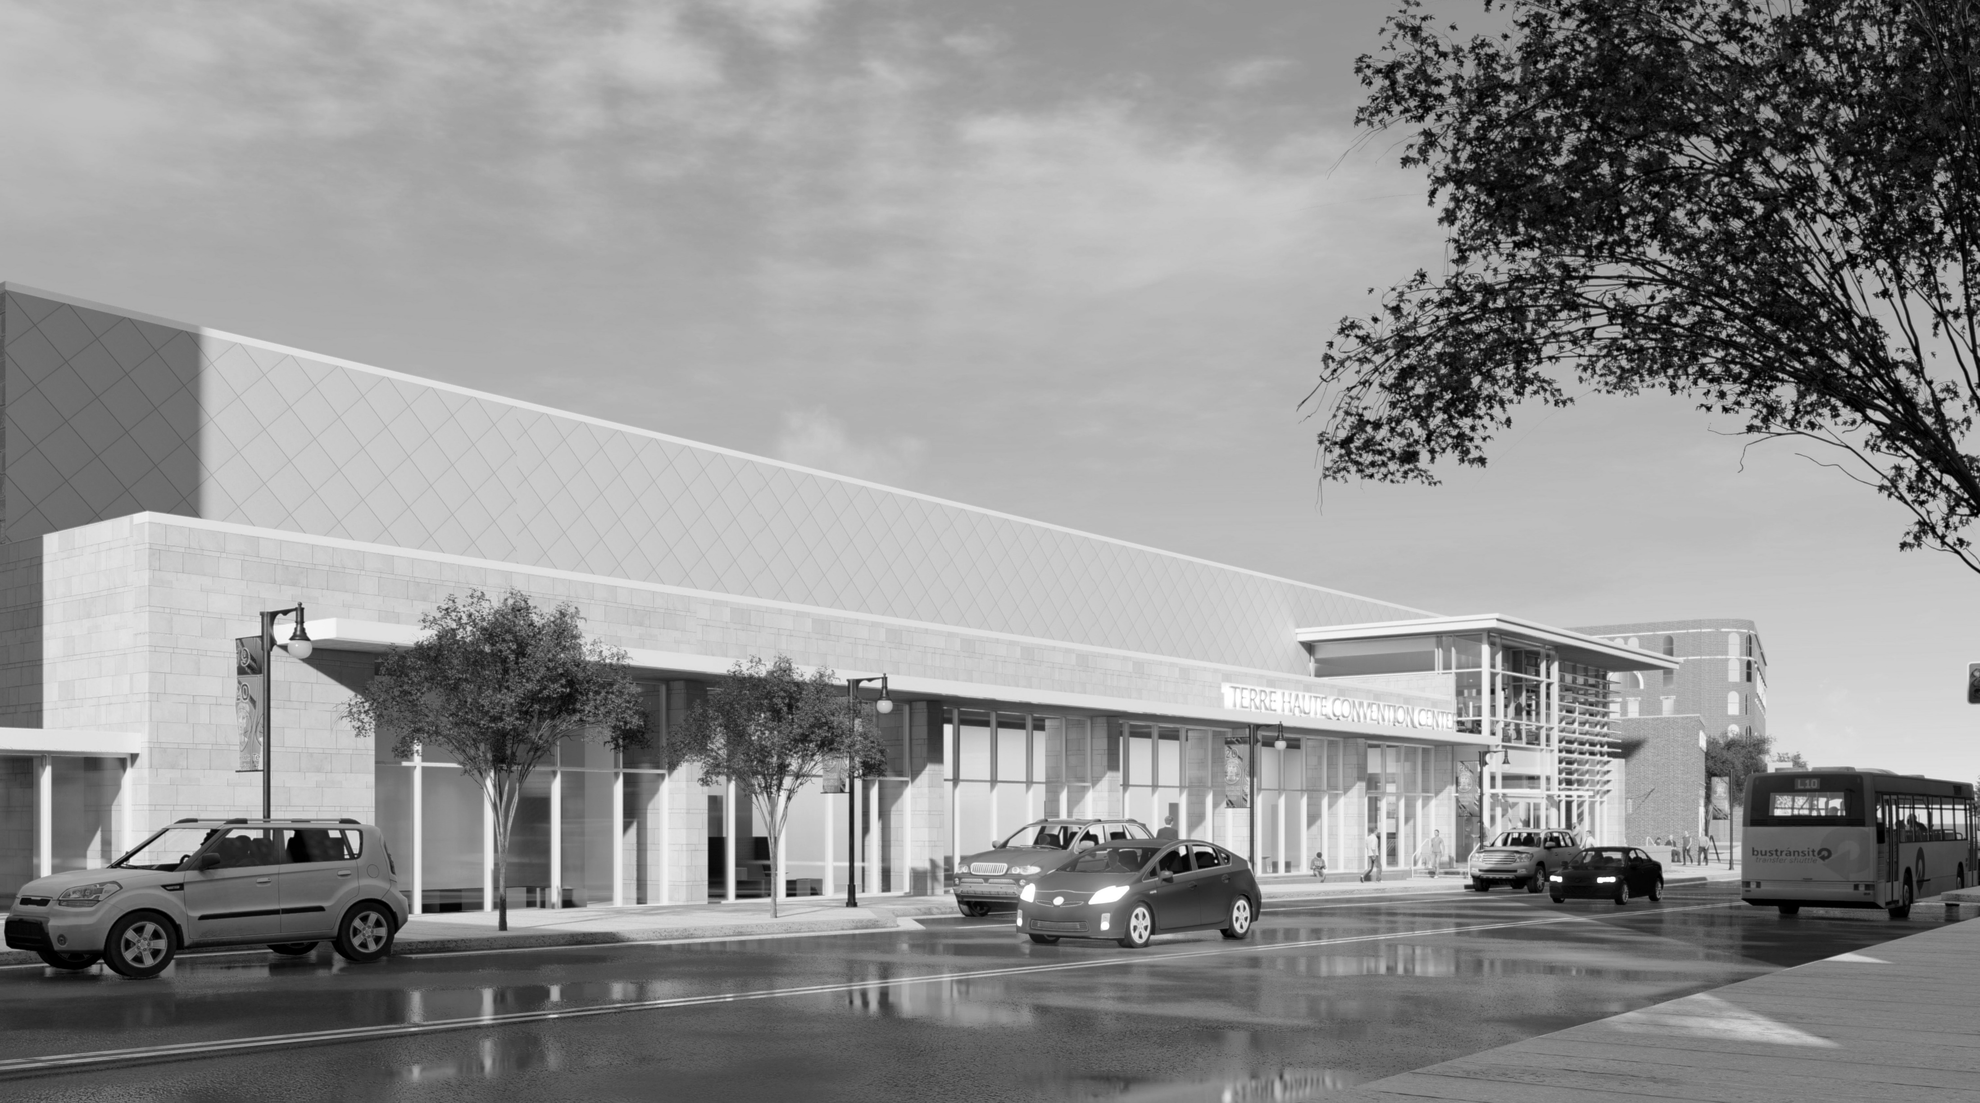
QUESTIONS?

