Slide 1
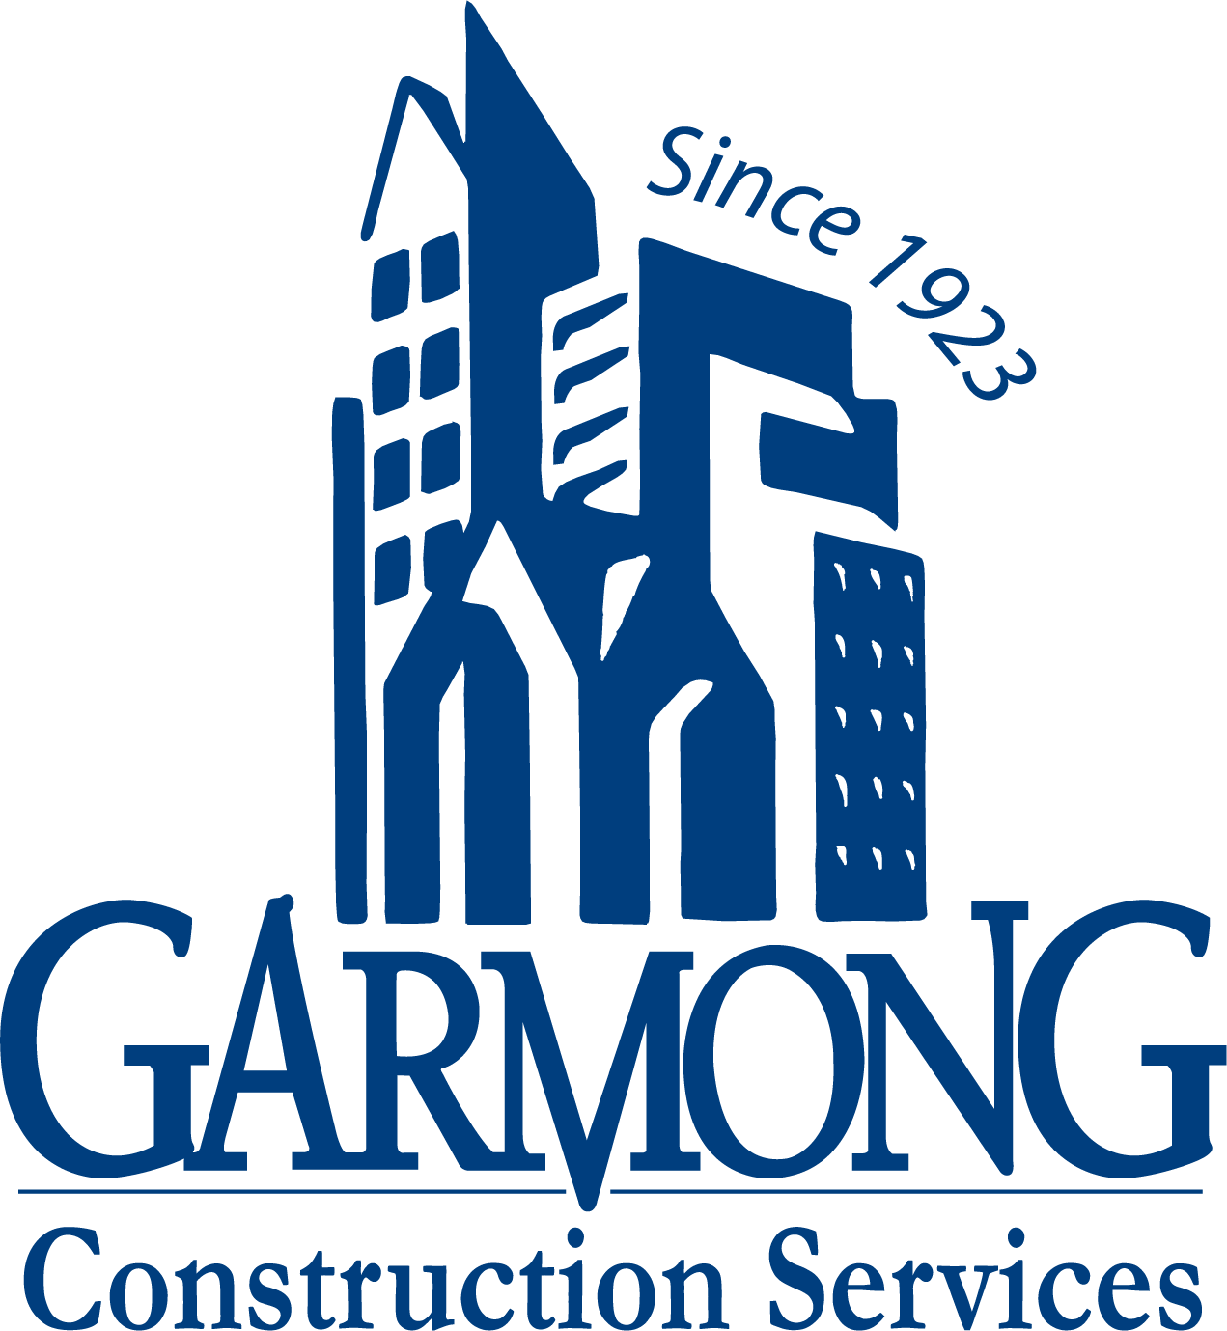
TERRE HAUTE CONVENTION CENTER
CONSTRUCTION UPDATE
December 2020

Slide 2
CONSTRUCTION OVERVIEW
Project remains on schedule and within budget
Recent progress:
Convention Center foundations, damp-proofing and backfill is complete
NE Garage foundation work has begun
Structural Steel erection began this week
Upcoming activities:
NE Garage foundations continue
Structural Steel, Joists, and Decking continues

Slide 3
RECENT PROGRESS – Foundation work in progress (Convention Center)

Slide 4
RECENT PROGRESS – Foundation work Complete (Convention Center)

Slide 5
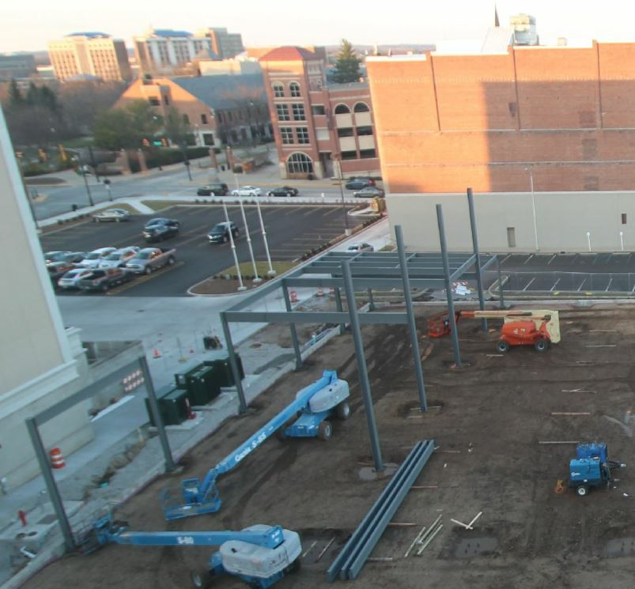
RECENT PROGRESS – Crane Mobilization and Structural Steel Erection – Day 1

Slide 6
PROJECT MILESTONES
Convention Center Foundation Work Completed: December 11, 2020
Structural Steel Erection Started: December 14, 2020
NE Garage Foundation Work Began: December 14, 2020
NE Garage Foundation Work Complete: January 30, 2021
NE Garage Precast Delivery: February 1, 2021
Structural Steel – Convention Center Completion: February 9, 2021

Slide 7
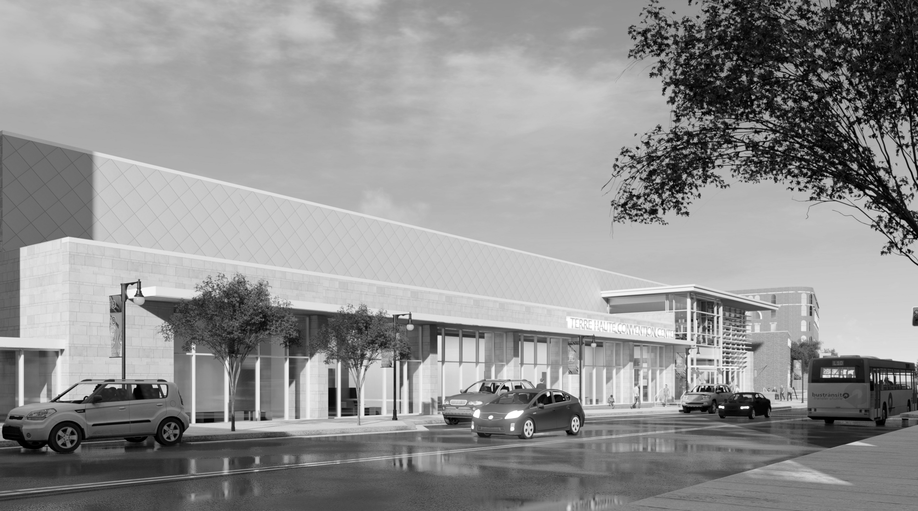
QUESTIONS?

