Slide 1
TERRE HAUTE CONVENTION CENTER
CONSTRUCTION UPDATE
January 2021

Slide 2
CONSTRUCTION OVERVIEW
Budget:
Current GMP amount is $26,325,510
Schedule:
Project is on schedule. Substantial completion date is April 27, 2022
Recent progress:
NE Garage foundation work is 95% complete
Structural Steel work continues
Underslab MEP work has begun
Mock-up is nearing completion for architectural review

Slide 3
CONSTRUCTION OVERVIEW
Upcoming activities:
Delivery and installation of garage pre-cast concrete
Completion of structural steel framing, joists and decking
Continuation of underslab plumbing
Concrete slab installation
Steel stair installation
Exterior framing and sheathing

Slide 4
RECENT PROGRESS – Convention Center

Slide 5
RECENT PROGRESS – NE Garage

Slide 6
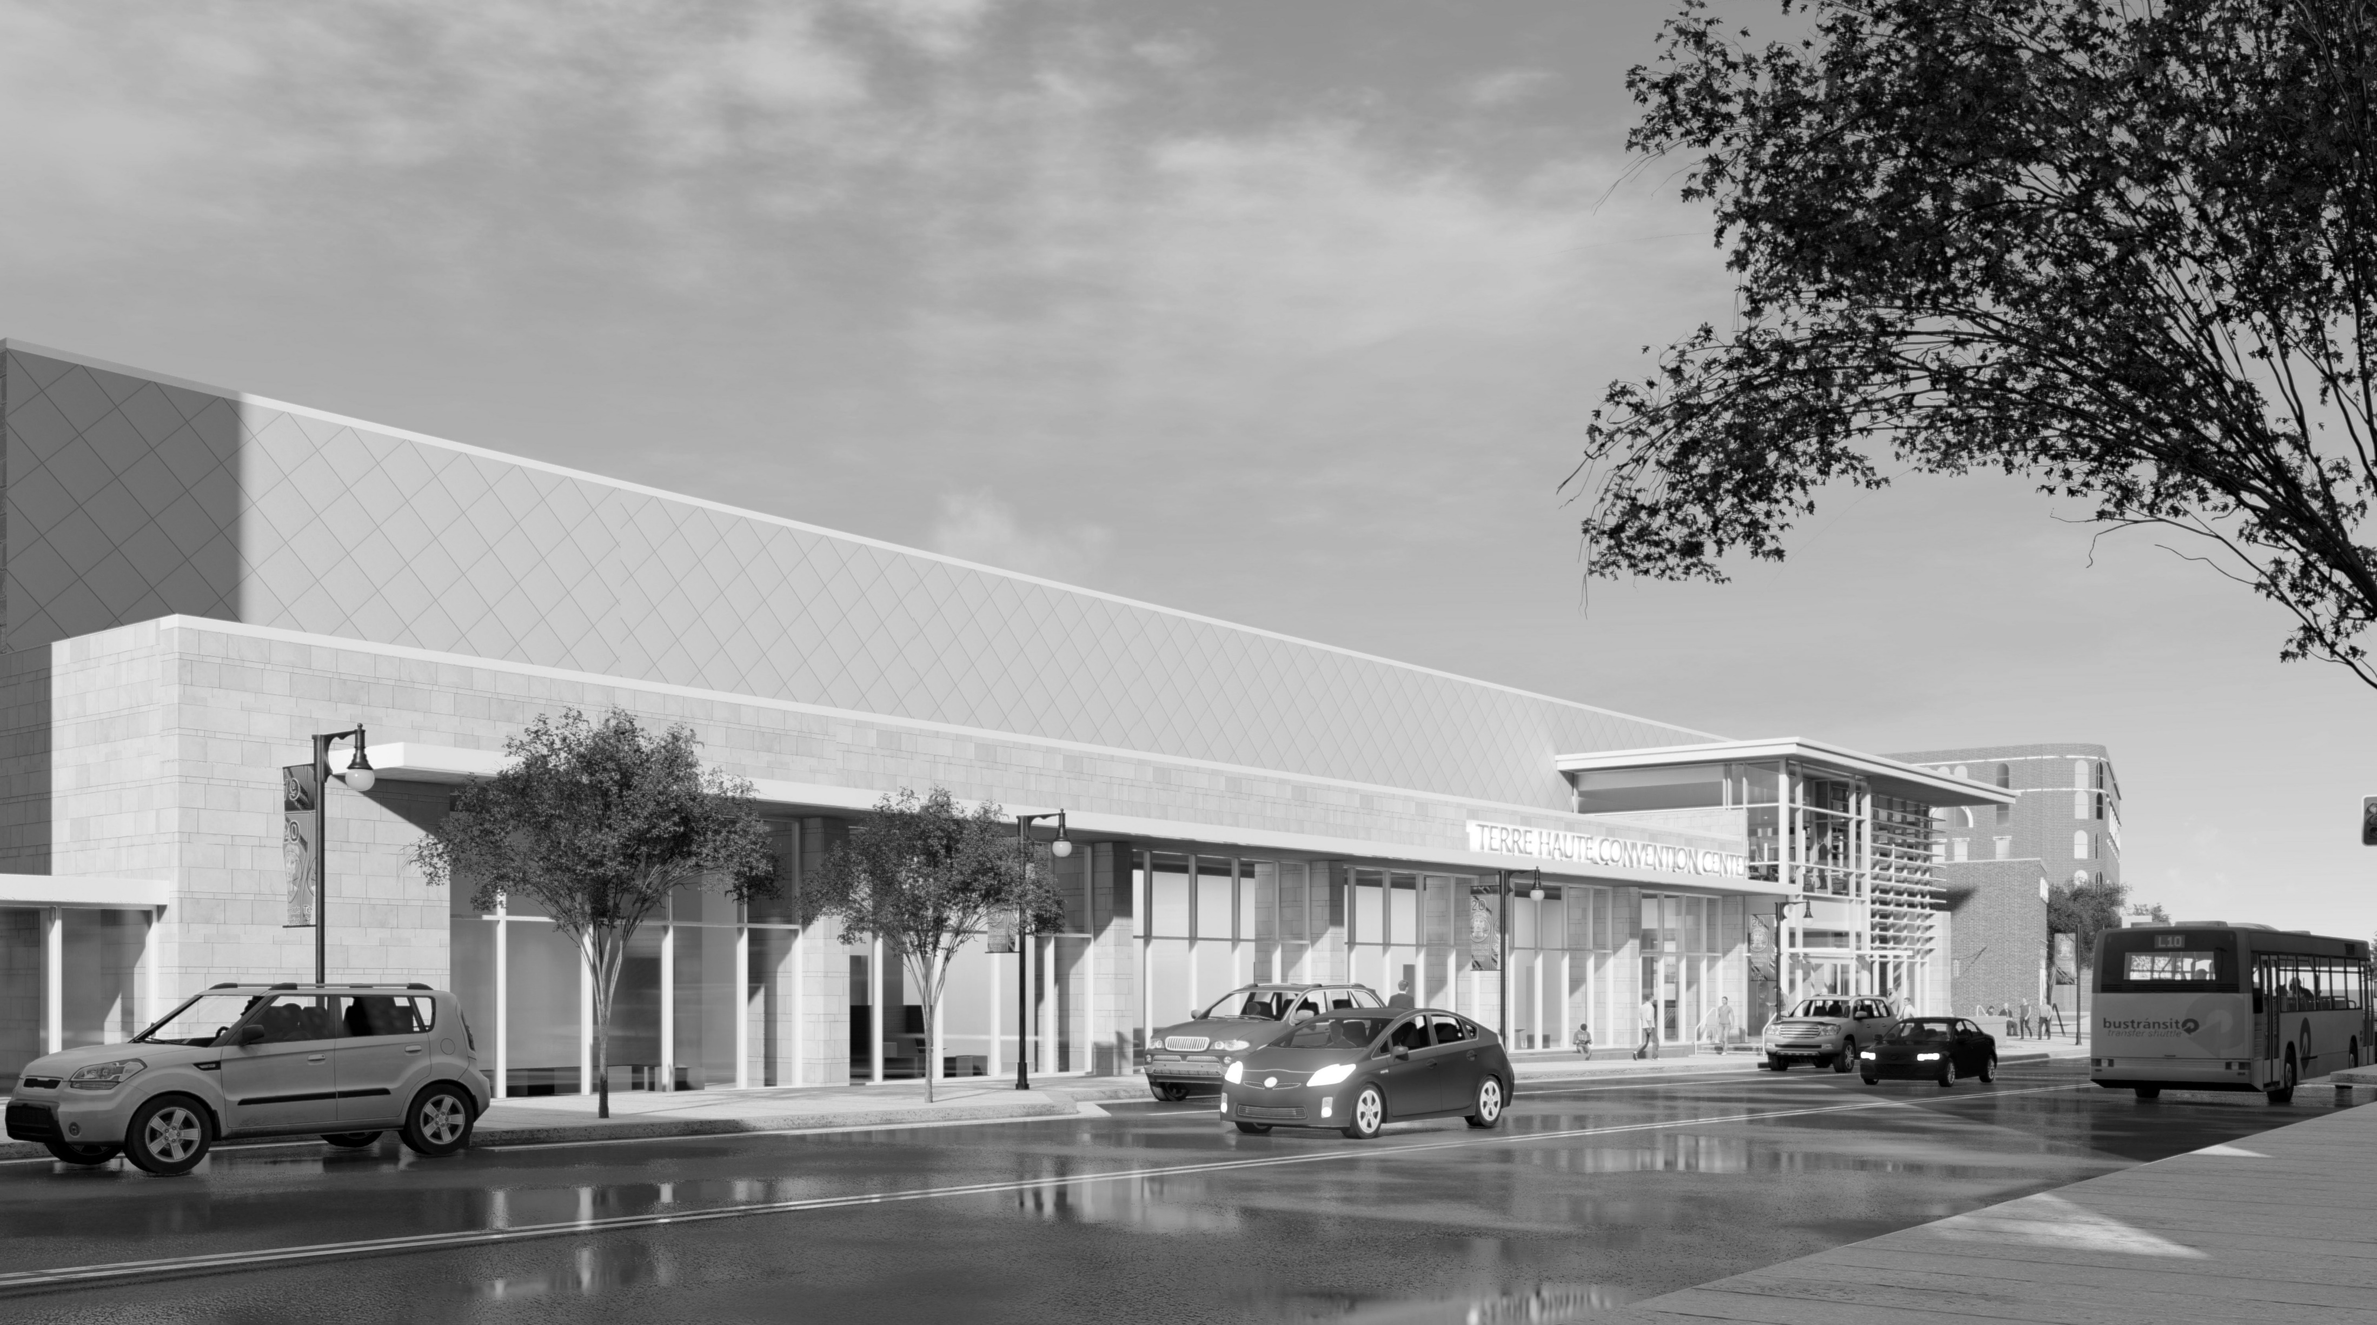
QUESTIONS?

Slide 7
TERRE HAUTE CONVENTION CENTER
PROJECT OVERVIEW
January 2021

Slide 8
Project Facts
Who is the Owner?
CIB – Capital Improvement Board
Who are the Architects?
CSO Architects – Indianapolis
Who is the Owners Representative?
Nations Group
Who represents the Garmong Team?
Brian Kooistra, COO
Lance Gassert, VP
Mark Merrill, Project Manager
Steve Elkins, Superintendent
Marla Flowers, Project Engineer

Slide 9
FAQ
Who are our major local subcontractors?
Ace Blind & Drapery
B & S Plumbing
Dennis Trucking
Central Indiana Ready-Mix
Crossroads Door & Hardware
Lee Company
Overhead Door Company of Terre Haute
SDR Coatings
SMC
Strode Construction
Sycamore Engineering

Slide 10
Site Plan

Slide 11
Convention Center – East View

Slide 12
Convention Center – West View

Slide 13
Convention Center - Spine

Slide 14
Convention Center – Pre-Function

Slide 15
Convention Center - Ballroom

Slide 16
Convention Center – Larry Bird Museum

Slide 17
Convention Center – South Courtyard

Slide 18
Convention Center – North Courtyard

Slide 19
Northeast Garage

Slide 20
First Floor Plan

Slide 21
Second Floor Plan

Slide 22
Banquet Layout Options

Slide 23
Theatre Layout Options

Slide 24
Classroom Layouts

Slide 25
Breakout Layouts

Slide 26
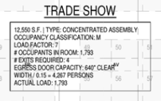
Tradeshow Layout Option

Slide 27
Fun Facts
Fun Facts:
How many square feet is the Convention Center?
41,000 sf
How many square feet is the Ballroom?
12,550 sf
How many seats can the Ballroom accommodate?
900
How many parking spaces in the Parking Garage?
460

Slide 28
QUESTIONS?

