Slide 1
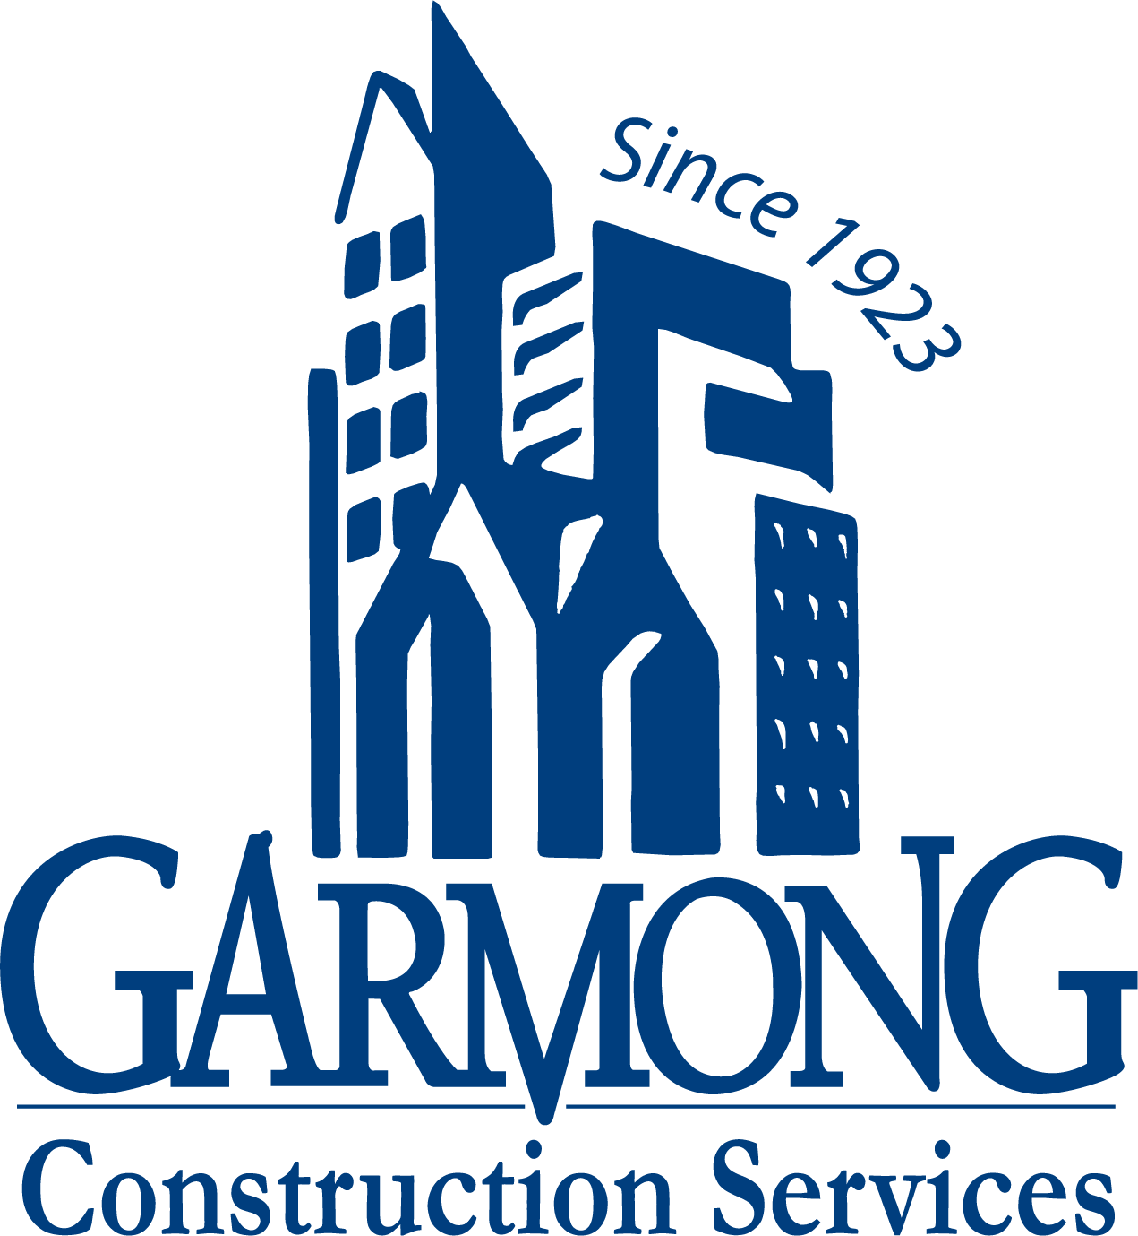
TERRE HAUTE CONVENTION CENTER
CONSTRUCTION UPDATE
August 2021

Slide 2
CONSTRUCTION OVERVIEW
Budget:
Current GMP amount is $26,958,850 (as of August 16, 2021)
Changes from previous GMP: CO NO. 11; $423,741
Schedule:
Project is on schedule. Original substantial completion date is April 27, 2022
Anticipated new substantial completion date is March 1, 2022.

Slide 3
CONSTRUCTION OVERVIEW
Recent progress:
Convention Center
Drywall finishing taking place in pre-function and ballroom areas
EIFS on North elevation is complete
Glass installation is substantially complete
Gutters and downspouts have started
Remaining site utilities are being completed
Connector foundations are installed
Parking Garage
Electrical installations are taking place
SOG ready to pour

Slide 4
CONSTRUCTION OVERVIEW
Upcoming activities:
Convention Center
Complete EIFS
Painting will begin
Installation of front and rear entrances
Exterior hardscape begins (between Copper Bar and along Wabash Ave.)
HGI connector steel
Parking Garage
First floor concrete slab
Roof installation over stairs and elevator shafts
Elevator installation begins

Slide 5
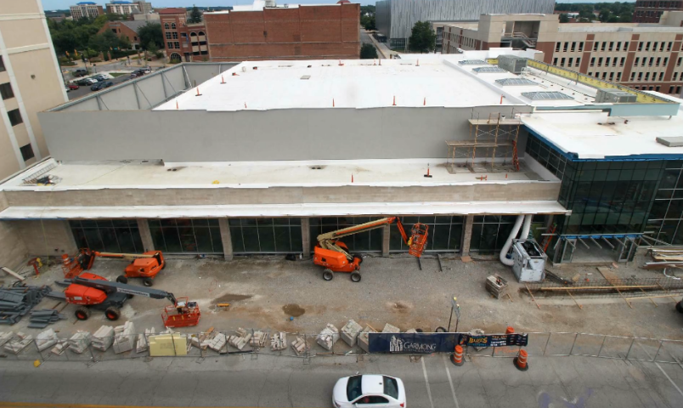
RECENT PROGRESS – Convention Center – August 2021

Slide 6
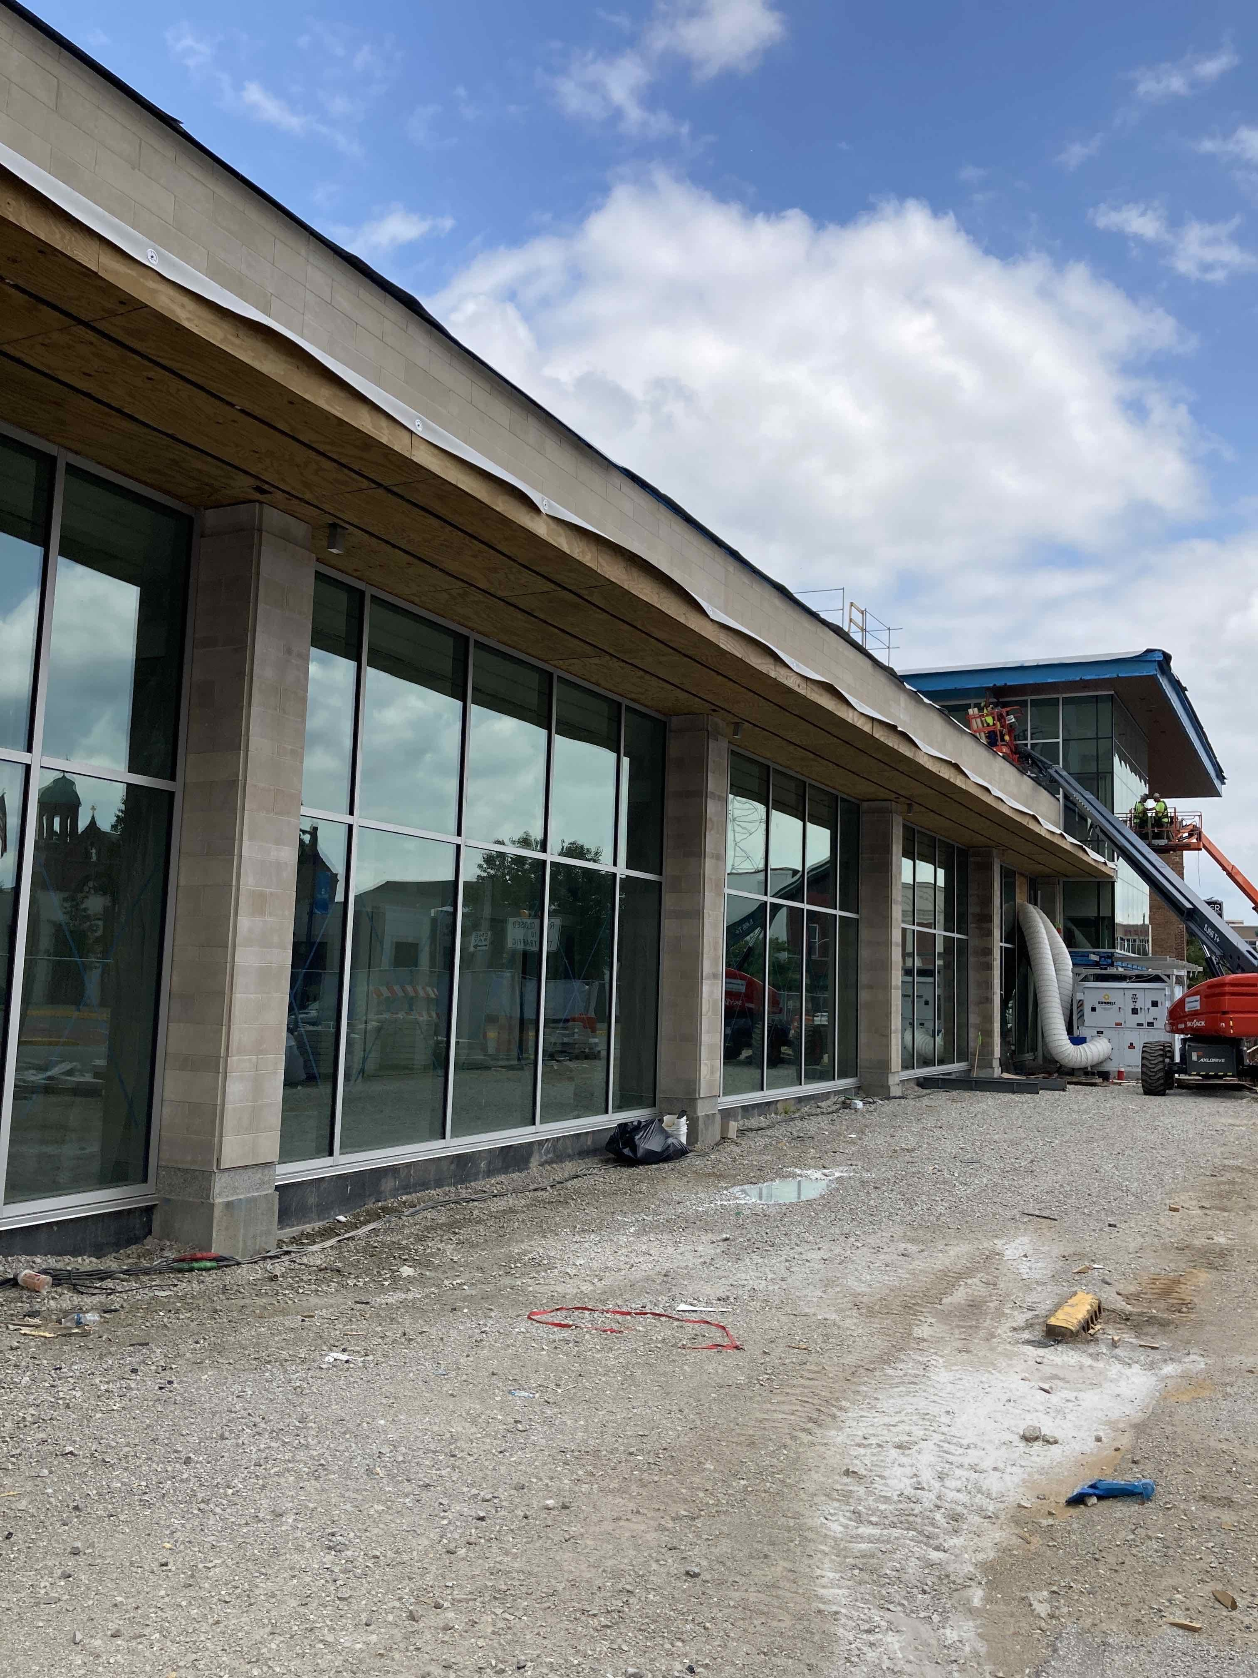
RECENT PROGRESS – South Elevation

Slide 7
RECENT PROGRESS – Larry Bird Museum

Slide 8
RECENT PROGRESS – East Elevation

Slide 9
RECENT PROGRESS – North Elevation

Slide 10
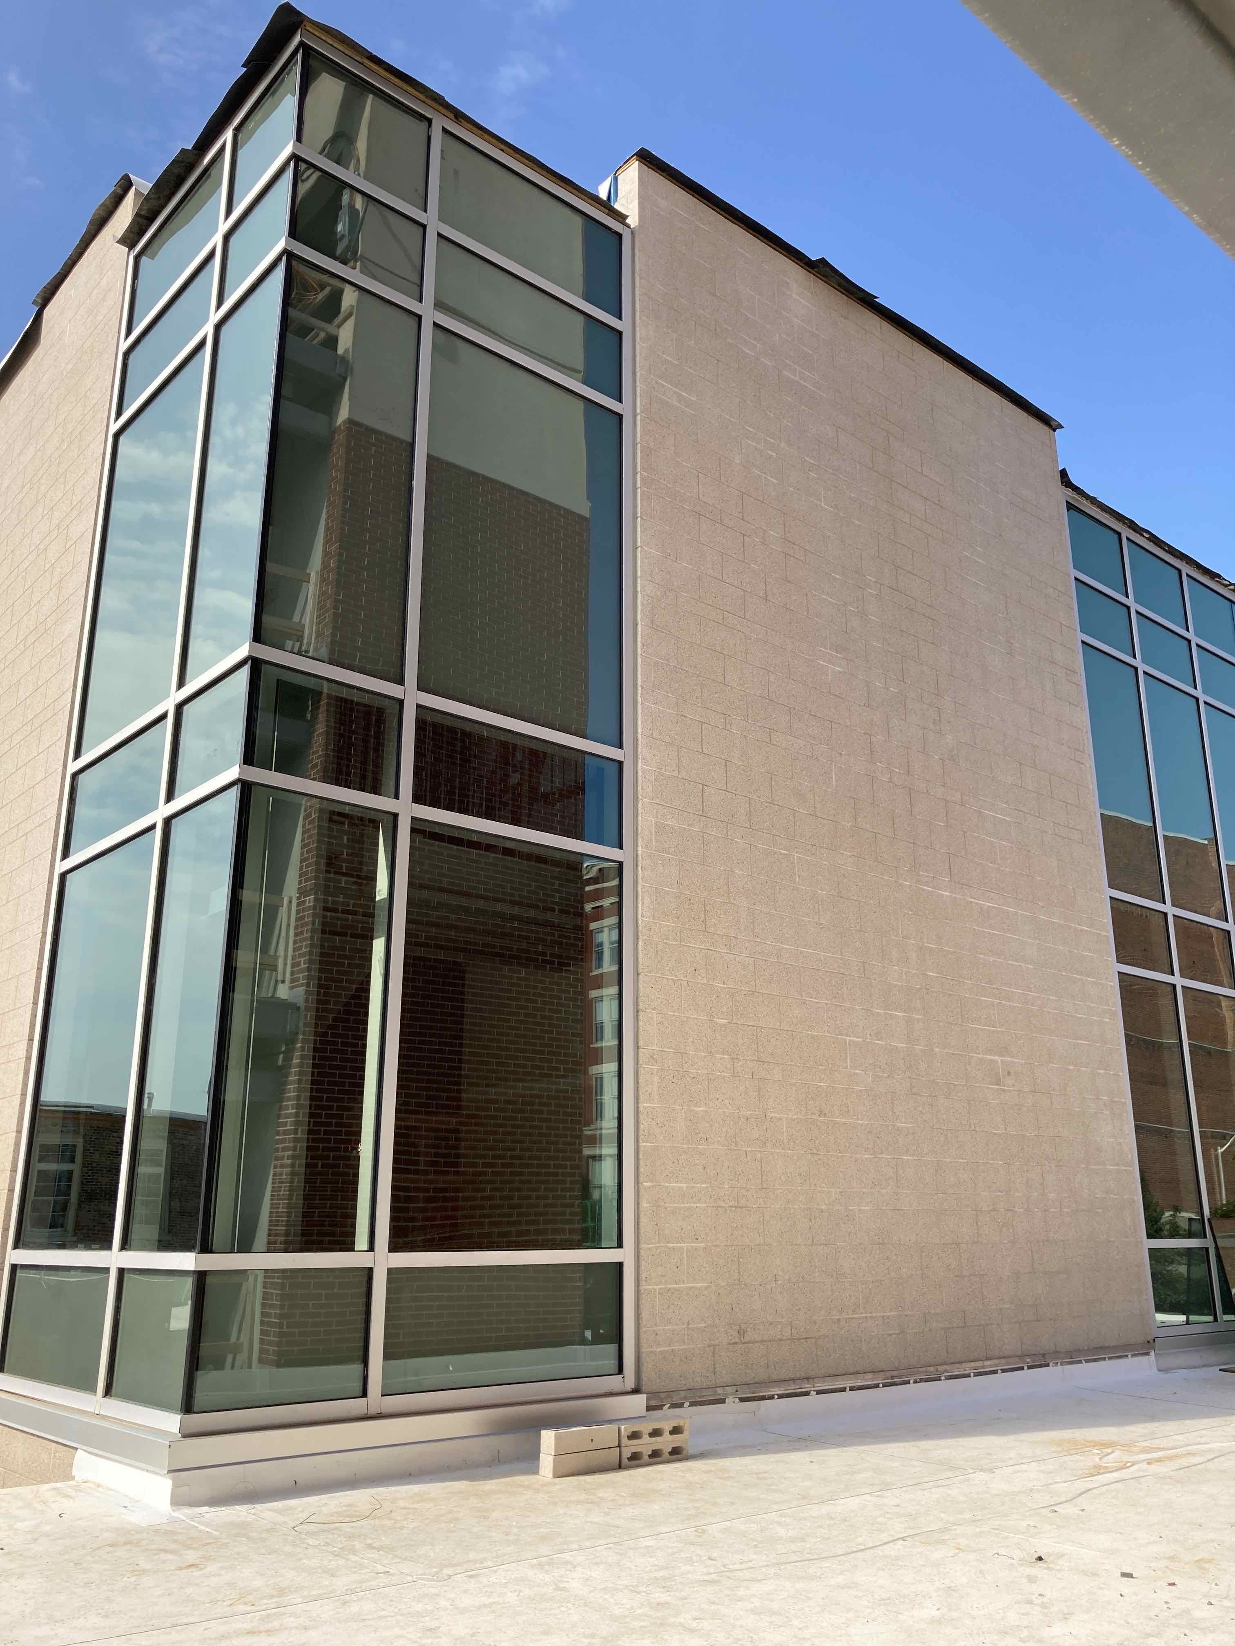
RECENT PROGRESS – Second Floor Northeast View

Slide 11
RECENT PROGRESS – Ballroom

Slide 12
RECENT PROGRESS – Pre-function Area

Slide 13
RECENT PROGRESS – Kitchen Fume Hood

Slide 14
RECENT PROGRESS – Elevator

Slide 15
RECENT PROGRESS – HGI Connector Location

Slide 16
RECENT PROGRESS – Convention Center South Entrance

Slide 17
RECENT PROGRESS – Convention Center Sign Wall

Slide 18
RECENT PROGRESS – Convention Center North Entrance

Slide 19
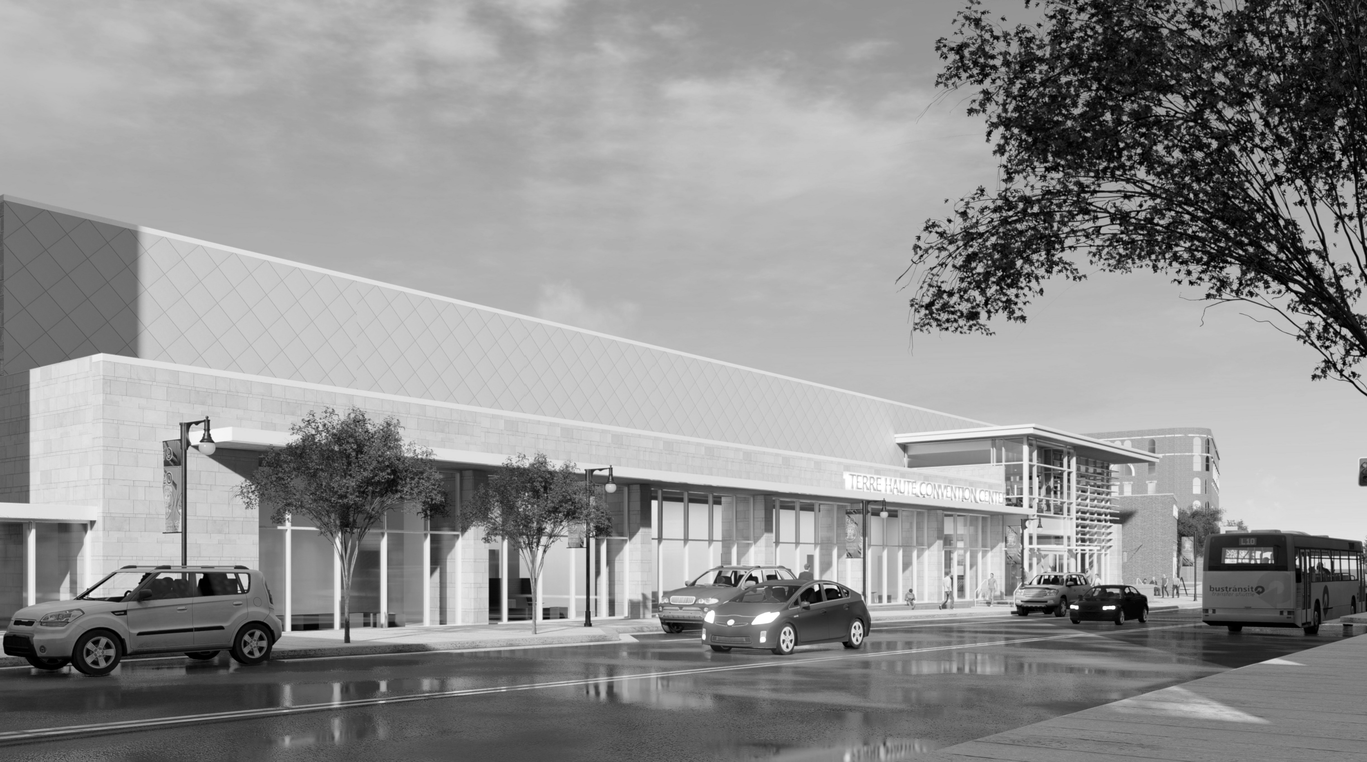
QUESTIONS?

