Slide 1
TERRE HAUTE CONVENTION CENTER
CONSTRUCTION UPDATE
October 2021

Slide 2
CONSTRUCTION OVERVIEW
Budget:
Current GMP amount is $27,075,034 (as of October 19, 2021)
Changes from previous GMP: CO NO. 13; $78,175
Schedule:
Project is on schedule. Original substantial completion date is April 27, 2022
Anticipated new substantial completion date is March 1, 2022

Slide 3
CONSTRUCTION OVERVIEW
Recent progress:
Convention Center
Drywall finishing ongoing 2nd Floor
Painting complete in Ballroom, started on east
Restroom ceramic wall and floor tile complete on 1st floor, started on 2nd
Walk in cooler/freezer installation is complete
Ceiling grid installation is 50% complete
Roof coping is nearing completion
Metal panel installation is nearing completion
Wood paneling 50% complete
FRP in kitchen has begun
Site hardscape is well underway
Parking Garage
Light fixture installation is 75% complete
Elevator installation is 70% complete
Southwest curtainwall is complete

Slide 4
CONSTRUCTION OVERVIEW
Upcoming activities:
Convention Center
Complete painting and ceiling grid
Install light fixtures
Ceramic tile on 2nd floor
Complete wood paneling
Install plumbing fixtures
HVAC fully functional
Terrazzo flooring in corridor
Epoxy flooring in kitchen
Interior glass and glazing
Exterior glass canopy
Substantially complete site work
Connector weather tight
Parking Garage
Nearing substantial completion of garage

Slide 5
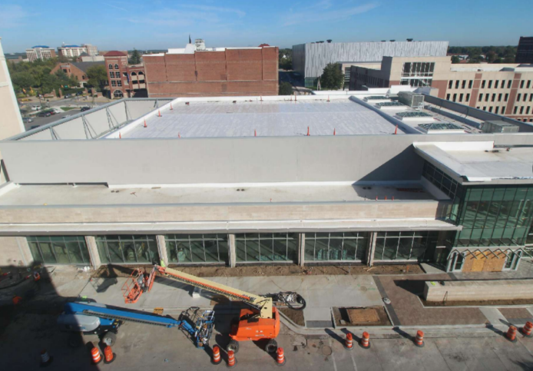
RECENT PROGRESS – Convention Center – September 2021

Slide 6
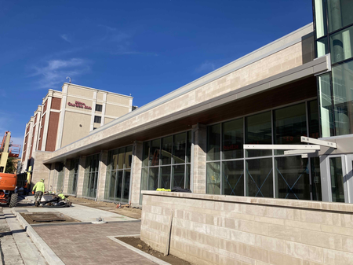
RECENT PROGRESS – South Elevation

Slide 7
RECENT PROGRESS – Larry Bird Museum

Slide 8
RECENT PROGRESS – East Elevation

Slide 9
RECENT PROGRESS – North Elevation

Slide 10
RECENT PROGRESS – Ballroom

Slide 11
RECENT PROGRESS – Pre-Function Area

Slide 12
RECENT PROGRESS – Lobby

Slide 13
RECENT PROGRESS –Kitchen Walk-In Freezer

Slide 14
RECENT PROGRESS – Kitchen FRP Installation

Slide 15
RECENT PROGRESS – Main Entry Storefront

Slide 16
RECENT PROGRESS – HGI Connector Location

Slide 17
RECENT PROGRESS – Restroom Tile

Slide 18
RECENT PROGRESS – Convention Center Decorative Paving

Slide 19
RECENT PROGRESS – Parking Garage South Elevation Curtainwall

Slide 20
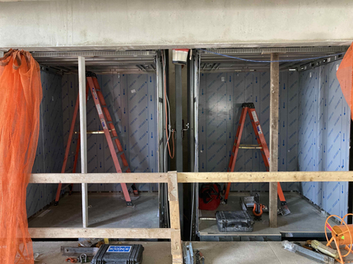
RECENT PROGRESS – Parking Garage Elevators

Slide 21
RECENT PROGRESS – Parking Garage West Elevation Limestone Planters/ Benches

Slide 22
RECENT PROGRESS – Parking Garage South Elevation

Slide 23
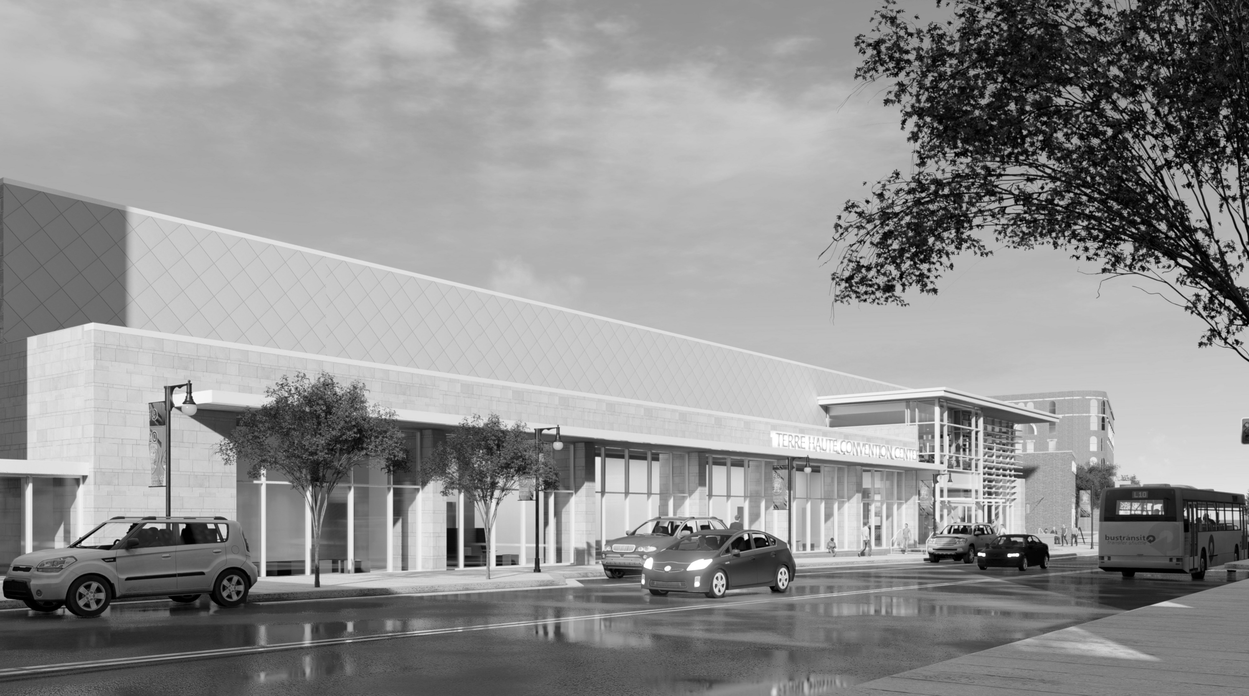
QUESTIONS?

