Slide 1
TERRE HAUTE CONVENTION CENTER
CONSTRUCTION UPDATE
November 2021

Slide 2
CONSTRUCTION OVERVIEW
Budget:
Current GMP amount is $27,075,034 (as of November 17, 2021)
Changes from previous GMP: CO NO. 13; $78,175
Schedule:
Project is on schedule. Original substantial completion date is April 27, 2022
Anticipated new substantial completion date is March 1, 2022.
Design:
No plans received to date on museum

Slide 3
CONSTRUCTION OVERVIEW
Recent progress:
Convention Center
Restroom ceramic tile and floor tile complete
Kitchen flooring
Ceiling grid
Wood paneling
Fabric panels
Terrazzo flooring
Toilet partitions
Plumbing fixtures
Lighting fixtures
Sliding entrance doors
Glass canopy
Parking Garage
Light fixture installation
Traffic coating
Painting
Elevator installation nearing completion

Slide 4
CONSTRUCTION OVERVIEW
Upcoming activities:
Convention Center
Operable partitions
Interior glass and glazing
Complete terrazzo flooring
Decorative handrail
Carpet
Complete wood paneling
Countertops and vanities
Parking lot asphalt
Kitchen equipment installation
Toilet accessories
Limestone for signs
Connector weather tight
Parking Garage
Substantial completion of garage

Slide 5
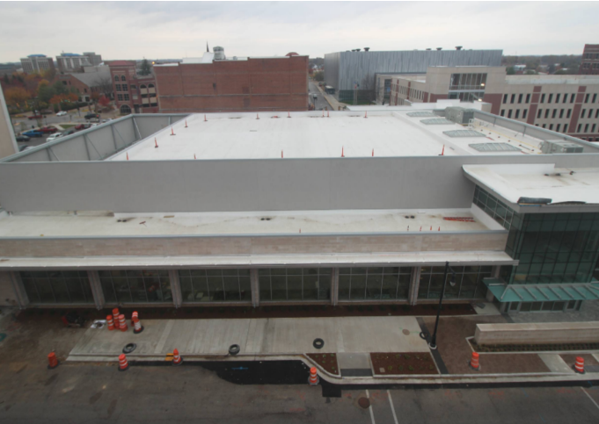
RECENT PROGRESS – Convention Center – November 2021

Slide 6
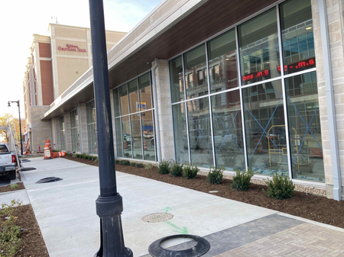
RECENT PROGRESS – South Elevation

Slide 7
RECENT PROGRESS – Main entrance

Slide 8
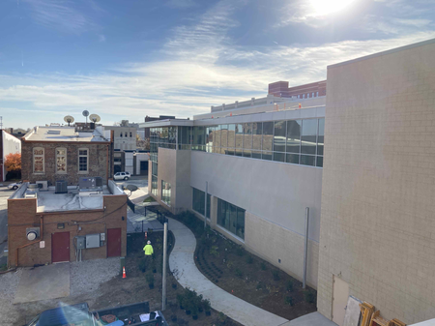
RECENT PROGRESS – East Elevation

Slide 9
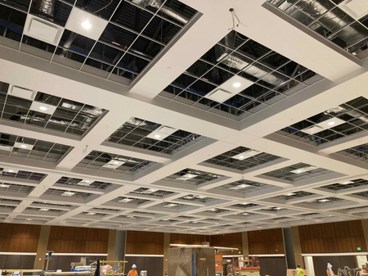
RECENT PROGRESS – Ballroom

Slide 10
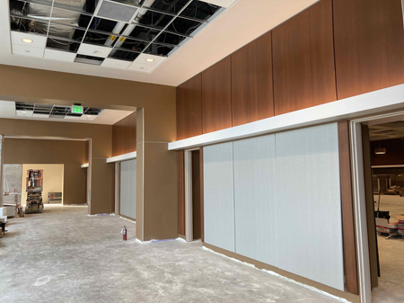
RECENT PROGRESS – Pre-function Area

Slide 11
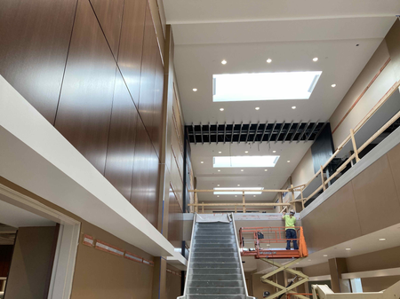
RECENT PROGRESS – Lobby

Slide 12
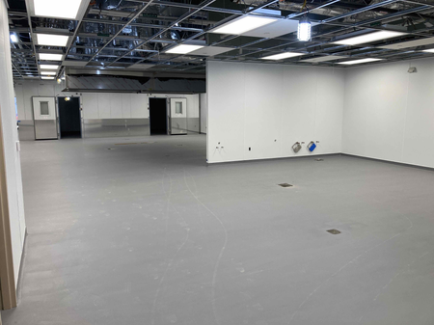
RECENT PROGRESS –Kitchen

Slide 13
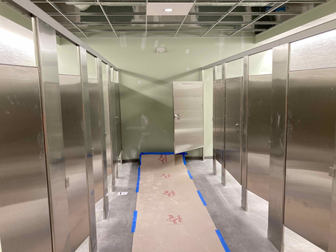
RECENT PROGRESS – Restrooms

Slide 14
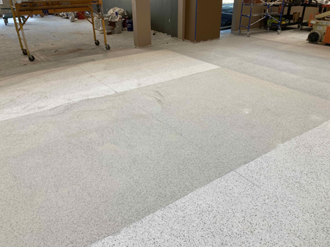
RECENT PROGRESS – Terrazzo Flooring Installation

Slide 15
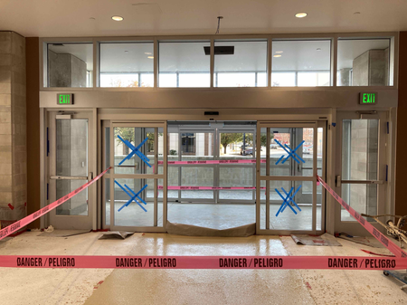
RECENT PROGRESS – Main Entry Sliding Doors

Slide 16
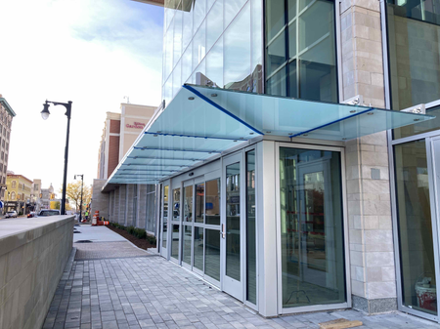
RECENT PROGRESS – Glass Canopy at South Entrance

Slide 17
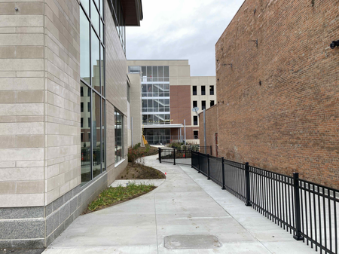
RECENT PROGRESS – Landscaping

Slide 18
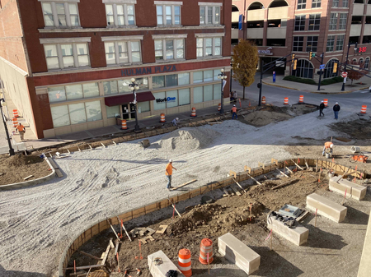
RECENT PROGRESS – Parking Garage West Elevation

Slide 19
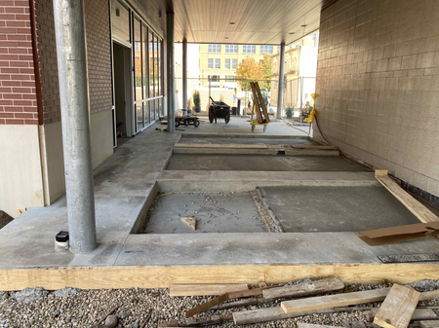
RECENT PROGRESS – Parking Garage South Entrance Sidewalk and Paver Location

Slide 20
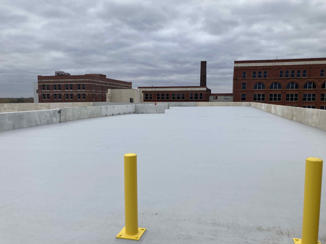
RECENT PROGRESS – Parking Garage 5th Floor Traffic Coating

Slide 21
RECENT PROGRESS – HGI Connector EIFS Installation

Slide 22
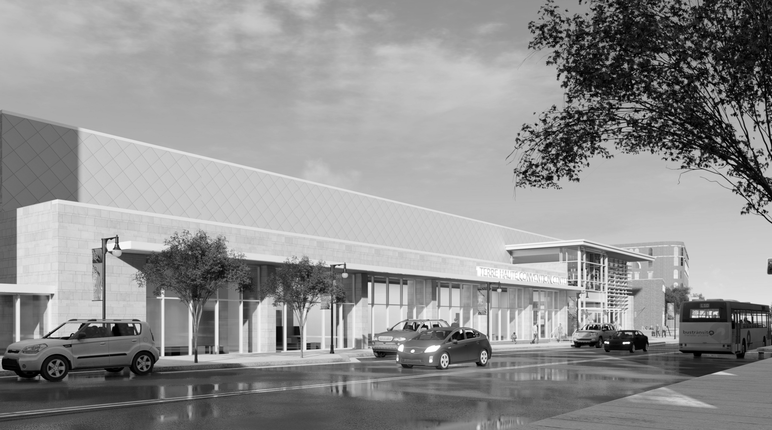
QUESTIONS?

